Slide 1
Truventic QCL SOP
24 Sep 2020

Slide 2
Truventic QCL Emission Spectrum
4.45 μm

Slide 3





Don’t go here!
Safe operating point
Threshold = 1.1 Amp

Slide 4

Voltage compliance set here at danger zone
Usual operating point

Slide 5
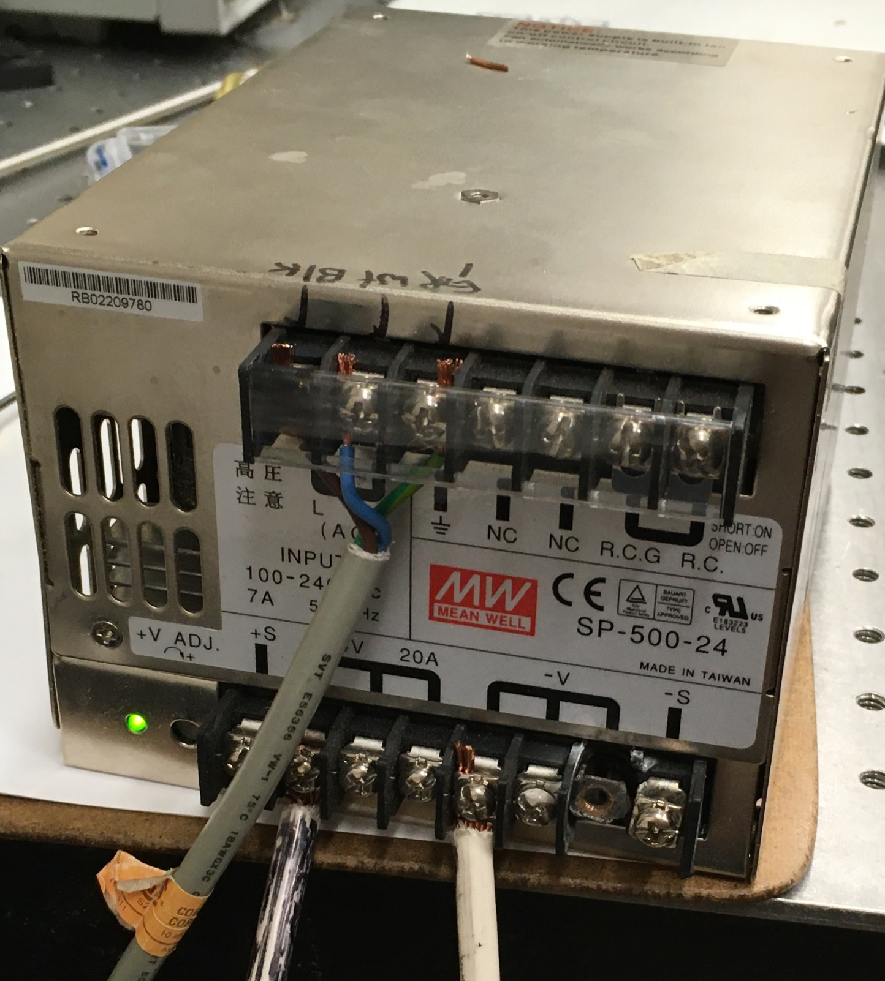





Power supply for Temperature contoller.
AC connections.
Hot (usually black, here brown) measures 120 VAC to ground.
Return (usually white, here blue) measures zero volts AC to ground (green).
This PS is kaput. Needs to be replaced.
To Temperature Contoller

Slide 6
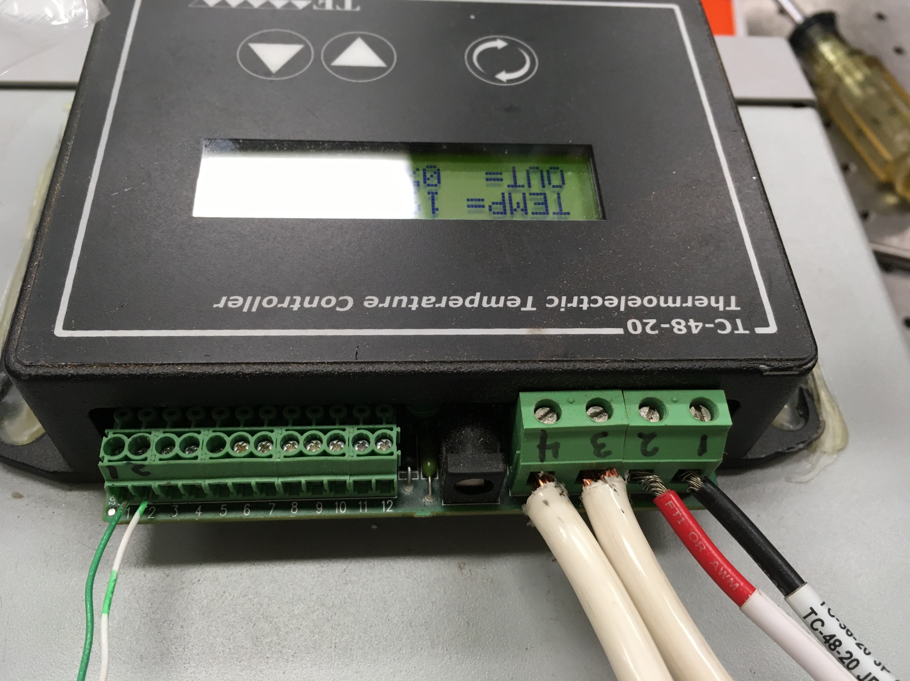

Temperature controller. Operating Temperature = 20 ºC.
Thermister

Slide 7
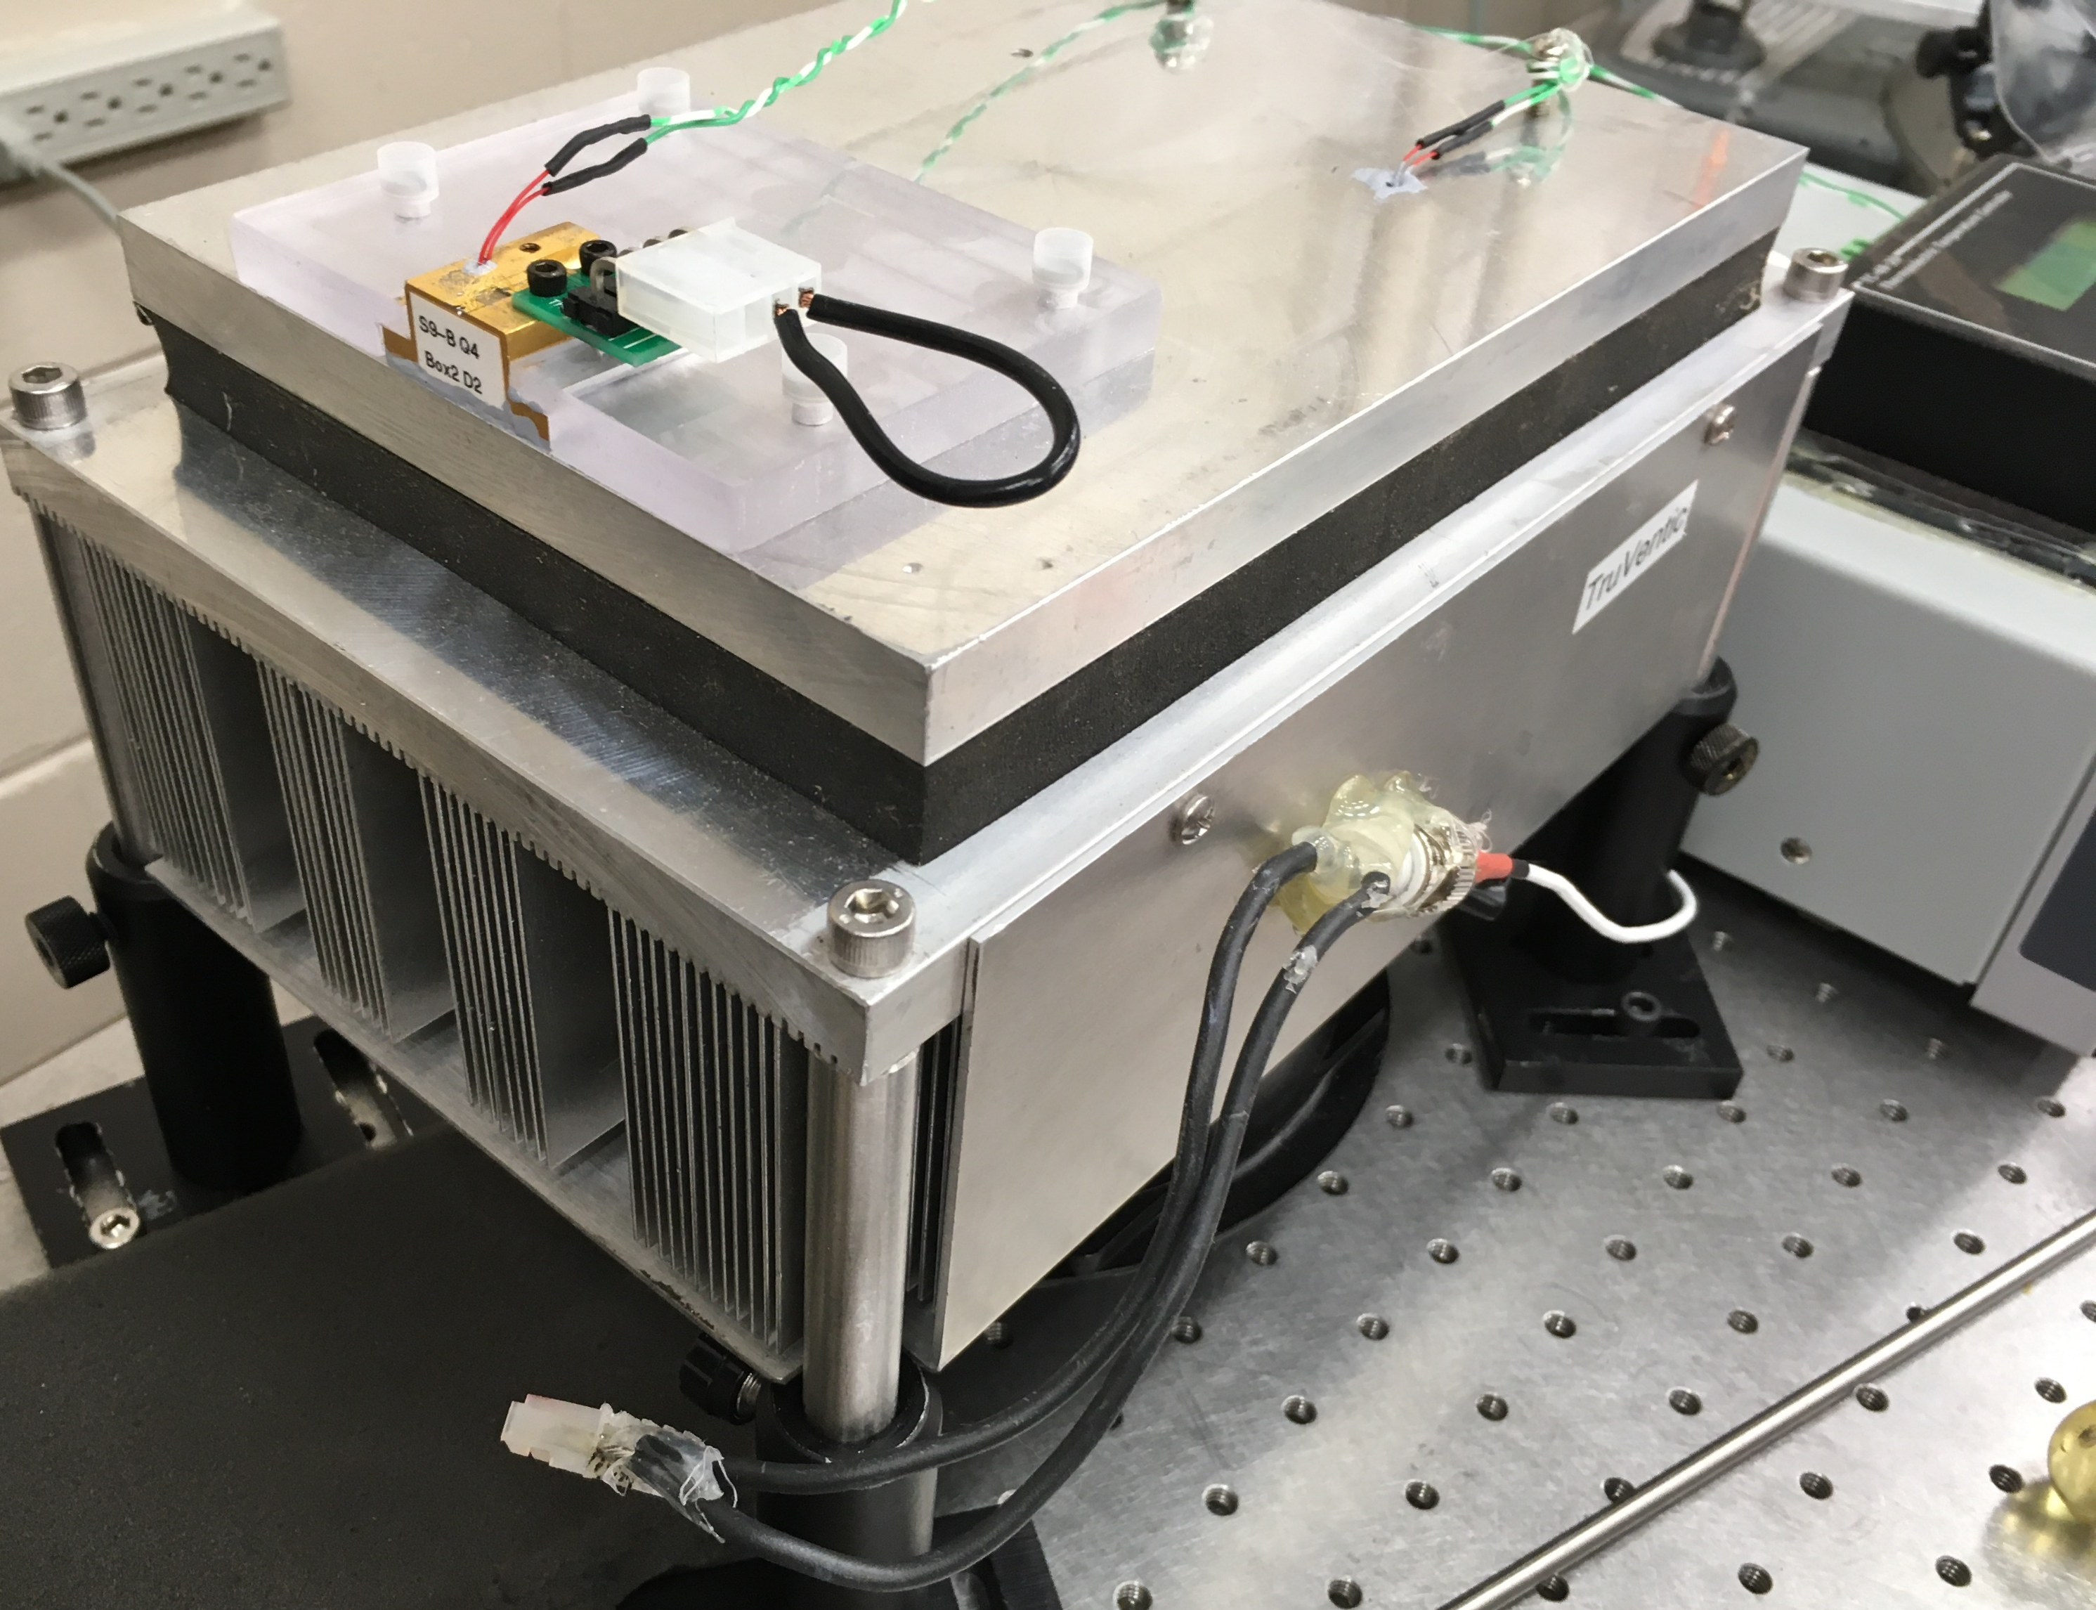





This thermistor is used with T-controller
T-control
Short for when laser not in use.
To light wave laser driver
Plug in when laser is to be used.

Slide 8
Lightwave laser driver
Make adjustments with output off. Choose 2000 mA range. Set knob to zero. Operate in current mode with limit 2.02 Amp. Set compliance voltage to 11.5 V.
Turn output on
Slowly increase current knob to 2 A

