Slide 1
High frequency properties of Josephson effect
Simple Voltage Source Model
BP 11.1

Slide 2



































Slide 3

















Slide 4









































Slide 5
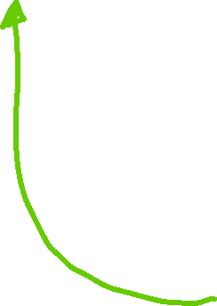






Slide 6











Slide 7
















Slide 8



















Slide 9






































Slide 10





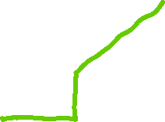















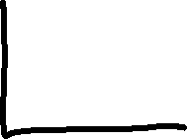




Slide 11










A simpler way to show the rf dependance of the maximum zero voltage current, which does not involve derivation of all the Shapiro steps using the Fourier-Bessel expansion or Bessel functions is as follows. From slide 6
This holds in the limit of low rf power, since
Dropping second-order term a² (which eliminates the effect we seek)

Slide 12
















The full theory gives that the 1st Shapiro step goes as the Bessel function of the first kind ₁(a).
To get the effect of rf on the max zero voltage current, we should have kept the a² term.

Slide 13








Full solution has Bessel factor

Slide 14
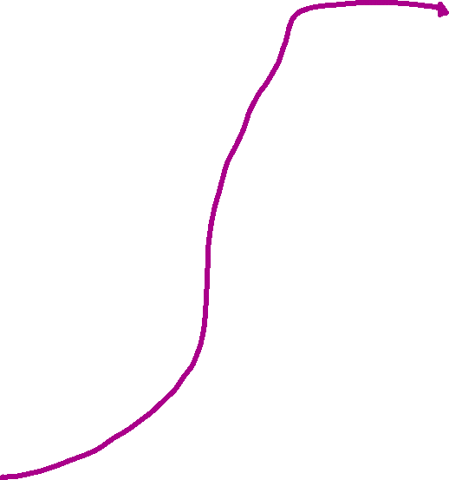








1st Josephson equation
Even simpler derivation. If we know we only care about the zero-voltage current, i.e. the zeroth Shapiro step, i.e. V₀ = 0, then the only voltage across the JJ is the radiation induced one.
2nd Josephson equation

