Slide 1
Electrodynamics of JJ
BP1.7

Slide 2

















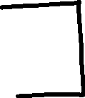
















Slide 3



















Slide 4








Slide 5





















Slide 6



























Slide 7


















Slide 8





















Slide 9
























Slide 10














