Slide 1
JJ Magnetic field effects
BP1.5

Slide 2














































































Slide 3





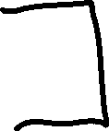











Slide 4

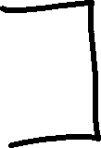




















Slide 5





























Slide 6








































