Slide 1
Equation of thermal conduction in solids
LL7 Section 32

Slide 2
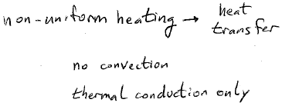
Solids

Slide 3
Rate of change of heat energy in a volume
=
negative of heat energy flux q out of volume through the boundary surface
=
Negative volume integral of div q by Gauss’s theorem.

Slide 4
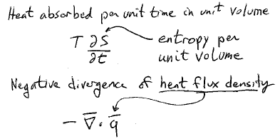
Per unit volume…

Slide 5
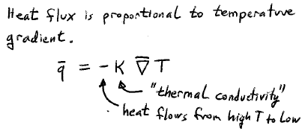

Slide 6
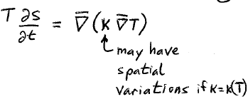

Slide 7
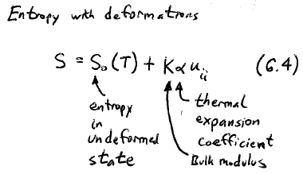

Slide 9
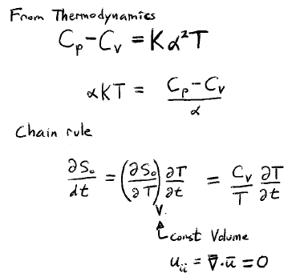

Slide 10
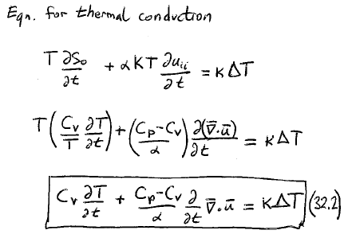

Slide 11
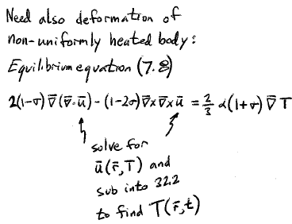
Because of second term…

Slide 12
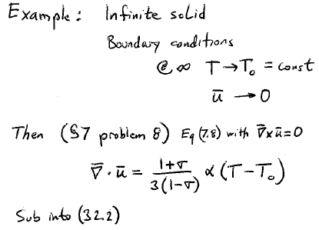

Slide 13
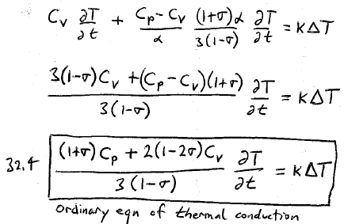

Slide 15
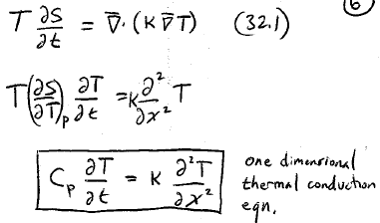

Slide 16
