Slide 1
Energy of a bent plate
LL7 Section 11

Slide 2
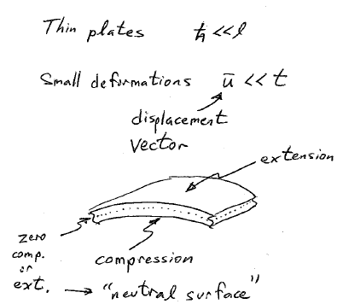
h
h

Slide 3
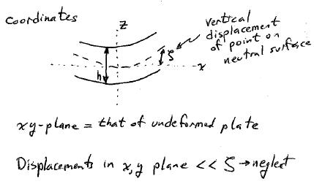

Slide 4
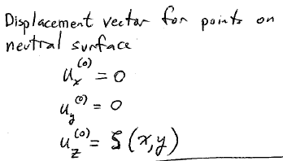

Slide 5
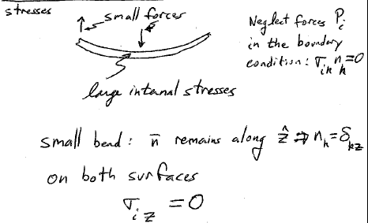

Slide 6
Since plate is thin, these components must be small inside the plate, too,
compared to other components of the stress tensor.
Equate them to zero everywhere, and use this condition to find strain tensor.

Slide 7
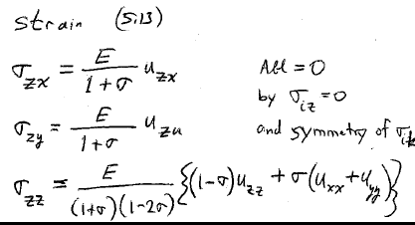

Slide 9
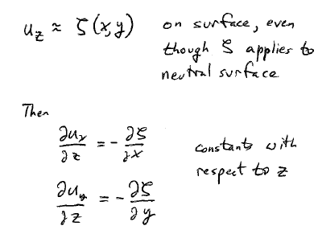

Slide 10
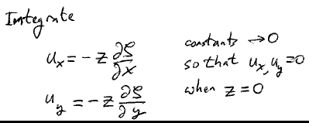
Horizontal x displacement is negative for positive x and z
No horizontal displacement of any point on neutral surface

Slide 11
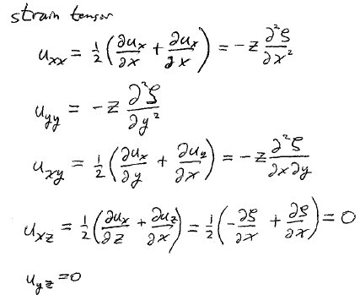

Slide 12
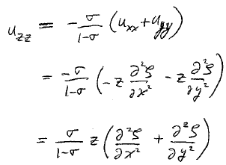

Slide 13
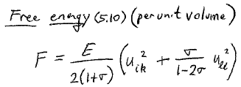
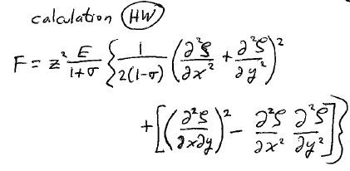

Slide 14
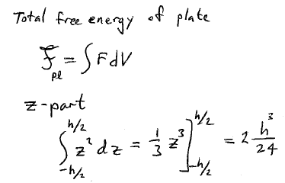

Slide 15
