Slide 1
LL7 Section 7 Problem 1

Slide 2
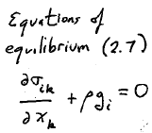
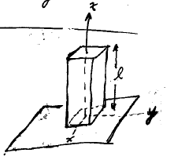
This is a differential equation for the stress tensor. What we ultimately want is the strain tensor, which will give the displacement field u.

Slide 3
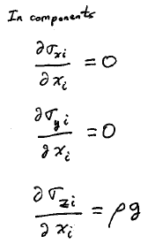
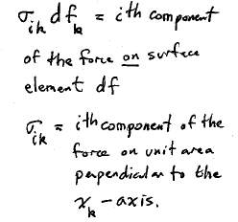

Slide 4
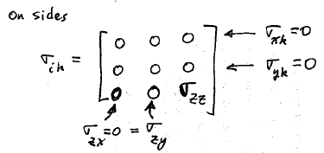

Slide 5
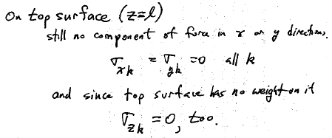

Slide 6
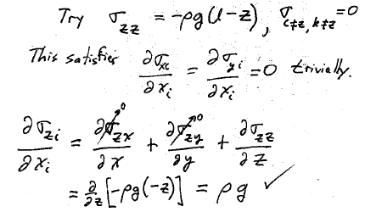

Slide 7
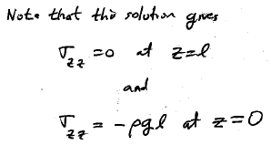

Slide 8
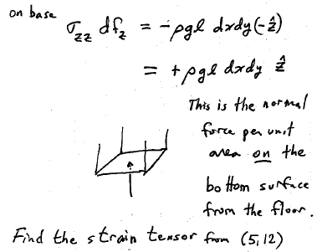

Slide 9
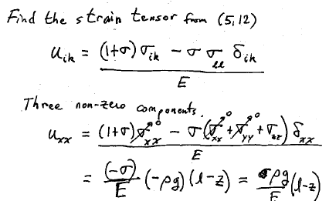

Slide 10
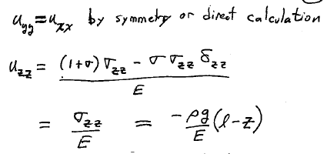

Slide 12
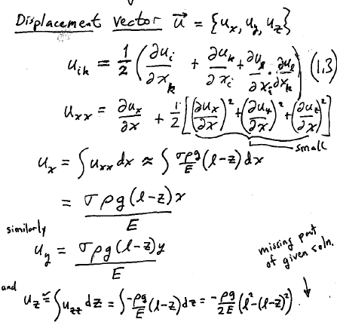

Slide 13
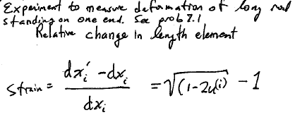
Previous solution was for absolute displacement field. But strain gauges measure relative change in length elements, i.e. strain.
1+

Slide 14
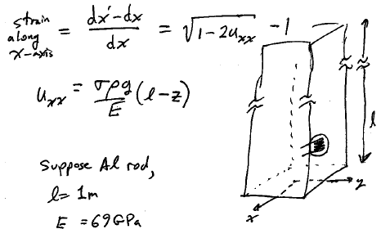
1+

Slide 15
Plexiglass should deform 10x more than metal
Material | Density (g/cm3) | Young’s Modulus (GPa) | ρ/E
Acrylic | 1.2 | 3.2 | 0.4
Aluminum | 2.7 | 69 | 0.039
Stainless Steel | 7.82 | 180-200 | 0.041
Lateral strain doesn’t depend on diameter of rod.
Doesn’t depend much on the type of metal.

Slide 16
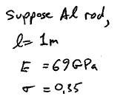

Slide 18
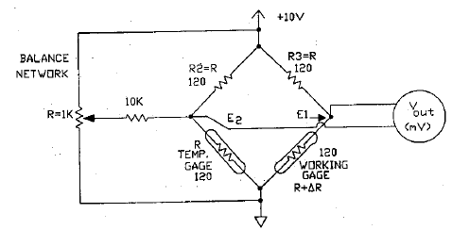
Output of bridge
=5V * 40 microOhm/120 Ohm
= 1.7 microVolt

