Slide 1
The stress tensor
Section 2

Slide 2
“Undeformed” body means…

Slide 3
“Deformed” body means…

Slide 4
Internal stresses are…

Slide 5
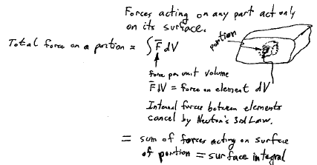

Slide 7
k^{th} component of area element df, which is along outward normal of portion

Slide 9
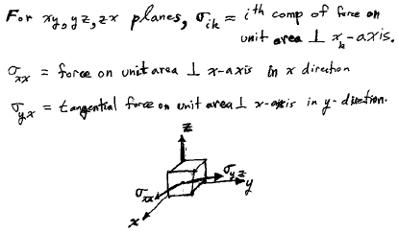

Slide 10
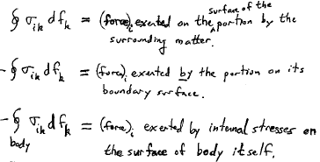

Slide 11
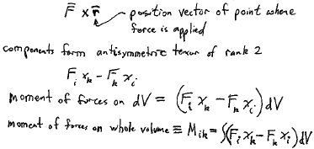
Moment of forces on portion (torque)

Slide 13
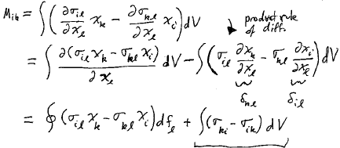
Vanishes if stress is symmetric, TBD

Slide 14
Then Mik is a surface integral, as required

Slide 15
Hydrostatic compression: Pressure of same magnitude acts on every unit area of the surface of the body along the inward normal.

Slide 16
Arbitrary deformation

Slide 17
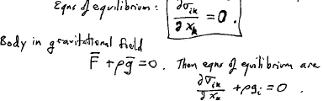
Equilibrium: Internal stresses balance F_{i} = 0 in every dV

Slide 18
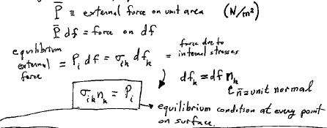
External forces applied to body surface appear in equations of equilibrum as boundary conditions

Slide 19
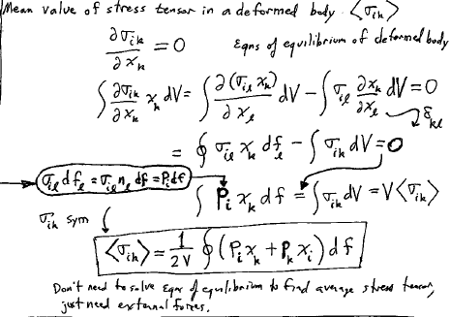

Slide 20
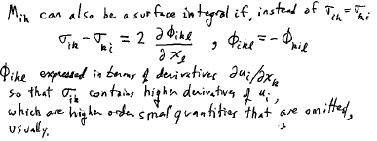
Proof of σ_{ik} symmetry

Slide 21
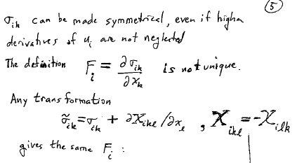

Slide 22
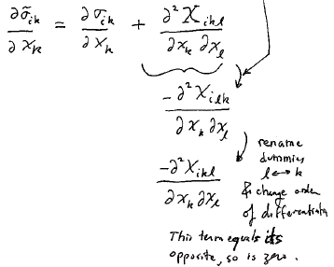

Slide 23
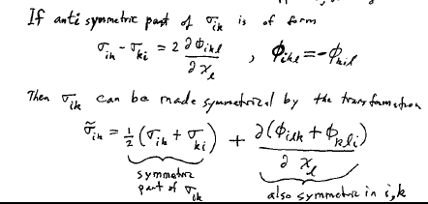

Slide 24
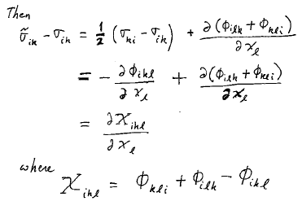

Slide 25
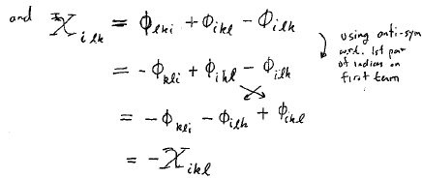

Slide 26
