Slide 1
The strain tensor
Section 1

Slide 2
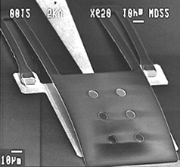
Why do we need to know about elasticity?

Slide 3
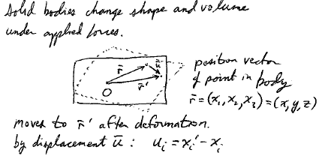

Slide 4
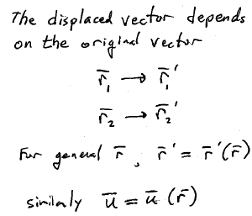
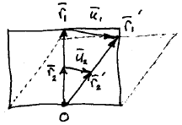

Slide 5
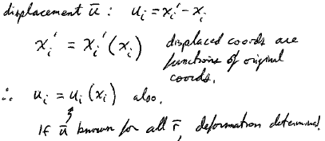

Slide 6
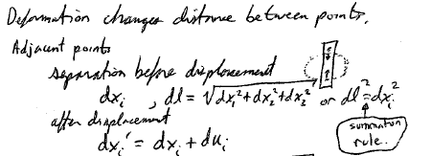

Slide 7
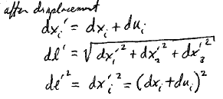

Slide 8
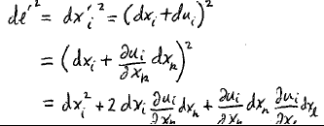

Slide 9
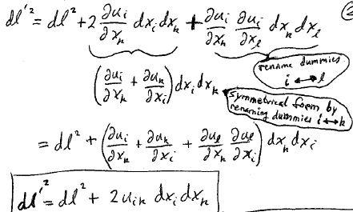

Slide 10
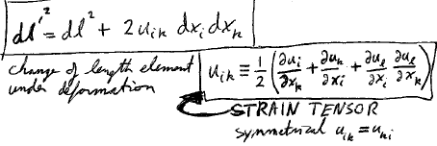

Slide 11
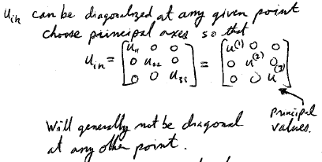

Slide 14
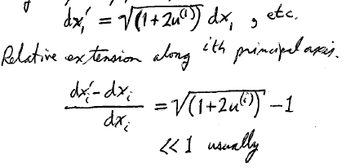

Slide 15
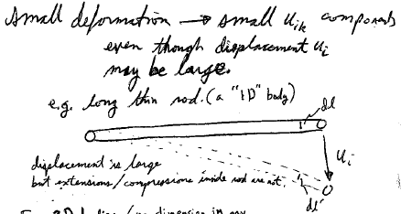

Slide 16
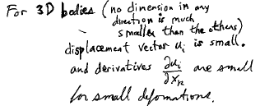

Slide 17
Strain tensor for small deformations

Slide 18
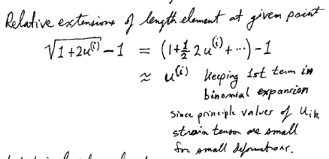

Slide 19
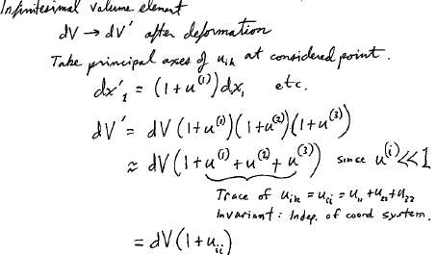

Slide 21
How do we measure strain? Strain Gauges
From James T. Humprhies and Leslie P. Sheets, Industrial Electronics 4th Ed. (Delmar, Albany NY, 1993)

Slide 23
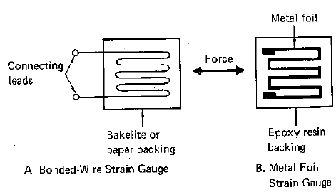

Slide 24
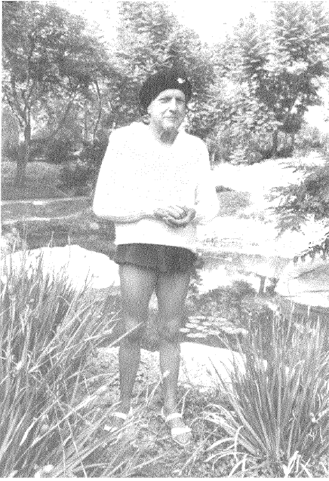
Edward Simmons, former Caltech ME graduate student, invented the bonded wire resistance strain gage in 1936.

Slide 25
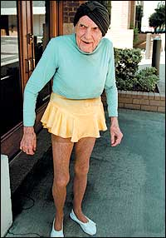
Dr. Simmons, creator of a billion dollar industry, first adopted by aerospace, helped win WWII

Slide 27
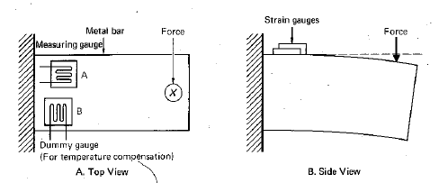

Slide 29
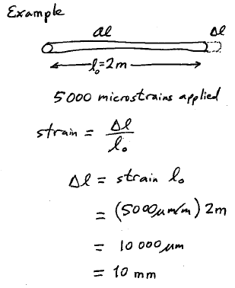

Slide 30
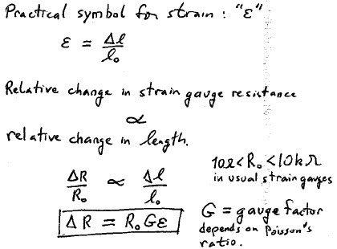

Slide 31
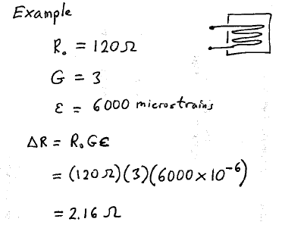

Slide 32
Range of Gauge Factor Values

Slide 33
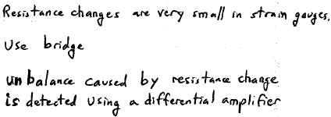

Slide 34
