Slide 1
A plane wave in an anisotropic medium
LL8 Section 97

Slide 2


Slide 3



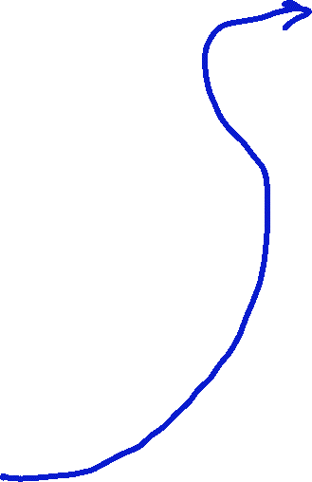



Slide 4


Slide 6





Slide 8














Slide 9
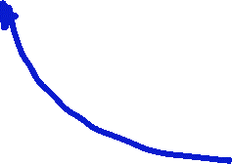

Time averaged energy flux density

Slide 10









Slide 11


















Slide 12




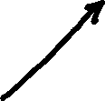


Slide 13




Slide 14



Slide 15













Slide 16
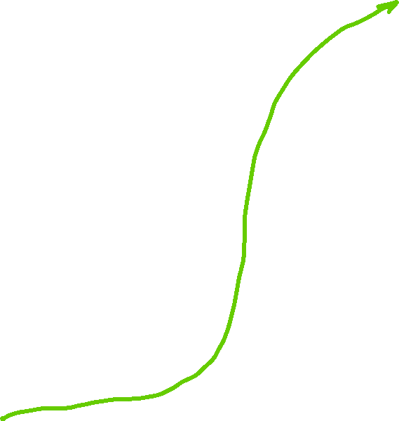





Slide 17




Slide 18






Slide 19


Slide 20







Slide 21



Slide 22


