Slide 1
Permittivity of a mixture
LL8 Section 9

Slide 2
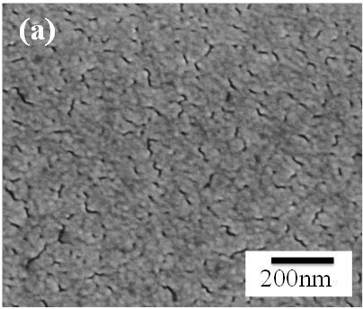
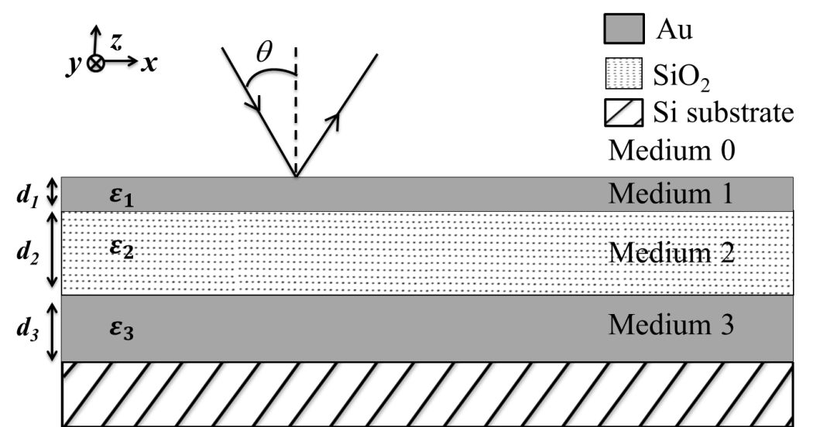
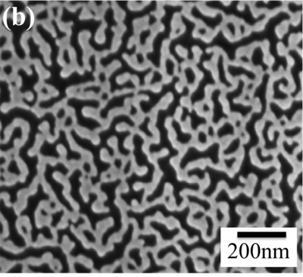
Salisbury Screen Absorber
(Janardan Nath)
Top layer (a) 20 nm (b) 10 nm
Discontinuous!

Slide 3
Theory based on bulk Au permittivity
(d2 = 300 nm)
Experiment.
Theory based on effective permittivity

Slide 4
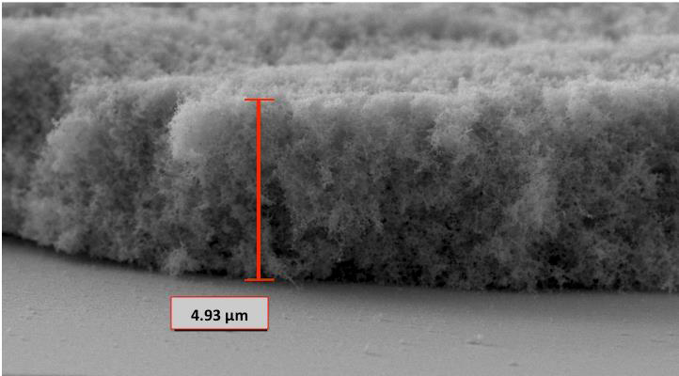
Gold black: Pure gold. What is its permittivity?

Slide 5
This section in Landau is one of several “effective medium” permittivity models.
It applies to finely dispersed mixtures, such as emulsions or powder mixtures.

Slide 6
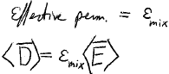
For macroscopic electrodynamics to hold, so that the medium can be described by a permittivity, we must average the E-field over distances larger than the inhomogeneities.
Then the medium is homogeneous and isotropic with respect to this averaged field.
The effective permittivity
Conditions
Particles must be isotropic.
Difference in their permittivities must be small compared to the permittivity itself.

Slide 7






















Slide 8
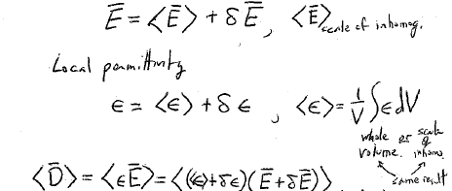


The macroscopic field at a given point differs from the averaged field by a little bit.
The local field is
Spatial average over scale of inhomogeneity
Local permittivity
<E>+
Spatial average over scale of inhomogeneity

Slide 9
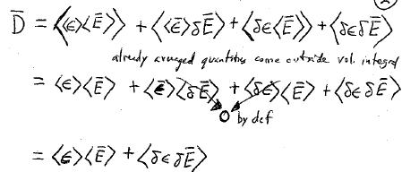
<D>

Slide 10
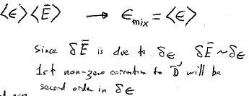






This seems obvious, but it is not usually a good approximation.
Zeroth-order approximation
<D> =

Slide 11
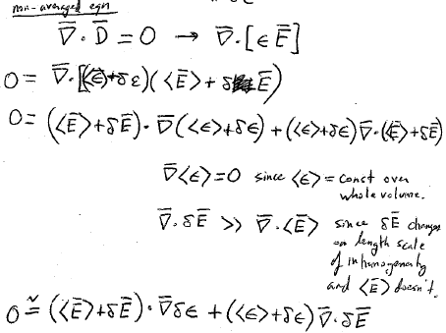




Non-averaged local equation
(Deriving a relation we will use later)
δ

Slide 12
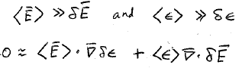
According to the conditions of the problem
This is the relation we will need later

Slide 13
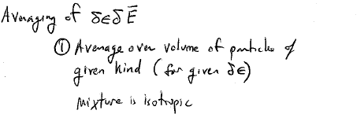
Step 1
(This is the term we neglected in the zeroth approximation)

Slide 15
(We’ll need this relation later, too.)

Slide 17
Step 2

Slide 18
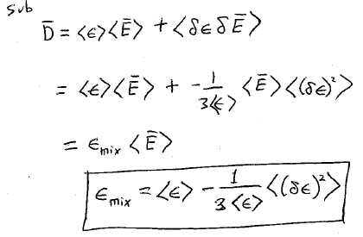

Zeroth approx.
First correction

Slide 19
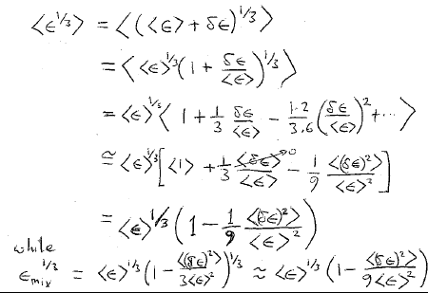
On the other hand
Same thing
While

Slide 20
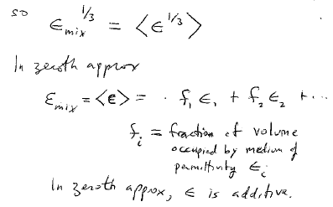

Slide 21
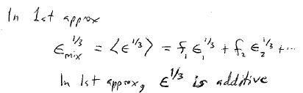

Slide 22
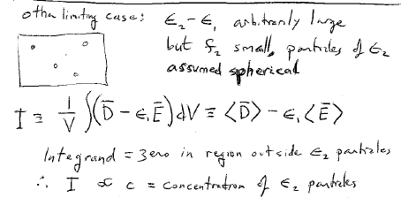

Slide 23
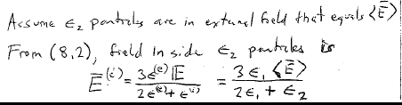

Slide 24
