Slide 1
The propagation of waves in an inhomogeneous medium
LL8 sec 88

Slide 2
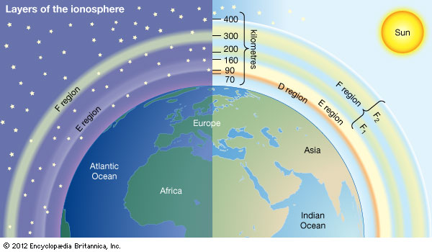
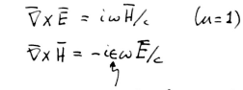
Consider a medium that is electrically inhomogeneous but isotropic
The ionosphere
Maxwell’s Equations
Permittivity changes with position, is a function of the coordinates

Slide 3
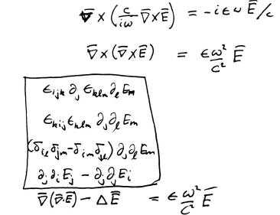

Eliminate H
Diff. Eq. for E

Slide 4
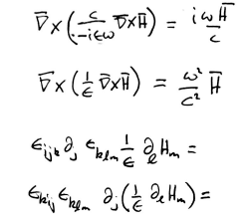





Instead, eliminate E
zero
Diff. Eq. for H

Slide 5
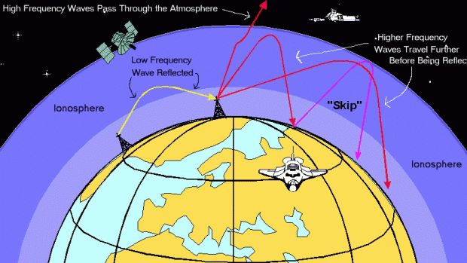
Special case where permittivity changes in only one direction, call it z.
Orient coordinates so that propagation is in the x-z plane.
All quantities are then independent of y.

Slide 6
Translational invariance in x means that the x-dependence of the wave is given by exp[iκx]
constant
For κ = 0, the field depends only on z.
The wave passes normally through a layer in which ε = ε(z).
For κ non-zero, the wave passes obliquely.

Slide 7
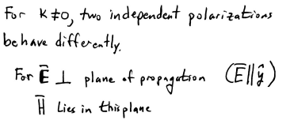
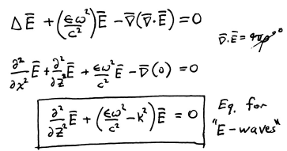
First case:
“E-waves”
Ionosphere has equal numbers of ions and electrons

Slide 8
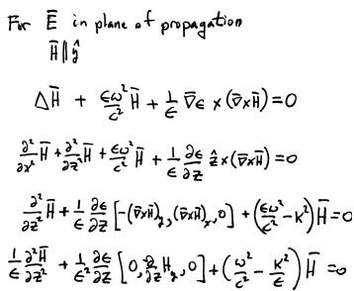
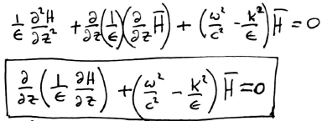
Second case:
“H-waves”
Equation for “H-waves”

Slide 9
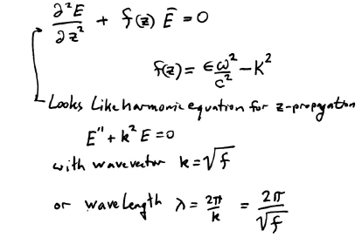
E-wave equation

Slide 10
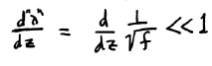
In geometrical optics, the wavelength should not change too fast along the ray of propagation
This means that the wavelength hardly changes over distances of order itself.
(Equality would mean that wavelength changes by its full value over distances equal to itself, Δλ = λ when Δz = λ)

Slide 11
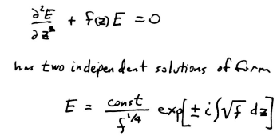
You cannot see this by simply substituting the solution into the differential equation!
The proof is way more difficult!
To see it, we go to quantum mechanics, where we have a similar problem!

Slide 12
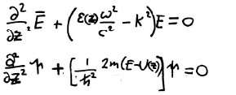
E-waves
1D permittivity variation
Quantum particles
1D potential
These are the same equation, just with different constants.
The solution of the quantum problem when the de Broglie wavelength is small compared to the characteristic distance for a change in U(z) is known:
It’s the “Quasi-classical case” or “WKB approximation”.

Slide 13
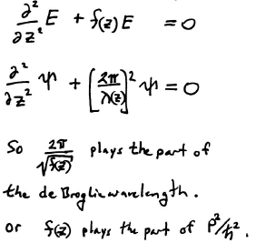
E-waves

Slide 14
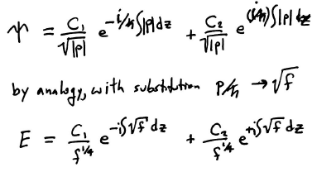
Solution in the quasi-classical case for quantum particles (HW)

Slide 15



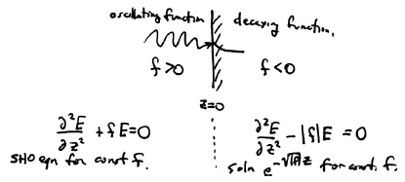
Conditions of validity for solution
Quasi-classical quantum particles
E-waves
Not satisfied near turning point, where E = U(z)
Not satisfied at reflection point, where

Slide 16
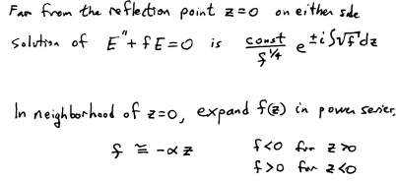

Slide 17
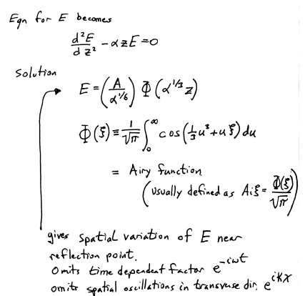

Slide 18
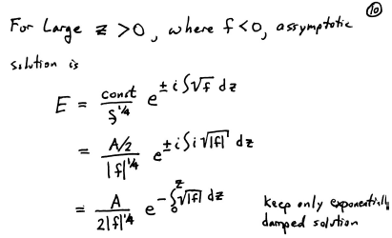

Slide 19
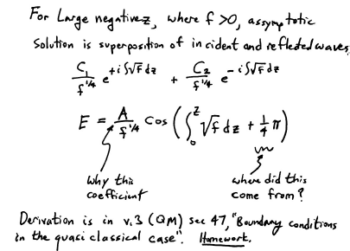

Slide 20
A function of z.
Amplitude decreases as f increases away from reflection point.

Slide 22
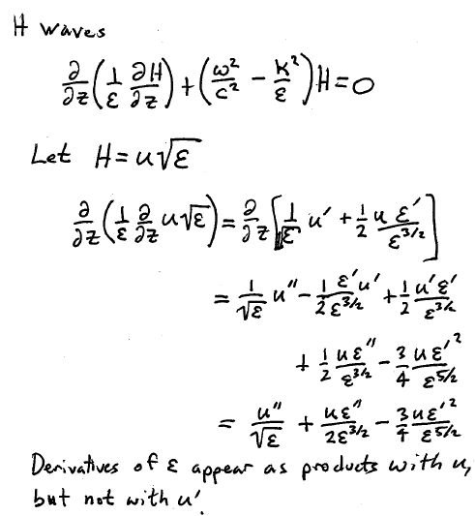

Slide 23
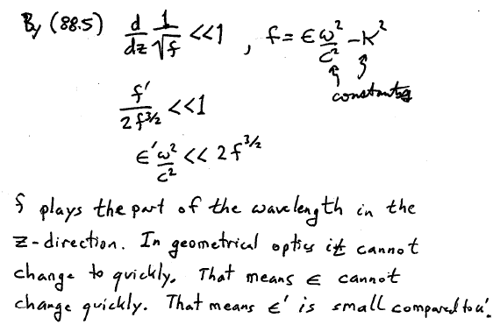

Slide 24
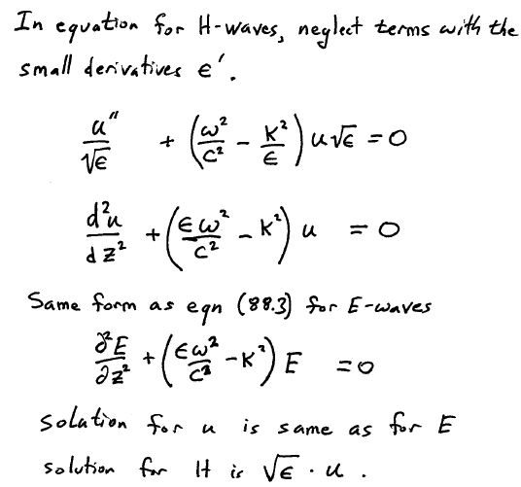

Slide 25
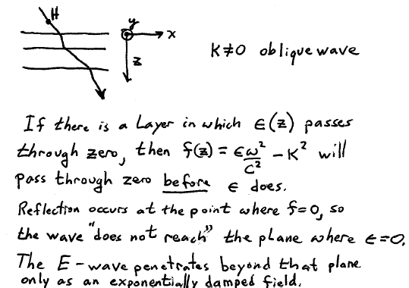

Slide 26
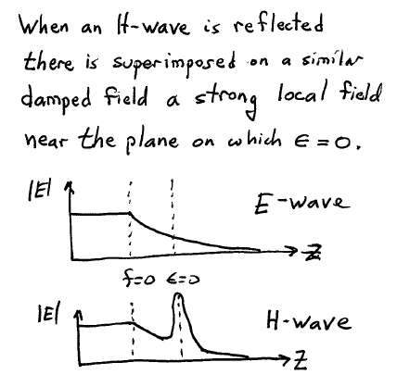

Slide 27
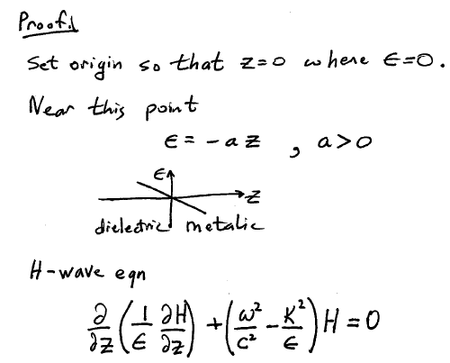

Slide 28
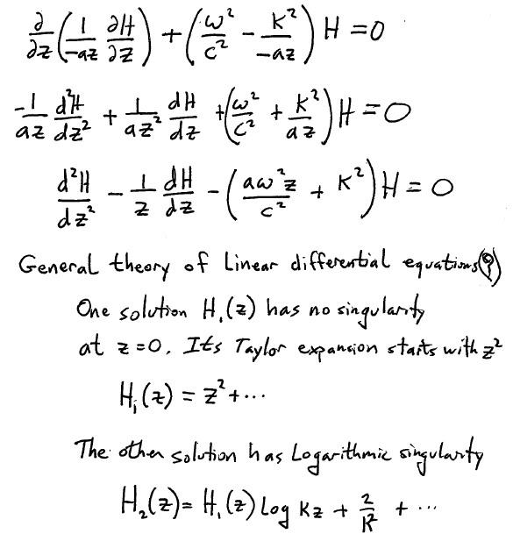

Slide 29
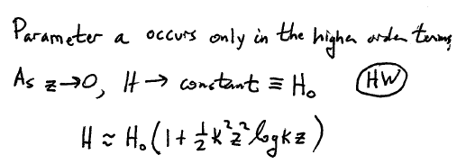
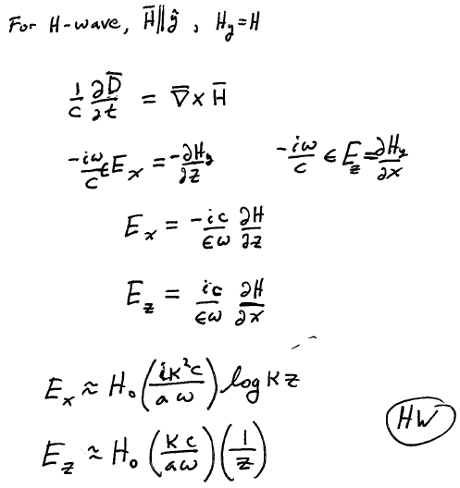

Slide 30
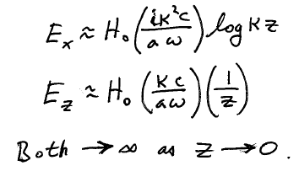
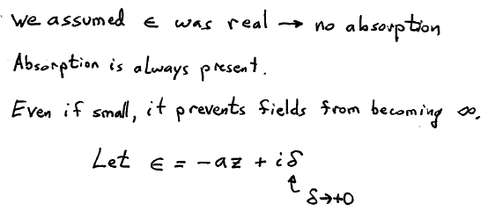

Slide 31
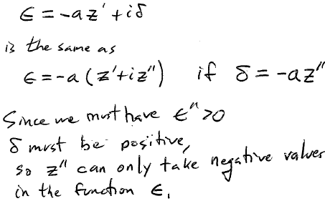
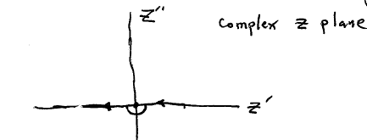
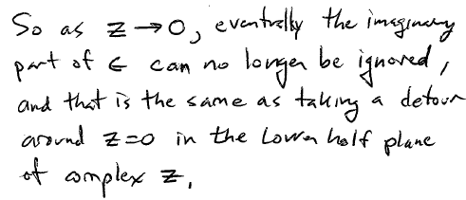

Slide 32
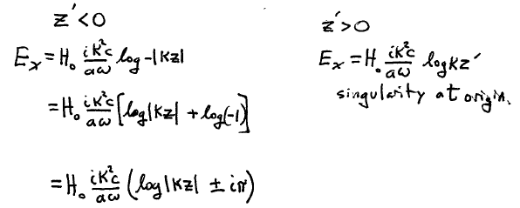


Slide 33
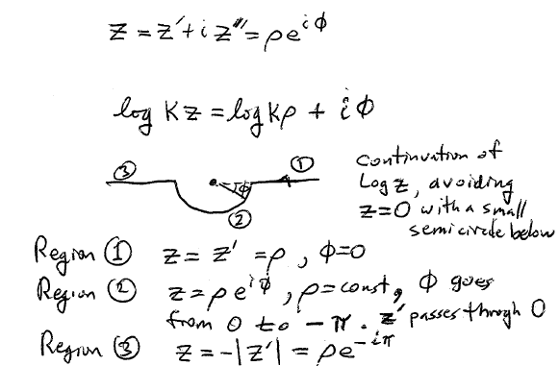

Slide 34
