Slide 1
Surface Impedance of Metals
Section 87

Slide 2











Slide 3
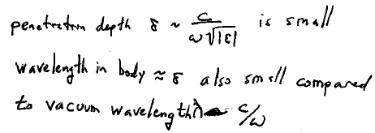


Slide 4
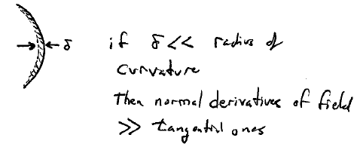


Slide 5
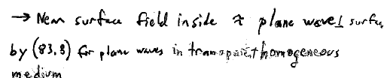
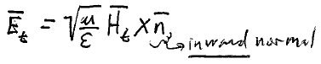





Inside and near a metal surface
E = -(c/ωε) k x H where k = √(εμ)ω/c

Slide 6
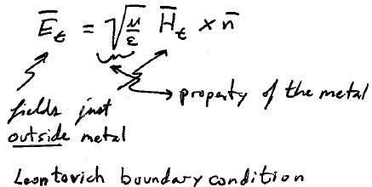






Since E_{t} and H_{t} are continuous at the surface, they are related by the same expression just outside

Slide 7

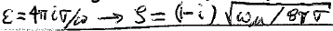








Surface impedance
At low ω

Slide 8
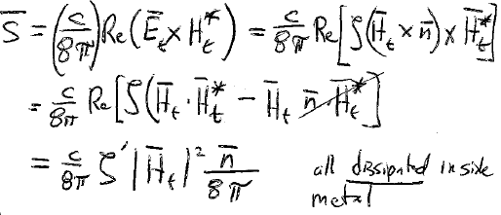
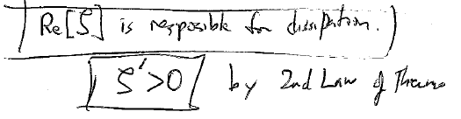


Time averaged energy flux through the metal surface

Slide 9

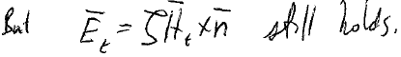
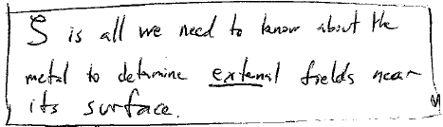

As frequency increases, penetration depth decreases until it becomes comparable to the electron mean free path.
The field is then too non-uniform to use the macroscopic description based on ε.
Fields don’t satisfy the macroscopic Maxwell equations in the metal
This is the only possible linear relation between the axial vector H and the polar vector E.

Slide 10
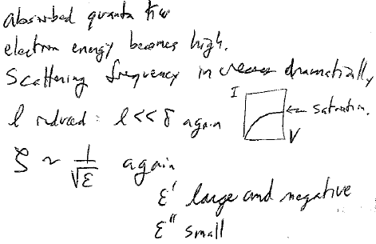
As frequency increases further, electron energy becomes high

Slide 11
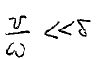
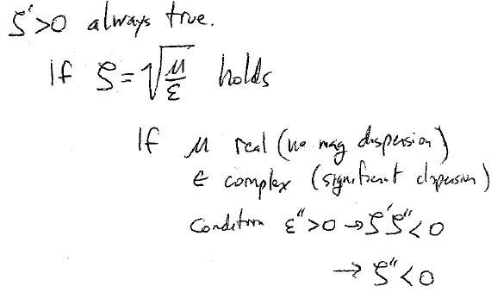














































At high frequency, the distance traveled by conduction electrons during one electromagnetic wave period
Then we can neglect the spatial inhomogeneity of the field relative to the electron motion

Slide 12
If
holds
and if μ is real (no magnetic dispersion)
while ε is complex (significant dispersion)
Then the condition ε” > 0 requires ζ’ζ” < 0,
And since ζ’ >0, we must have ζ” < 0.
On the other hand, if μ is complex and ε is real, then ζ” > 0.

Slide 13
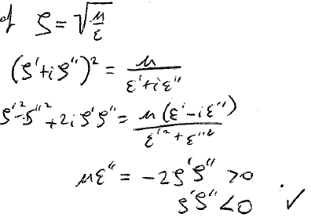




Proof of first inequality

Slide 14
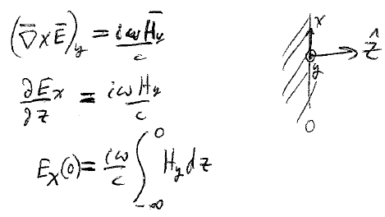
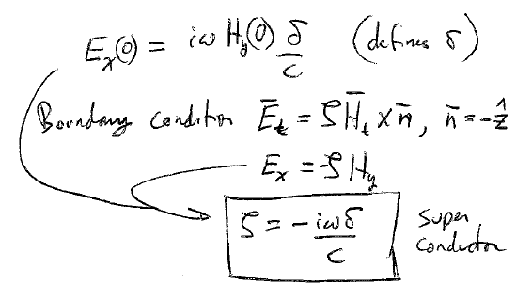

















For superconductors, the penetration depth δ is very small even for DC fields ω = 0.
For small ω, the distribution of the H-field is the same as in the static case.
(59.2)
Defines δ
Boundary condition
For a superconductor. Pure Imaginary. No loss.

Slide 15
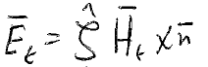
Surface impedance has dispersion.
Consider complex ζ to be a function of a complex frequency ω.
Surface impedance integral operator
E_{t} depends on values of H_{t} at previous times.
This means that ζ(ω) must be regular in the upper half plane of complex ω.
ζ(ω) is regular on the real ω axis except at ω = 0.
If H_{t} is real, then E_{t} must be real: ζ(-ω*) = ζ*(ω)

Slide 16
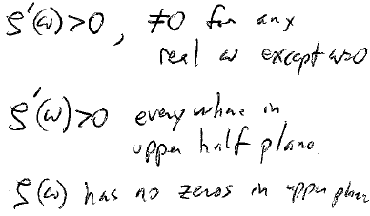
Energy dissipation is determined by ζ’
These properties give Kramers-Kronig relations between ζ’ and ζ”

Slide 17
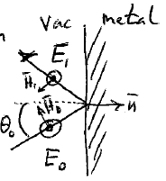


















A use of surface impedance is to calculate reflection from metals.
For perpendicular polarization

Slide 18
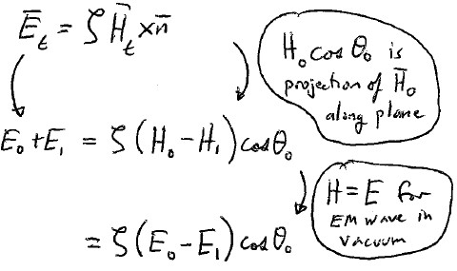
Boundary condition
superposition

Slide 19
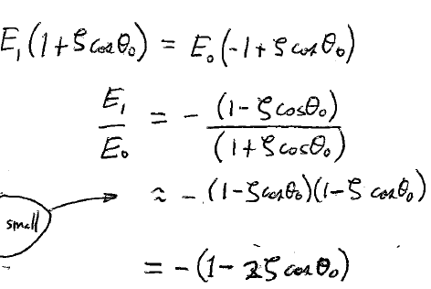
is small for metals

Slide 20
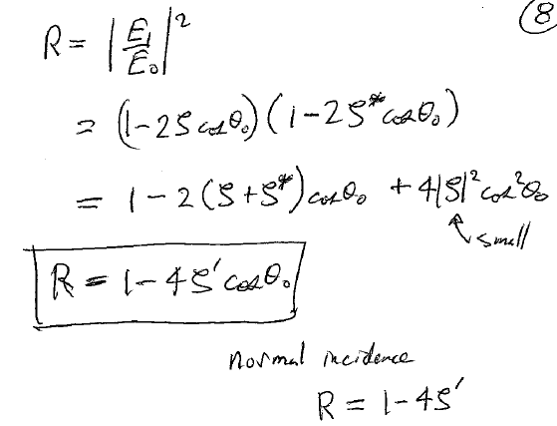


Slide 21
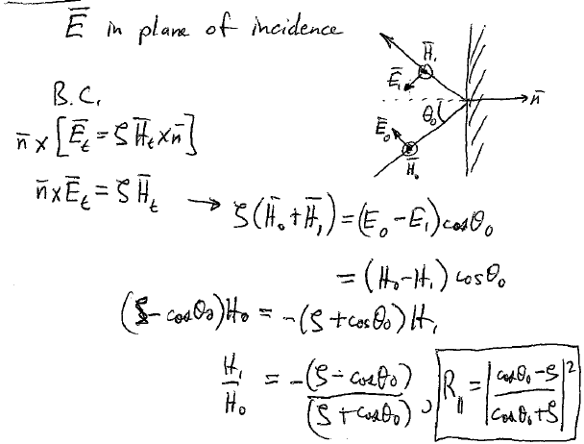
Parallel polarization

Slide 22
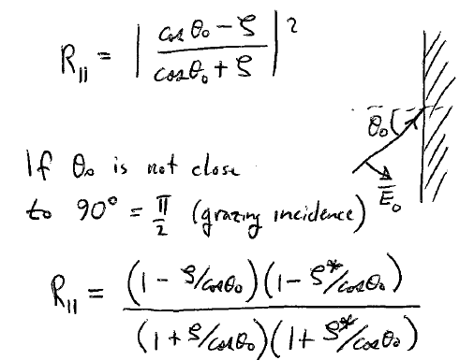

Slide 23
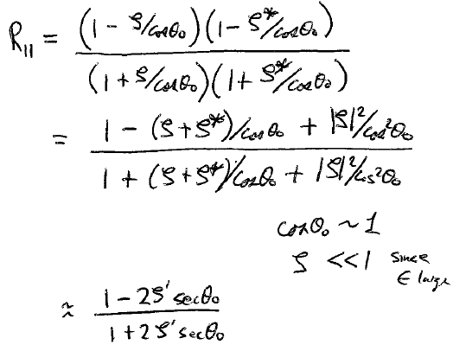

Slide 24
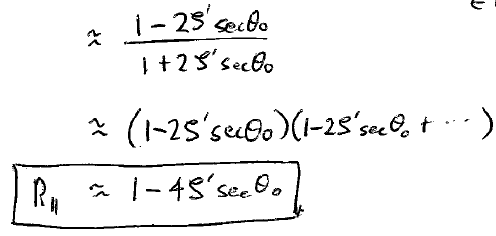


Slide 25
