Slide 1
Dielectric Ellipsoid
Section 8

Slide 2
Dielectric sphere in a uniform external electric field
Field that would exist without the sphere
Put the origin at the center of the sphere.

Slide 3
Potential of uniform external field
Change in potential caused by sphere
Potential outside the sphere

Slide 4
Solution of Laplace’s Equation in spherical coordinates is of the form
There is no dependence on the azimuthal angle φ by symmetry
Blows up at infinity. Set a = 0.
The l = 0 term (const/r) doesn’t have the symmetry of the constant vector , the only parameter of the problem.
The l = 1 term is the first non-zero term.

Slide 5
Inside the sphere, the solution must be finite at the origin. Set b = 0.
The l = 0 term is just a constant. Ignore.
The l = 1 term is arCosθ
φ^{(i)} = -B E₀.r
Field inside = B E₀ , i.e. uniform

Slide 6
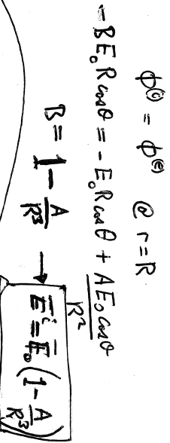
Boundary condition on potential

Slide 7
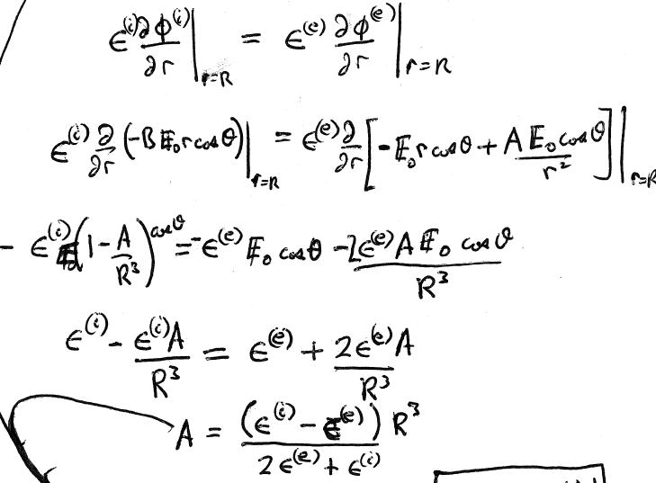
Normal component of induction is continuous

Slide 8
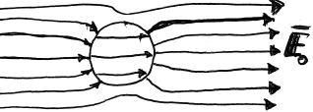
Field inside dielectric sphere
The sketch is for
E^{(e)} is similar to that of a conducting sphere in a uniform field.

Slide 9
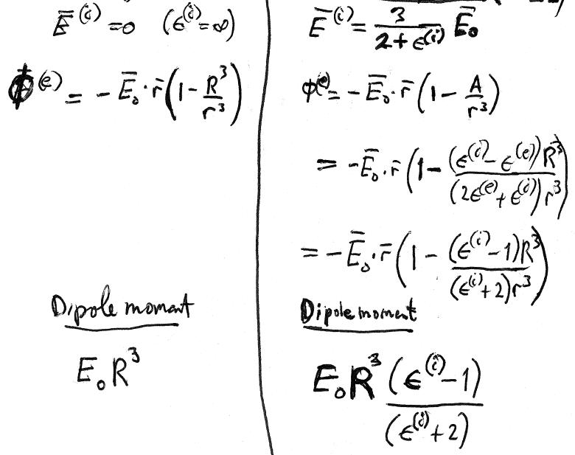
Conducting sphere
Dielectric sphere (ε^{(e)} = 1)

Slide 13
We did the dielectric sphere in an external field, and the dielectric cylinder in a transverse field. Now let’s look at some other limiting ellipsoids.
A dielectric cylinder in a longitudinal field

Slide 14
Flat dielectric plate in a normal external field

Slide 15
Theorem
Whatever the ratio of the semiaxes a,b,c, the internal field of a dielectric ellipsoid placed in a uniform external field is uniform.
Solution already found for the external field of the conducting ellipsoid

Slide 16
Now consider the field inside the dielectric ellipsoid in an external field.
The elliptic integral solution for

Slide 17
The solution we discarded for the external field of the conducting ellipsoid

