Slide 1
Dielectric Properties of Crystals
LL8 section 13

Slide 3


Slide 5
Obtain the Free Energy F, where induction D, instead of field E, is the independent variable, by Legendre transformation

Slide 7
No angles or sides are the same
No sides equal
Two angles = 90
No sides equal. All angles = 90

Slide 12



Slide 14





Slide 16











Slide 17
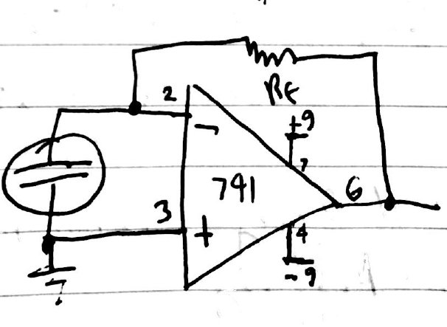
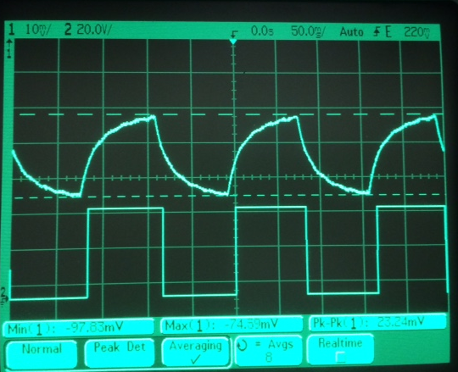
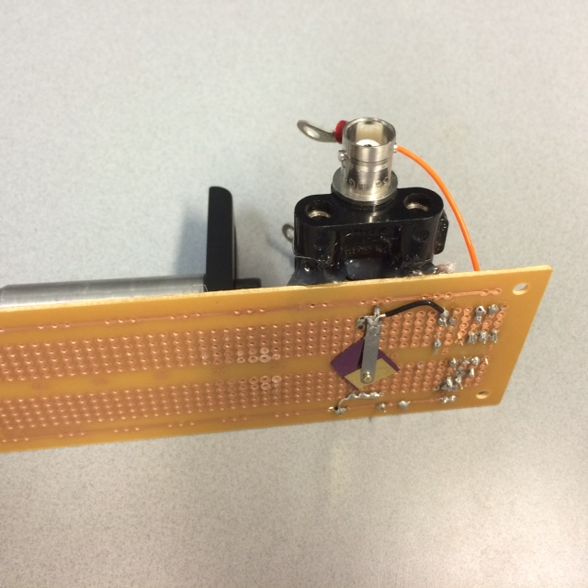
6 Hz chopping
Goldsmith Memorial sputtered AlN pyroelectric
Chop
Ref.
Quantum Cascade Laser
9.3 μm wavelength

Slide 18
“BaTiO3 film grown by water-based process,” Sarmad Fawzi Hamza Alhasan, Hussain Abouelkhair, Robert. E. Peale, Isaiah O. Oladeji, ECS Transactions 72 (2) 343-349 (2016).
Pyroelectric response of spray-deposited BaTiO3 thin film, Robert E. Peale, Isaiah O. Oladeji, Evan M. Smith, Vladimir Vasilyev, Sarmad Fawzi Hamza Alhasan, Hussain Abouelkhair, Dalibor Todorovski, Martin Kimani, Justin W. Cleary, in Nanostructured Thin Films IX, edited by Akhlesh Lakhtakia, Tom G. Mackay, Motofumi Suzuki, Proc. of SPIE Vol. 9929, 99290Z (2016).

