Slide 1
The general theory of X-ray scattering
LL8
Section 124

Slide 2
Example: Thin film grazing incidence “2-theta” scan.
Why the peaks? Why are they characteristic of one specific crystal? What determines their intensities and locations?

Slide 3
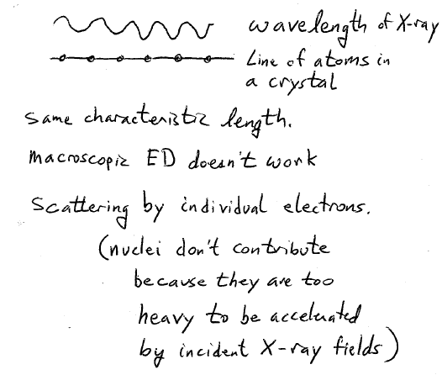
Cu Kα X-ray: 0.1540598 nm
Inter-atomic distances ~0.2 nm

Slide 4
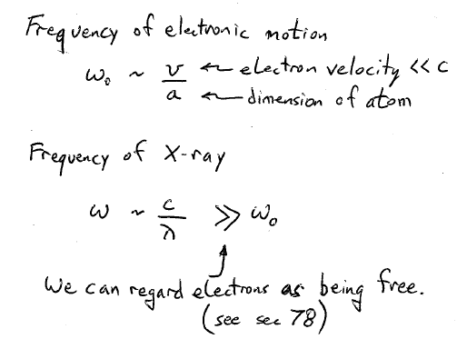
Because c >> v and λ~a

Slide 5
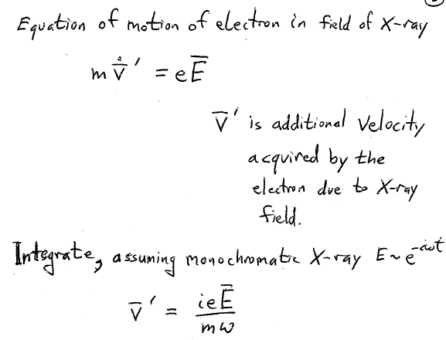

Slide 6
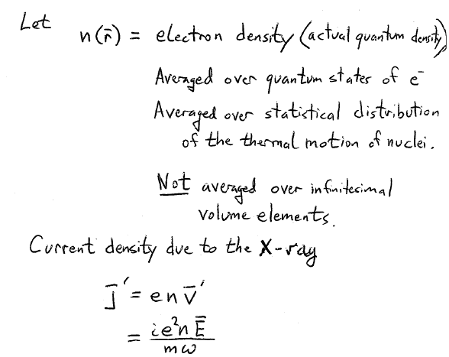

Slide 7
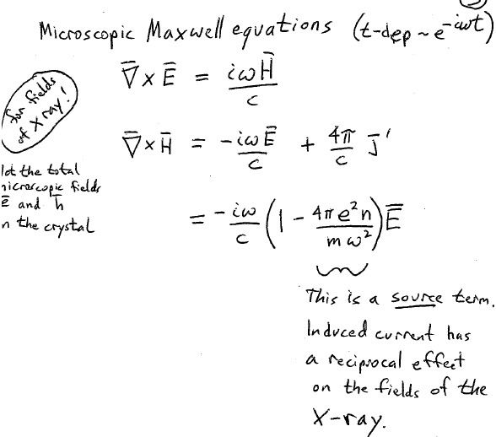
(Not the total microscopic fields e and h in the crystal)

Slide 8
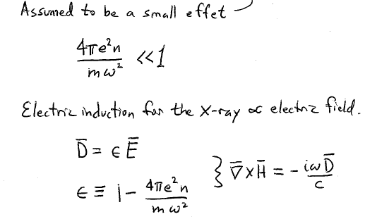
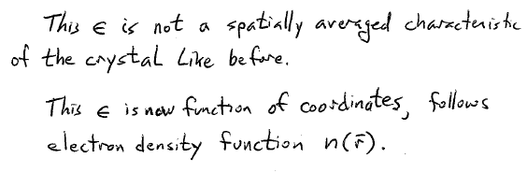
The source term is the cause of the scattering

Slide 9
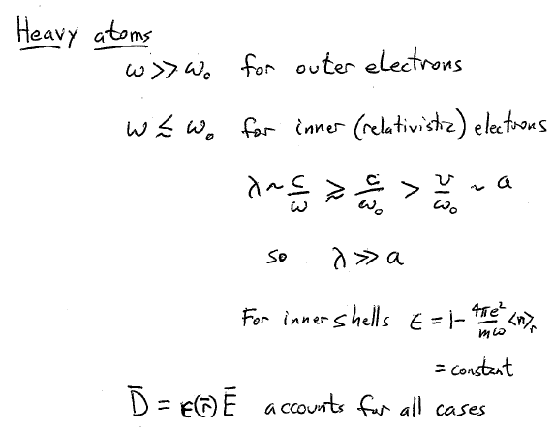

Slide 10
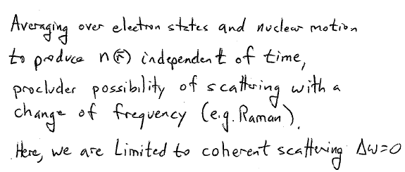

Slide 11
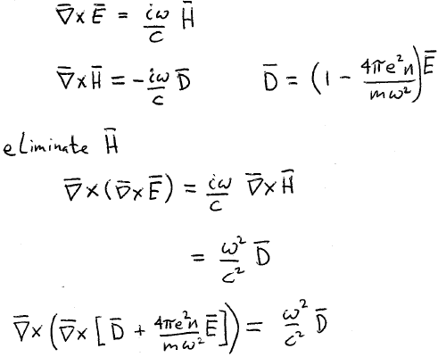
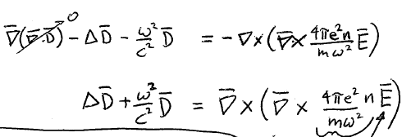
Small
Take as given field of incident X-ray without scattering part

Slide 12
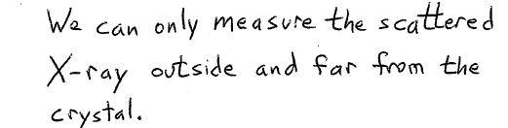
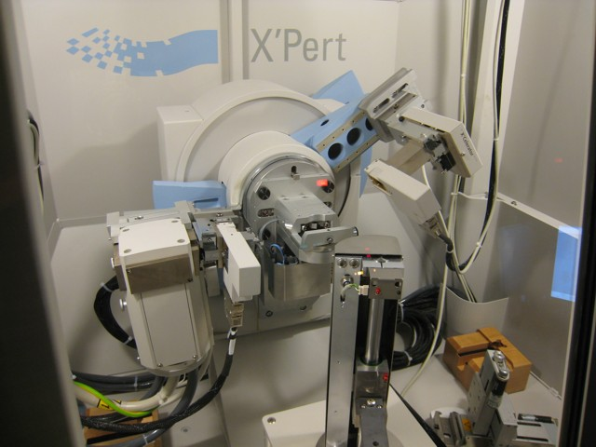

Slide 13
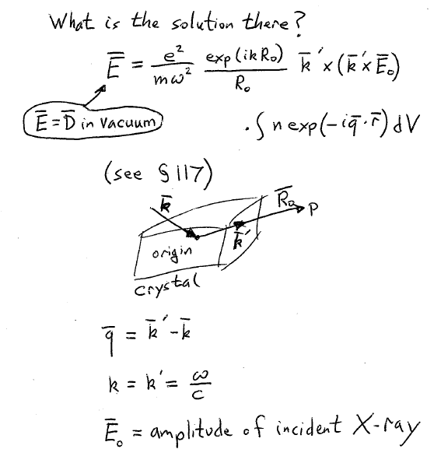

Slide 14
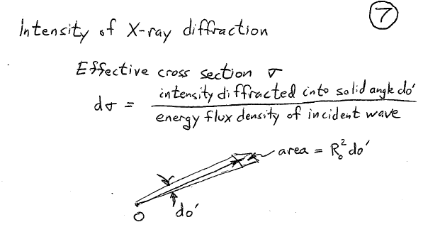

Slide 15
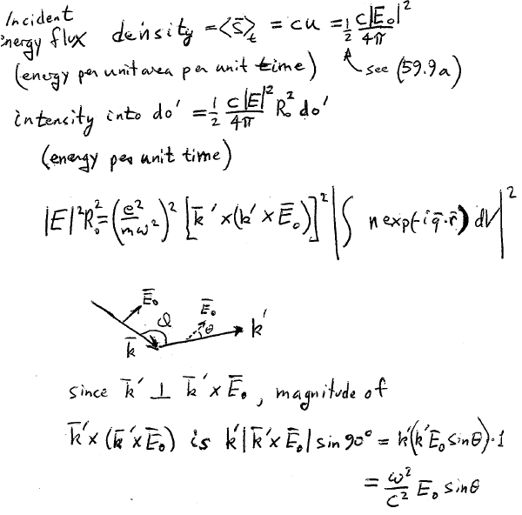

Slide 16
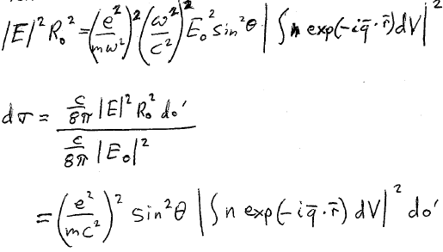
Then

Slide 17
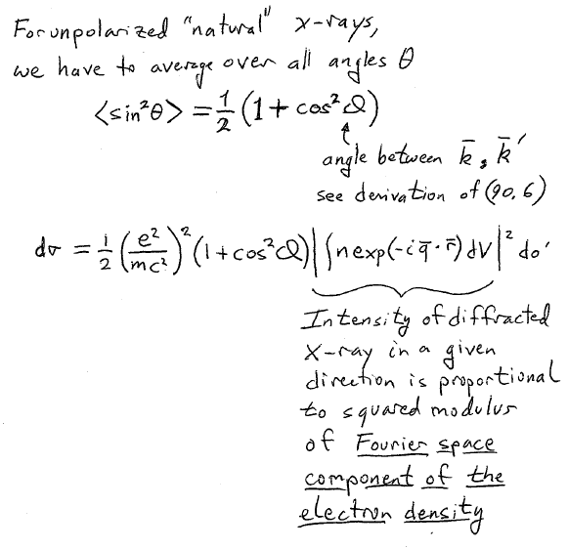
Angle between incident polarization and k’
See derivation of (92.6)
What would be the lowest spatial period and the relative amplitude of this component?

Slide 18
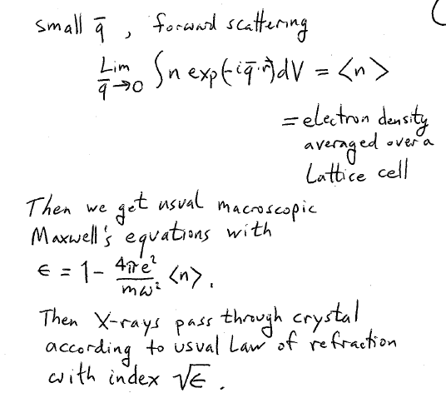
What do you expect for the value of this index?
What do you expect for its imaginary part?

Slide 19
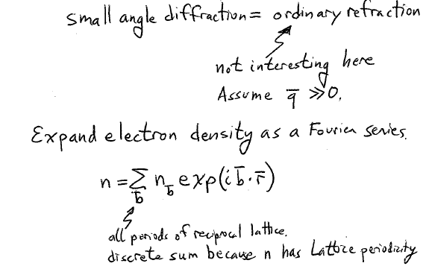
What do you expect for the relative magnitudes of n_{b} for large and small b?

Slide 20
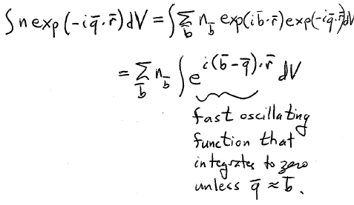
Fourier component of the electron density
Explains why we see just narrow peaks and why they are labeled by reciprocal lattice vectors.

Slide 21
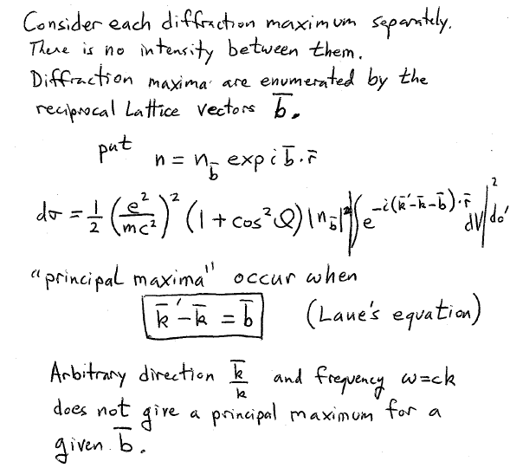
(For one of the peaks.)

Slide 22
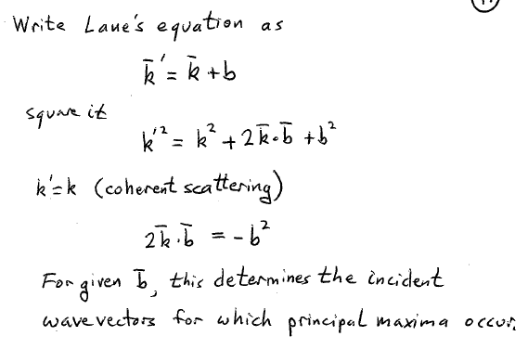

Slide 23
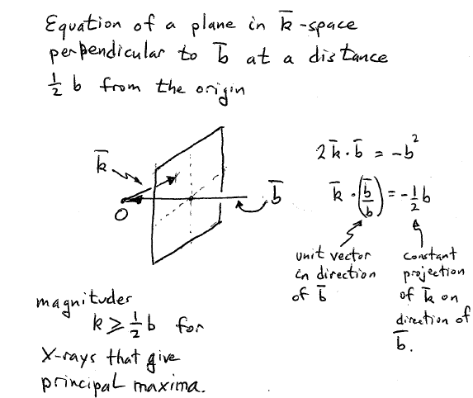

Slide 24
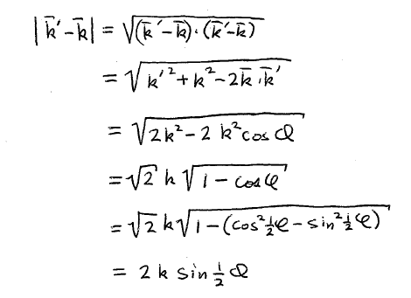

Slide 25
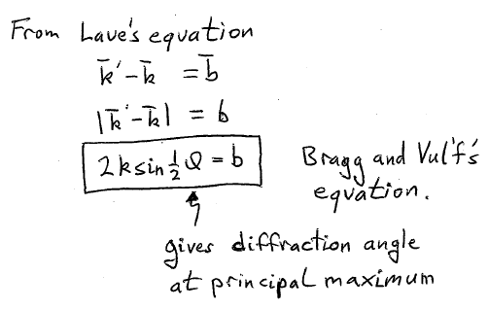

Slide 26
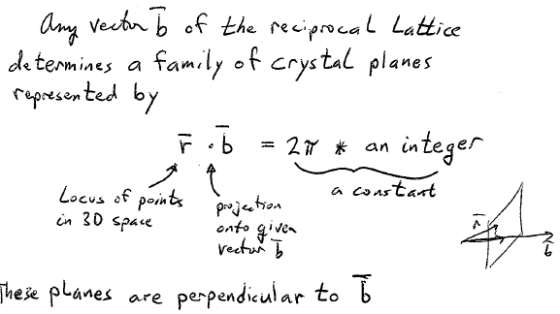

Slide 27
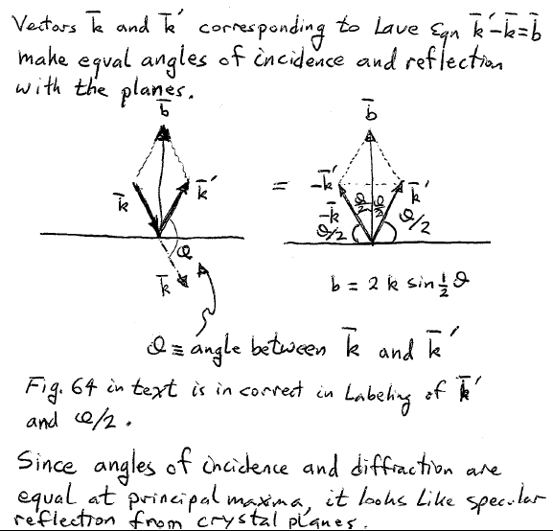

Slide 28
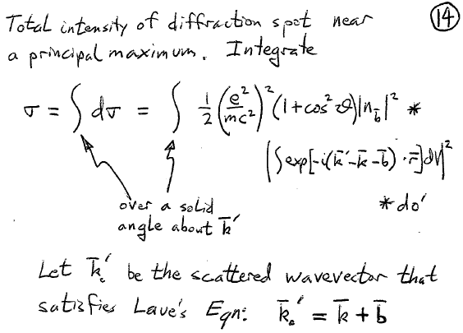

Slide 29
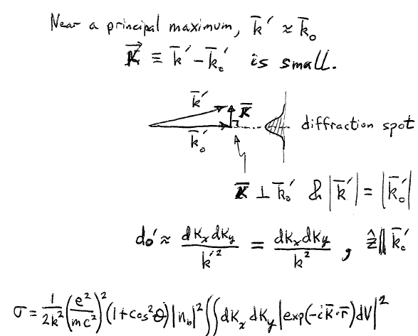

Slide 30
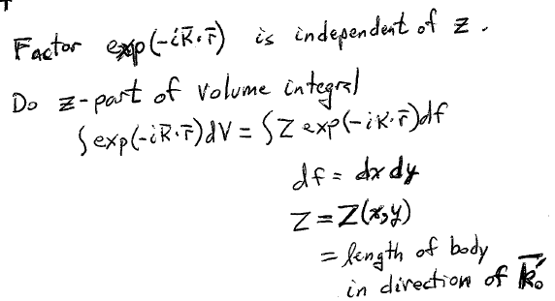

Slide 31
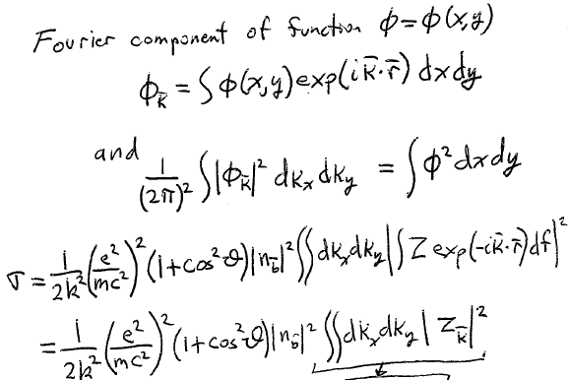
Bragg-Vul’f

Slide 32
L = characteristic linear dimension of body
Total cross section ~ Integrated intensity of the principal maximum ~ sample volume^4/3

Slide 33
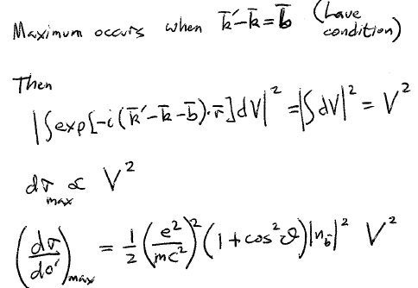
What about the peak of the principal maximum? How does that depend on volume?

Slide 34
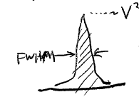
What about the width of the principal maximum?

Slide 35
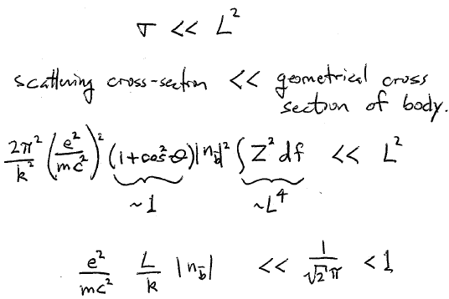


Slide 36
