Slide 1
Electrostriction of isotropic dielectrics
LL8 section 12

Slide 2
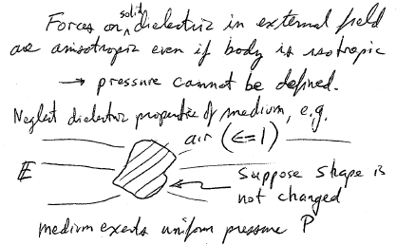

Slide 3
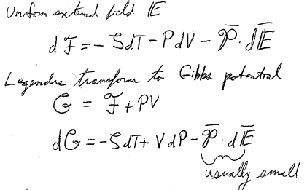

Slide 4
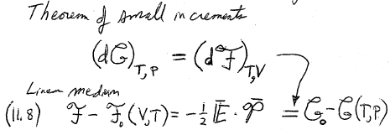

Slide 5
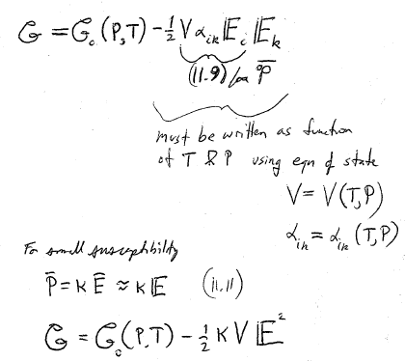

Slide 6
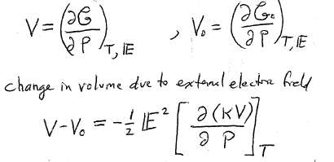
This difference may have either sign. For conductors, it is positive.

Slide 7
=increase in entropy when external field is applied to body
Q = TS
= heat absorbed by body when external field is applied isothermally
=

Slide 8
Homework
Find experimental example of electrostriction

