Slide 1
General theory of scattering in isotropic media
LL8
Section 117

Slide 2
Charges in a medium are accelerated by an incident electromagnetic wave.
Accelerated charges radiate scattered waves in new directions.

Slide 3
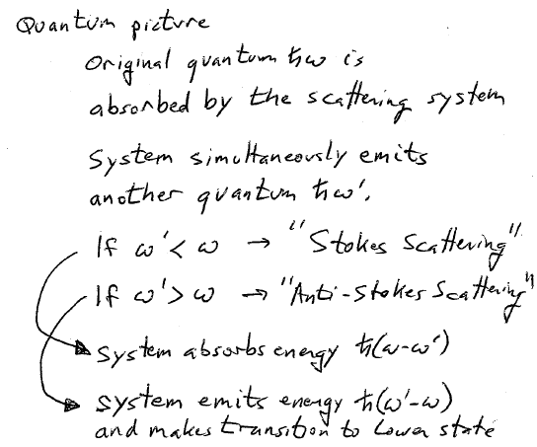
Quantum picture.

Slide 4
Macroscopic electrodynamics picture
Average the fields over an infinitesimal volume with given positions of all particles inside.
But this time, don’t do the second step, which is averaging over the subsequent motion.
Since average acceleration is zero in a finite system, you would average away the scattering effect.

Slide 5
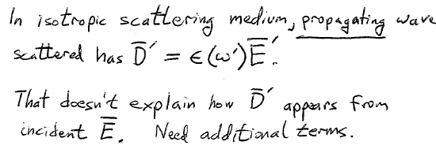
Fields of scattered wave, with frequency ω’.
Fields of incident wave, assumed monochromatic with frequency ω.

Slide 6
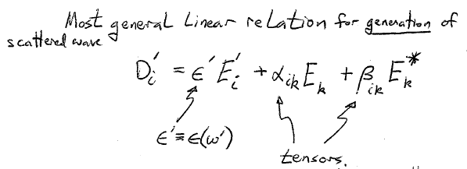
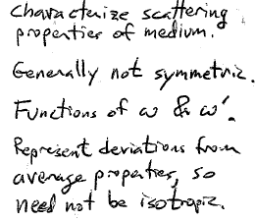

Slide 7
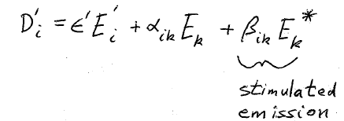
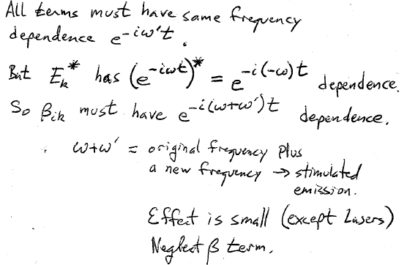

Slide 8
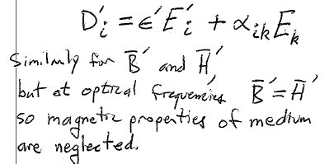

Slide 9
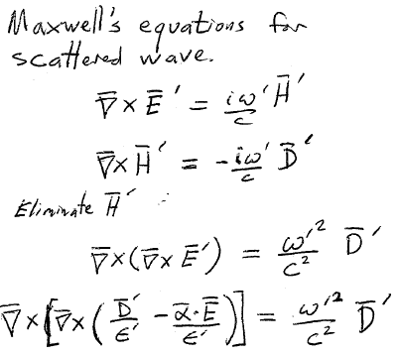

Slide 10
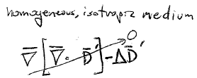
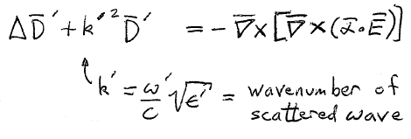

Slide 11
Divide medium into small regions with dimensions still large compared to intermolecular distances.
Then dimensions are also large compared to the correlation length.
Different regions are therefore uncorrelated.
Scattered light from them is non-coherent.
Treat scattering from each region independently, as if light is not scattered at all from any other region.

Slide 12
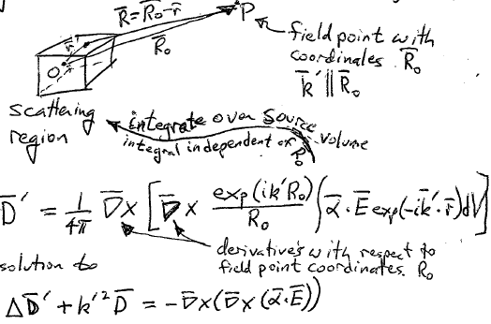
Calculate the field of the scattered wave at large distance from the scattering region.
Use the retarded potentials from v.2 section 66.
Derivatives are with respect to the field point coordinates R₀.
is the solution to
This is a little tricky to see, but…

Slide 13
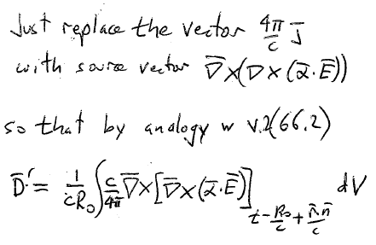
Problem is equivalent to v.2 (62.3), but with different source term.
Which has solution v.2, (62.10)

Slide 14
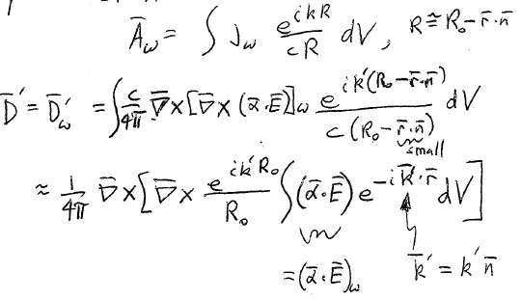
Since field was assumed monochromatic, we follow analogy with v.2 (64.2) for the Fourier component of A

Slide 15
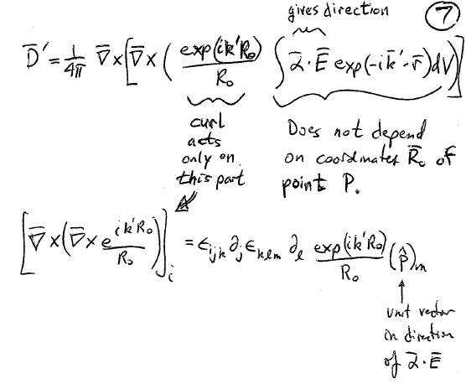

Slide 16
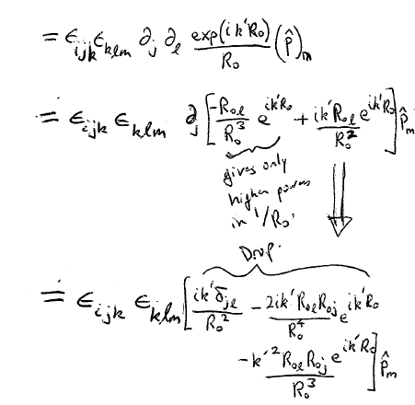

Slide 17
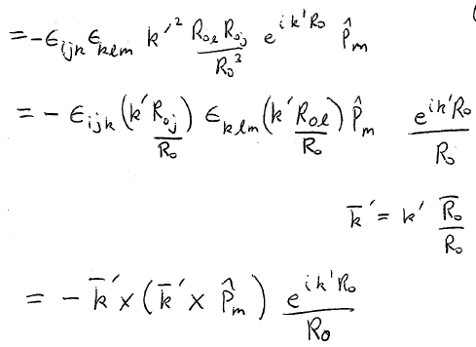

Slide 18
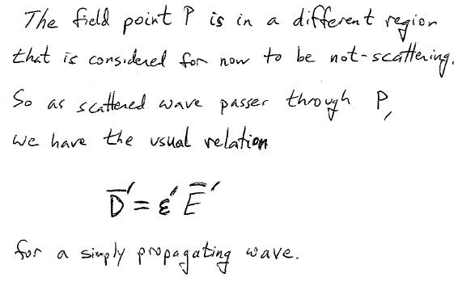

Slide 19
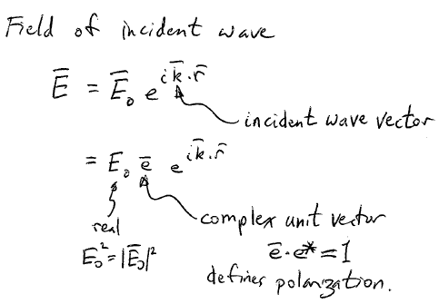

Slide 20
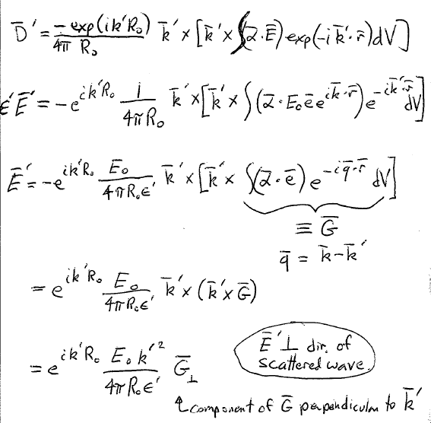

Slide 21
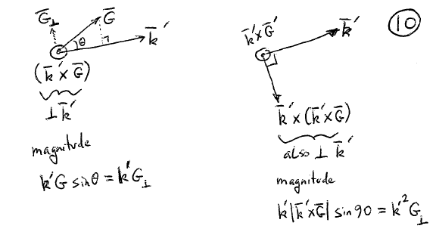

Slide 22
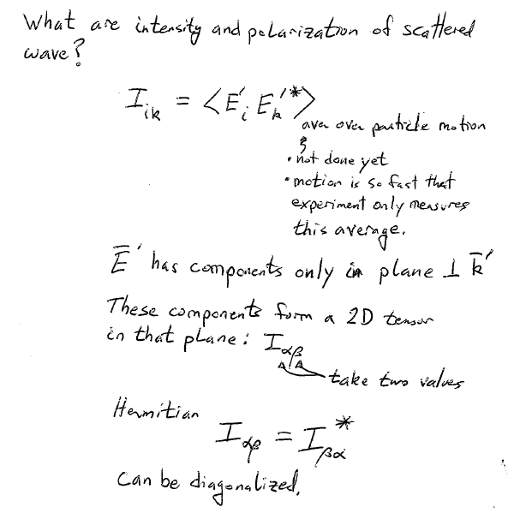

Slide 23
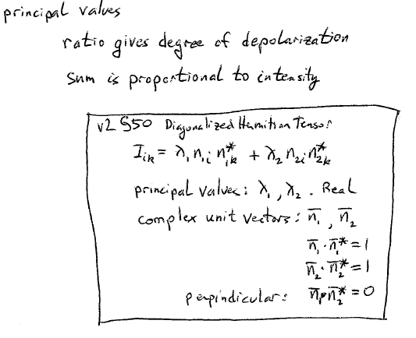

Slide 24
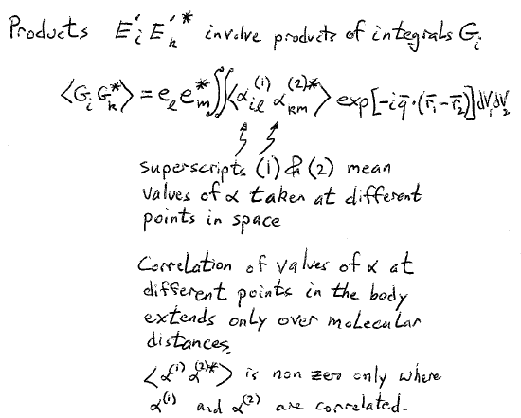

Slide 25
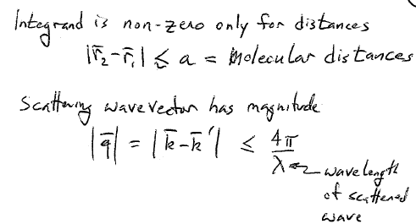

Slide 26
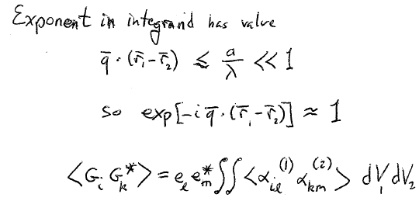

Slide 27
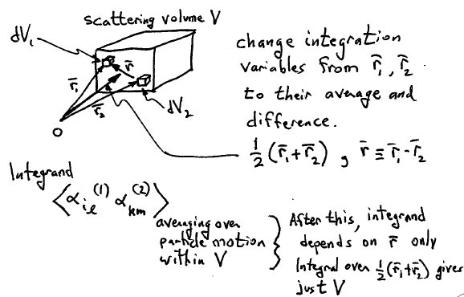

Slide 28
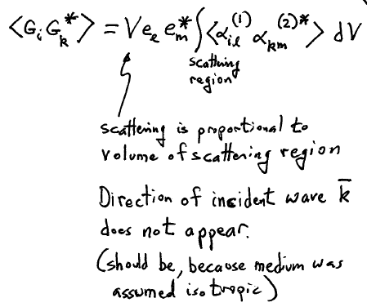

Slide 29
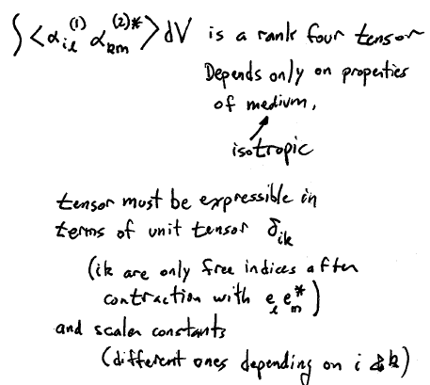

Slide 30
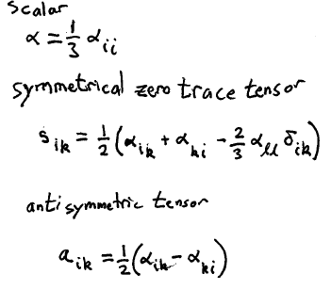

Slide 32
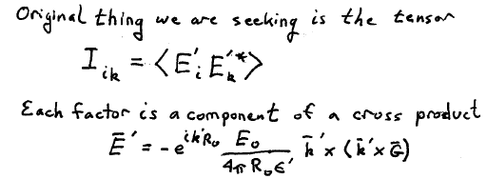

Slide 33
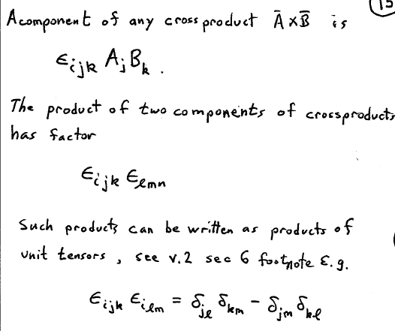

Slide 34
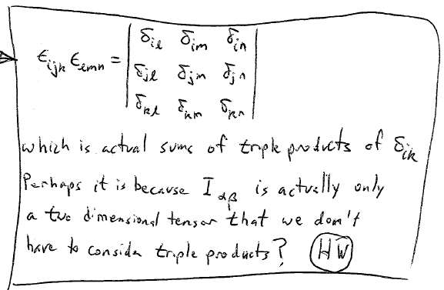

Slide 35
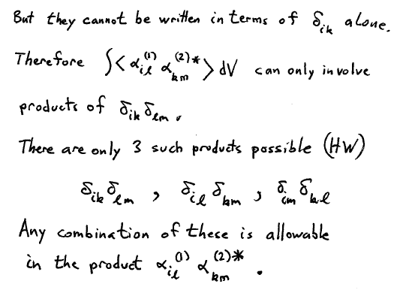

Slide 36
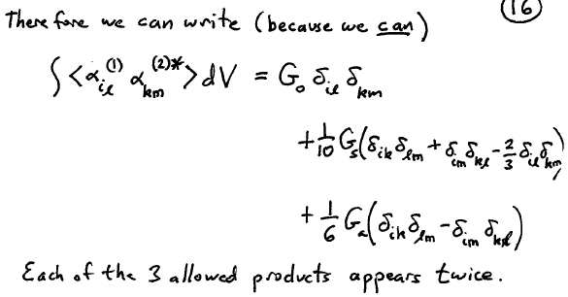
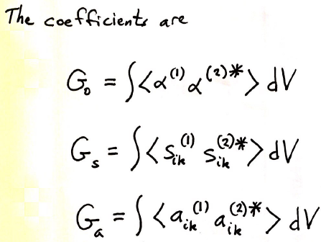
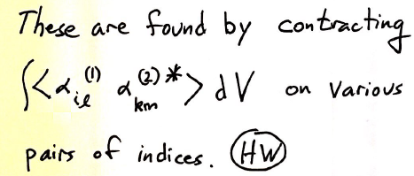

Slide 37
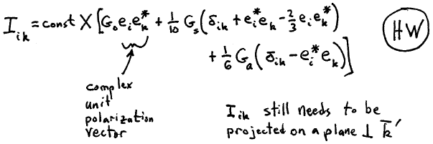

Slide 38
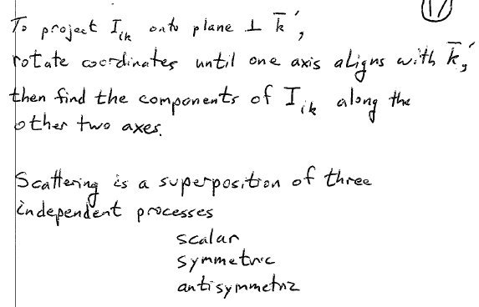

Slide 39
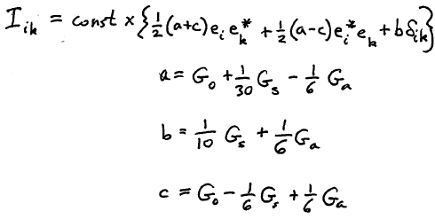
The superposition of 3 independent parts can be written differently:
Either form of I_{ik} determines the angular distribution and polarization of scattered light.

Slide 40
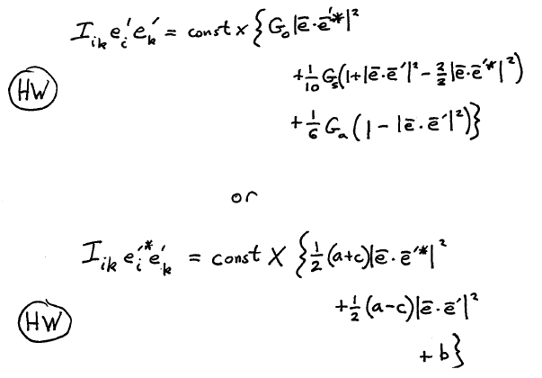
Polarization is determined using an analyzer to measure the intensity of light with a particular component of E’.
Mathematically, project I_{ik} on some polarization vector e’ to get the theoretical value of this intensity.
Note that the projection of I_{ik} onto the plane transverse to the scattered propagation vector k’ involves projections of the incident wave’s polarization vector e onto e’, because
this plane is defined by the components of the scattered wave’s polarization vector e’.

Slide 41
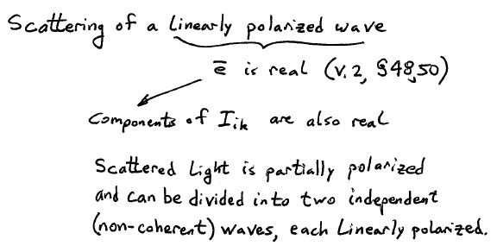

Slide 42
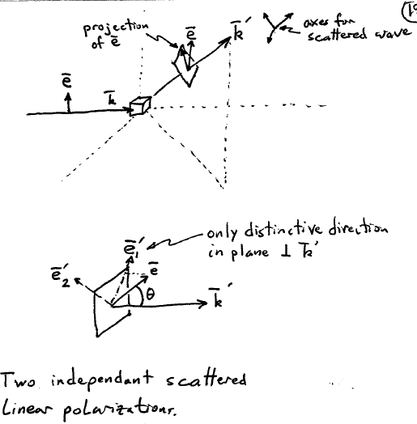

Slide 43
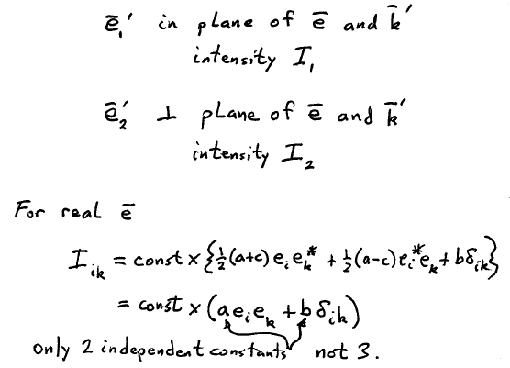

Slide 44
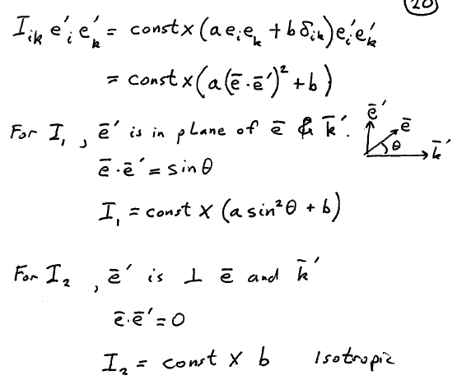

Slide 45
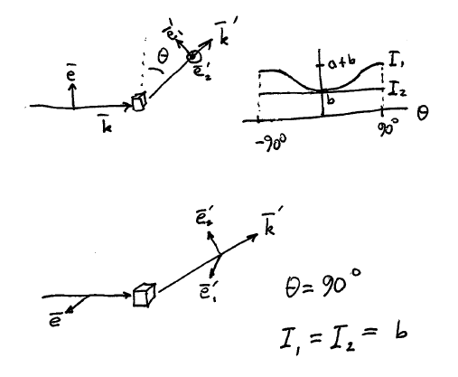

Slide 46
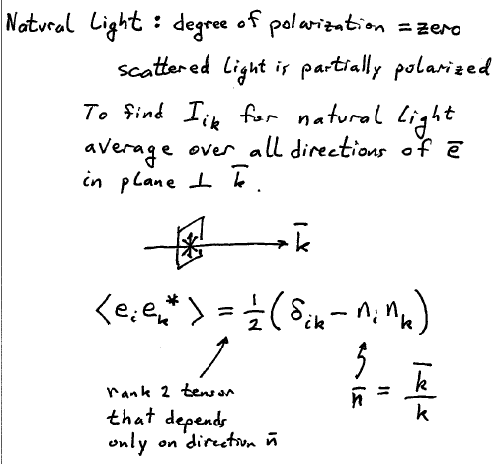

Slide 47
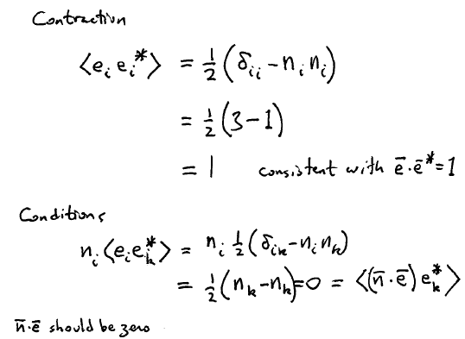

Slide 48
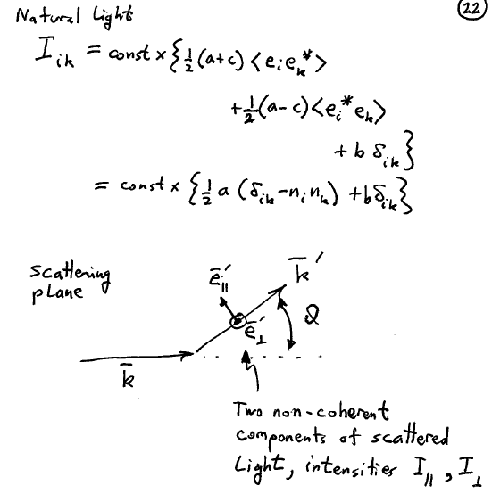

Slide 49
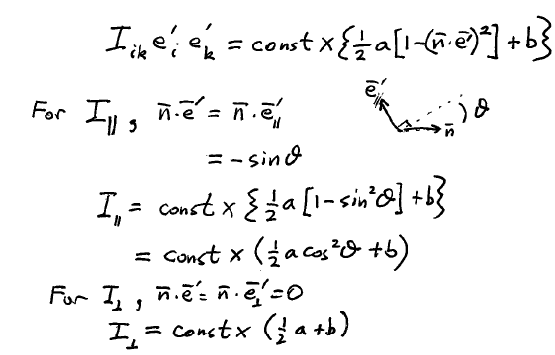

Slide 50
