Slide 1
Ionization losses by fast particles in matter, non-relativistic case
LL8 section 113

Slide 2
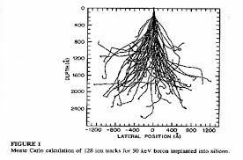
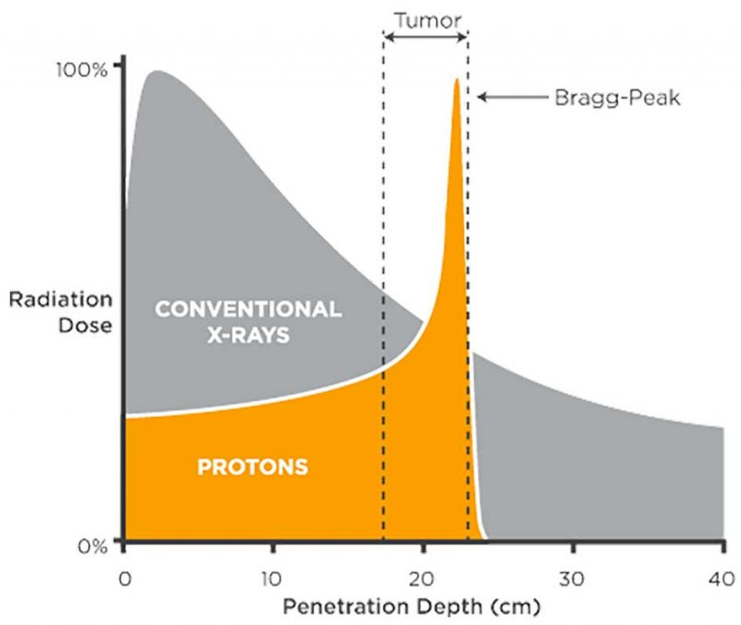








Ion implantation
Proton therapy

Slide 4
Maximum particle energy loss does not occur at the same frequency as maximum loss for electromagnetic waves.

Slide 5







Slide 6
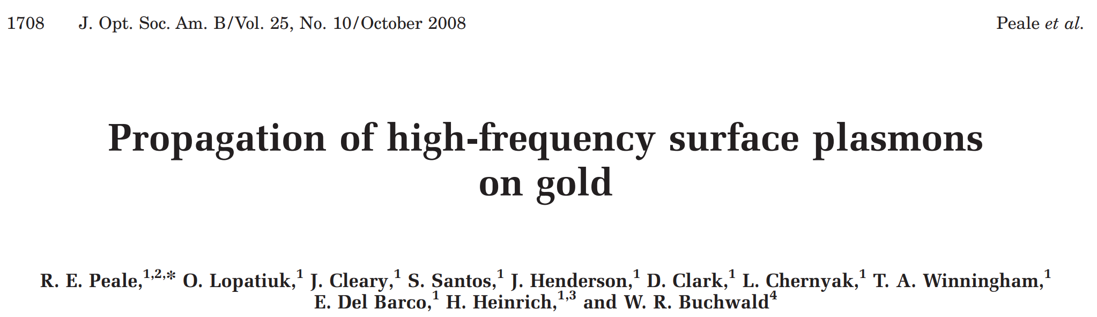
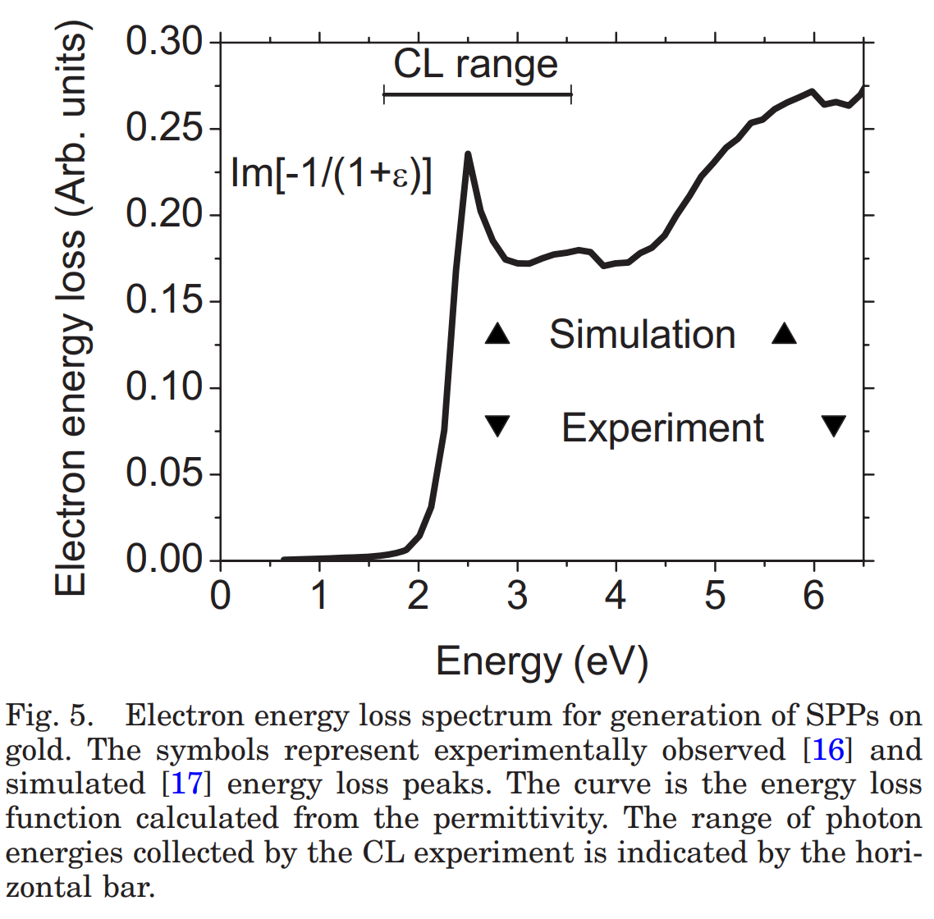
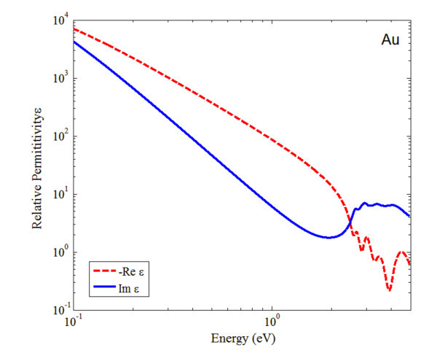


Slide 7
The macroscopic view of ionization loss is that the medium is polarized by the particle, which constitutes an extraneous charge

Slide 8



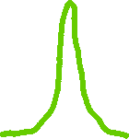
P
r - vt
r
O
vt
e
The characteristic duration of the interaction between the fast particle and electrons in the crystal is r/v.
Spectral resolution of field at r (its temporal Fourier expansion) is dominated by frequencies v/r.
Magnitude of the E-field at r
Cos[2π (v/r) t]
Terms in the expansion of E(t) with much different ω have small amplitude.

Slide 9














Ionization is caused by spectral components with ω ≥ ω₀, where ω₀ is the mean resonant frequency for electrons in the atoms of the crystal.
If r_{min} is the minimum distance to cause an ionization, then we need
If r_{min} >> a (size of atom and interatomic distance), then the particle interacts with many atoms at once, which allows a macroscopic electrodynamics description.
For solids and liquids we need v/ω₀ >> a, or v >> a ω₀ = velocity of atomic electrons.
For macro ED description of energy loss via ionization, extraneous particle must be much faster that the speed of electrons in the atoms.

Slide 10


Field of extraneous charge is given by Poisson’s Eqn.
Permittivity is an integral operator because D(t) depends on prior history of E(t).

Slide 11

Spatial Fourier expansion of potential

Slide 12







Poisson equation
Coefficient in spatial Fourier expansion
Now consider only given frequencies in the temporal Fourier expansion
From

Slide 13
Fourier components of the electric field

Slide 14









The energy lost by the extraneous particle equals the work done on it by the field at the particle, which is due to the polarization that it created.
General Fourier expansion
Field at the particle’s position r=vt is
The force on the particle is
Let the x-direction coincide with the particle’s velocity vector. The only component of k that survives the integration is k_{x}, since the field is axially symmetric.
The force on the particle is opposite to its motion.

Slide 15










For longitudinal component, let
For transverse components, let
Cylindrical coordinates

Slide 16



As ω →∞, ε(ω) → 1. That means the integral as written is log-divergent.
We should have subtracted the field that would be present if the particle was in vacuum: 1/ε → 1/ε – 1, because that doesn’t act on the particle. Then the integral converges.
The same integral is found by taking it over a finite range ω = {-Ω, Ω}, then taking the limit Ω → ∞.
Divide the integral into two parts corresponding to Re(1/ε) and Im(1/ε).
The first one is
(Ignoring the “-1” we just added above.)
(The “1” has the same property, so it doesn’t matter that we ignored it.)

Slide 17




The second part is
This integral converges because

Slide 18







= work done on the particle per unit path
= “Stopping Power” of the medium

Slide 19












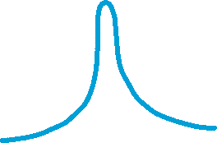




Slide 20

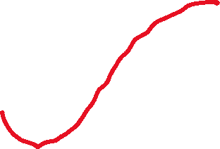





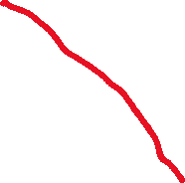
Atom in medium
For a given q, the impact parameter is ~ 1/q = characteristic transverse length of the field distribution
Fast particle
Spatial dependence of E_{y} at y = r is mainly given by cos(q y) with q = 1/r.

Slide 21







According to quantum mechanics, the k^{th} Fourier component of an electromagnetic wave imparts a momentum ħk to the electron it ionizes. (Absorbed photon momentum becomes ionized electron’s momentum.)
For small impact parameter, v/r is much greater than frequency ω₀ needed for ionization:
Atom in medium
Then momentum transfer ~ ħq (mostly in the transverse direction).
Requirements: = 1/q >> a
Fast particle
The upper integration limit q₀ has to satisfy ω₀/v < q₀ << 1/a.
F(q₀) = energy loss of fast particle due to all ionizations that transfer momentum less than ħq₀ to the ionized atomic electron.
Gives lower bound on the total stopping power.

Slide 22


Do the q integration
Range of frequencies in integral is 0 to infinity, but frequencies much above ω₀ don’t contribute much to the field and hence not to the ionization or the integral, and η” -> 0.

Slide 23




Slide 25


Slide 26

Define a weighted log mean frequency for motion of atomic electrons as

Slide 27


Stopping power on high energy particles is very small. Shoots up as particles slow down.

Slide 28
Range

