Slide 1
Spatial dispersion near an absorption line
LL8 section 106

Slide 5
Note: You cannot expand the Thomas Fermi permittivity about k = 0, because it is not valid at small k. The actual permittivity function can be expanded.

Slide 8


Slide 9


Slide 10








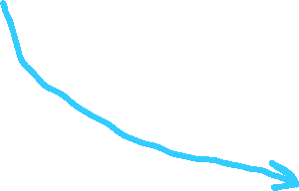





Slide 13




Slide 14

Polariton region shifted from 0.04 to 0.15 eV (closer to experiment).

Slide 15










Slide 16















Slide 17







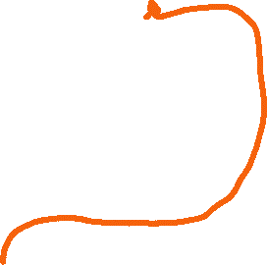




Slide 18



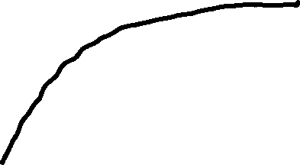
We only get an intersection because of dispersion:

