Slide 1
Spatial Dispersion
LL8 section 103

Slide 2
The dispersion of the permittivity was given in section 77 by
This was a local relation
Now we allow the medium to be anisotropic
The electric induction at a given point depended on the entire prior temporal history of the electric field at that same point in space.

Slide 3




More generally D(r) depends on E(r’) at other points r’ in the neighborhood of r.
Then
This relation is called “spatial” dispersion. The ordinary kind is called “time” or “frequency” dispersion
Double integral over all other points and all previous times

Slide 4
For monochromatic field components with time dependence e^{-iωt}

Slide 7




















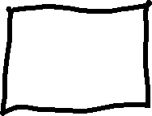

Slide 9


Slide 10


Slide 15






Slide 16








Slide 19


Slide 20
For large k, ε_{k}(k) would be small.

Slide 21



Slide 23


Slide 24









Slide 25




Slide 26
Problem 4

Slide 27
Problem 5
But group velocity is higher than c?

Slide 28

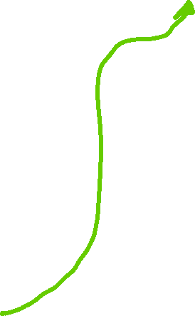
Laplace’s equation for a point extraneous charge.
Fourier series representation of delta function
Fourier series representation of potential due to extraneous charge

Slide 29
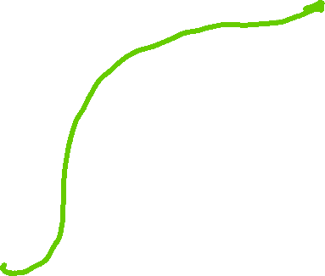

Fourier series representation of the total potential
Problem 6

