Slide 1
Scattering by free charges
LL2 section 78

Slide 2
Incident electromagnetic wave
System of charges
Scattered wave
Energy flux density S

Slide 3
Effective scattering cross section
Energy radiated by system into do per second
=
Poynting vector
Units
Energy per second
= area
Energy per area per second
Total scattering cross section

Slide 4
Consider a free charge at rest
Incident plane monochromatic linearly-polarized wave
Assume that the velocity acquired by e is v << c
The force on the charge is
Small. Neglect.

Slide 5
Neglect the effect of displacement.
Put the origin at the center of the charge’s vibrations.
The field acting on the charge is the same as that at the origin r = 0:

Slide 6
Equation of motion
Dipole moment
Dipole radiation formula is valid since v << c
The frequency of oscillations is the same as the driving frequency.
The frequencies of scattered and incident waves are the same.

Slide 8
Total cross section
using
=
Thomson formula

Slide 9
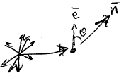
For unpolarized light, we need to average over all initial polarization directions.
Let e be a unit vector in the direction of E.

Slide 10
After averaging, we need a tensor with these properties that does not depend on e.
This is it:

Slide 12
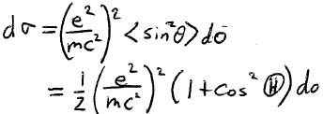
Maximum for forward and back scattering
Half as much for orthogonal scattering.
Because there is no radiation along the direction of the electron’s oscillation.

Slide 13
Scattering imparts a force on the electron
Average energy density in the incident wave = <W>
Average energy flux density (energy/area-time) = c <W>
Average energy lost to scattering per unit time = c <W> σ
Average momentum in the incident wave = <W> /c
Average momentum per unit time lost to scattering = <W> σ

Slide 14
Vibrations of charge driven by eE are usually small.
Velocities of charges are also small, v ~0.
Then total radiated momentum dP = 0 by (73.2).
All of the momentum lost by the incident wave is absrobed by the charge.
Average force on the charge
Second order in the field since W ~ E²
Direction of incident wave
Instantaneous force = eE is 1st order in the field.

Slide 15
Radiation damping force on the charge (75.10)

