Slide 1
The Lagrangian to terms of second order
LL2 section 65

Slide 2
In classical mechanics, interactions are instantaneous.
The Lagrangian depends on the coordinates and velocities evaluated at the same time for all particles in the system.
In relativistic mechanics, the velocity of propagation for interactions is finite.
The field must be considered as an independent system.
The Lagrangian for interaction of particles must include degrees of freedom for the field.

Slide 3
If v << c, we can obtain an approximate Lagrangian to order (v/c)².
Electromagnetic radiation from charged particles appears only in the next (3rd) approximations.

Slide 4
The exact relativistic Lagrangian for a given charge in the field of all the other charges
In the zeroth approximation (no powers of v/c), we have the classical Lagrangian, which is the sum of Lagrangians for each individual charge in the field of the other charges.

Slide 5
At the position of e_{a}, φ and A change due to the motion of all the other charges according to

Slide 6
If v << c for all charges, then ρ changes little during the time R/c.
Expand in powers of R/c.
In Taylor expansion, ∂/∂(R/c) = -∂/∂t
≈
is evaluated at R/c = 0, i.e. at the present time, i.e.
= total charge of the system = constant

Slide 7
The expression for A already contains 1/c, and it gets multiplied by 1/c again in the Lagrangian.
Keep only the first term in the expansion.
When these approximate forms of φ and A are substituted into the Lagrangian, we obtain an a approximate Lagrangian to second order in v/c.

Slide 8
We are trying to find the Lagrangian for one charge in the field of other charges zooming around not too fast. What is the field of one of those charges?
= |r – r₀(t)| is time dependent

Slide 9
Do a Gauge transform
with
These new potentials give the same E and H, but they don’t satisfy the Lorentz condition
or the inhomogeneous differential equation (62.2) for the potentials

Slide 10
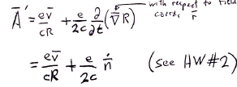
This gradient is with respect to the field point coordinates r.

Slide 11
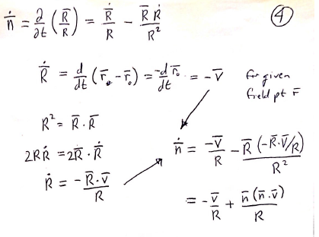

Slide 12
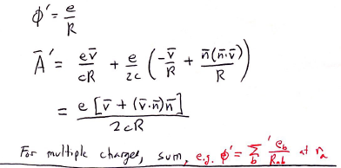
For multiple charges, make a sum, e.g.

Slide 13
Lagrangian for charge e_{a} in the field of other charges e_{b}.
≈

Slide 14
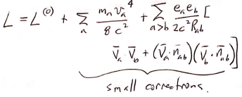
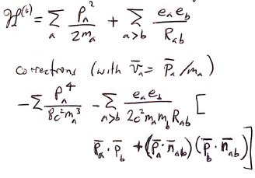
Hamiltonian for system of charges to second order in v/c.
From Mechanics (v. 1, Eq. 40.7), for small changes of L and H, the additions are equal in magnitude but opposite in sign.

