Slide 1
Frauenhofer diffraction
LL2 section 61

Slide 2
Plane parallel bundle of rays incident on a screen. (Far field).
Light propagation in directions other than the initial one.
What is the distribution over direction far beyond the screen?

Slide 3
Deviation angles can be assumed to be small.
The general diffraction formula is (59.2).
Take the limit that the source point Q and the field point P are infinitely far from the screen.
Then, unlike Fresnel diffraction, we have to integrate over the whole wave surface, not just the part nearest the screen.

Slide 4
It is easier to use a different approach.
Shadow region
Part of plane cross-section where u₀ is nonzero.
u₀ = constant over surface S if geometrical optics holds.
(Actual u is a little different.)
Any wave with limited cross section cannot be strictly plane.
Spatial Fourier expansion must include components with wave vectors having different directions.

Slide 5
Expand u₀ in a 2D Fourier integral over the transverse YZ plane.
{q} are constant wave vectors in the transverse YZ plane.
“(2π)²” because it’s a 2D expansion.
Extends only over the part of S where u₀ is nonzero.

Slide 6
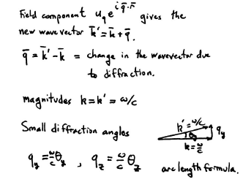
Let k = wavevector of the incident light.
= change in the wave vector due to diffraction.
Magnitudes
For small diffraction angles
Arc length formula

Slide 7
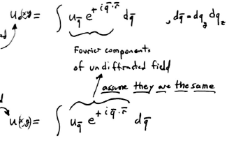
For small deviations from geometrical optics
Undiffracted field
Fourier components of the undiffracted field
Fourier components of the actual diffracted field
Actual diffracted field is only a little different
What would be the difference between u₀ and u if the Fourier components were actually the same?

Slide 8
Then
Gives the amount of light with different transverse wavevector components for the actual distribution.

Slide 9
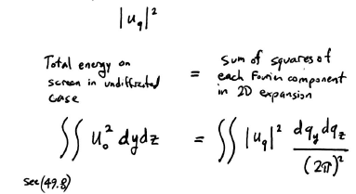
What is the distribution of intensity between all Fourier components of diffracted beam?
i.e. what is ?
Total energy incident on screen
Sum of all Fourier components of diffracted beam

Slide 10
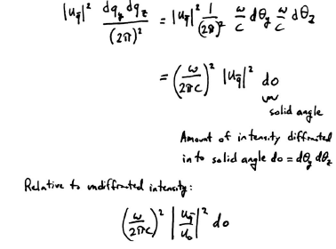
Amount of intensity with wave vector in the range q to q + dq is

Slide 11
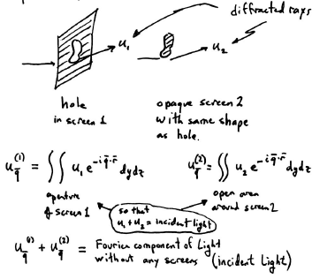
Complimentary screens

Slide 12
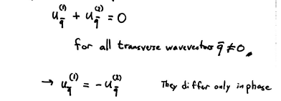
Incident light is a plane wave with definite propagation direction along X
Intensities
Complementary screens give the same distribution of intensity of the diffracted light.
Babinet’s principle.

Slide 13
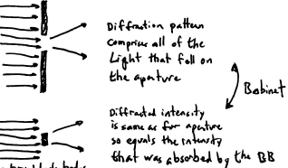
Screen with aperture
Complementary black body

