Slide 1
Fresnel diffraction
LL2 section 60

Slide 2
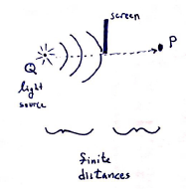

Slide 3
General diffraction formula
Only points on the wave surface that are close to the line between the source and P are important, since deviations from geometrical optics are small.
Area of integration.
Over sufficiently small areas, the edge of the screen is a straight line.

Slide 4
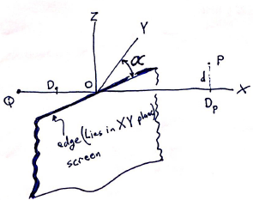
XY plane passes through the source Q and through the line at the edge of the screen.
XZ plane passes through Q and P.
Origin O is on the line of the edge of the screen.
Geometrical optics:
Light should pass only through points above the XY plane (Z>0).
The region Z<0 is in geometrical shadow.
Region of integration=
Half plan perpendicular to XY and passing through the edge.

Slide 5
The coordinates on the plane of integration are x,y,z.
x = y Tan z.
z > 0.

Slide 6
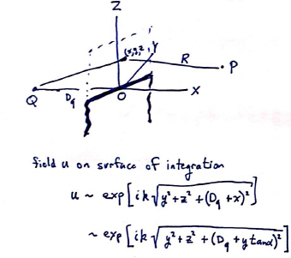
The field on the surface of integration is

Slide 7
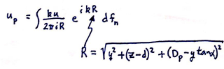
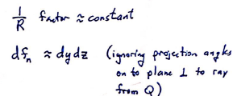
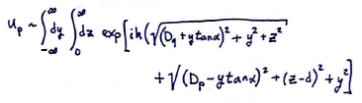
The field at P is
The exponential factors in the integral change rapidly and are most important, so
Then

Slide 8
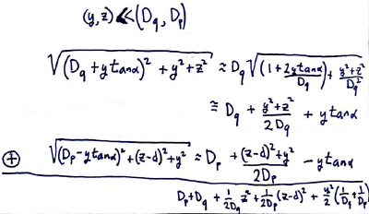
Light passing through P comes mainlyh from regions on the integration surface that are close to O, with

Slide 9
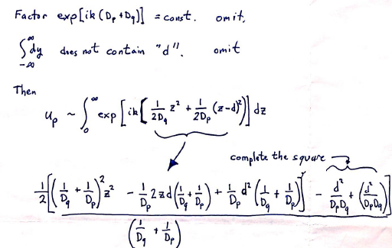

Slide 10
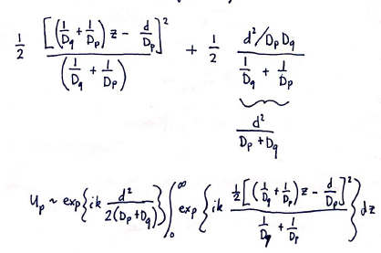

Slide 11
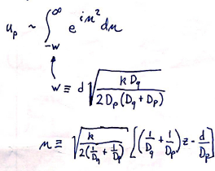
Light intensity is determined by |u_{p}|²
Complex exponential in front of integral goes away.
Change variables.

Slide 12
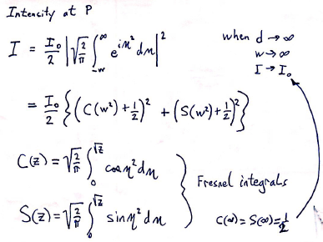

Slide 13
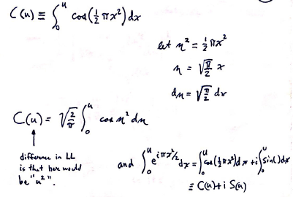

Slide 14
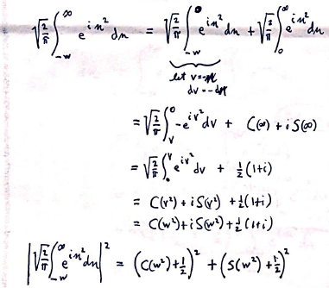

Slide 15
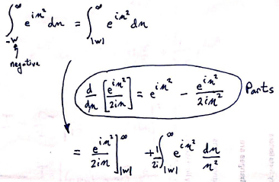
In the region of geometrical shadow, w<0.
Asymptotic form of I(w) for large negative w.

Slide 16
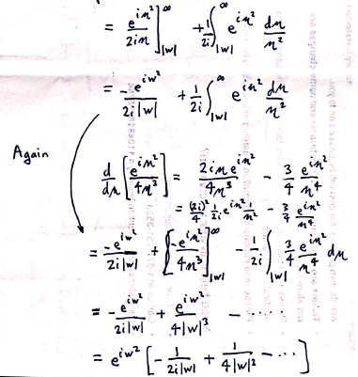

Slide 17
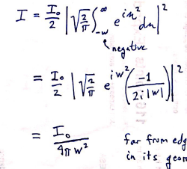
Keeping just the first term in the asymptotic series,
Far from the edge of the screen in its geometrical shadow.

Slide 18
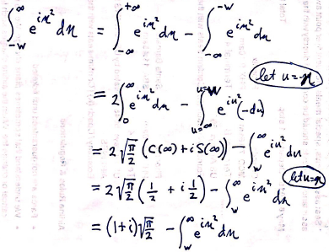
Positive w

Slide 19
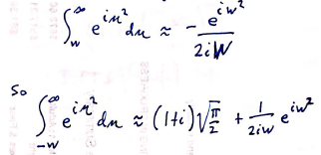
For sufficiently large w

Slide 20
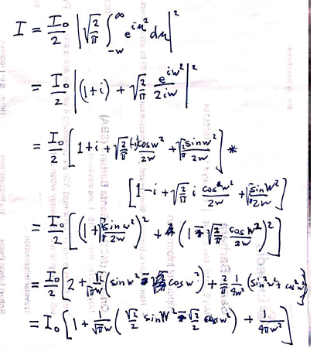

Slide 21
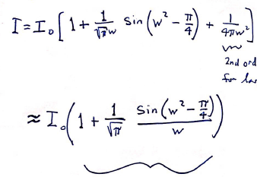
2nd order smallness for large w.
Oscillates about unity
Oscillations decrease as 1/w, inversely with distance from the edge of the geometric shadow.
Period of oscillations decreases as w.

Slide 22
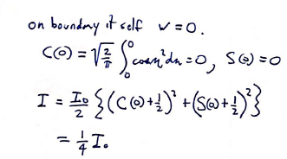

Slide 23
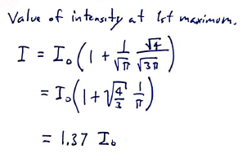
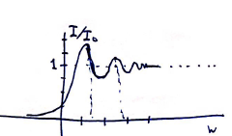

Slide 24
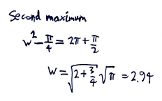
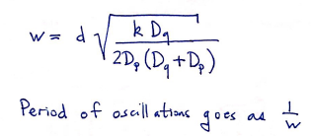

Slide 25
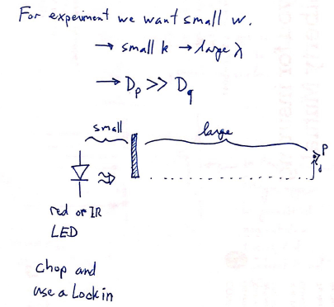
How can we try to observe and quantify Fresnel diffraction at home.

Slide 26
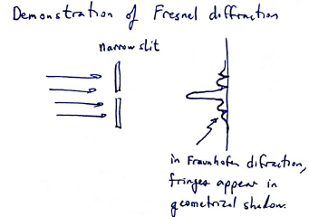
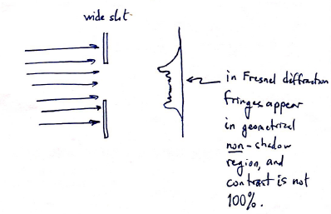
From an MIT YouTube video. The first example is Fraunhofer diffraction.
Notice for the Fresnel diffraction demo that the incoming light is a parallel beam, i.e. source at infinity. Is it really Fresnel diffraction?

Slide 27
