Slide 1
Diffraction
LL2 section 59

Slide 2
Geometrical optics holds in the limit λ → 0.
When λ ≈ dimensions of the screen, the pattern of light beyond the screen has a complicated distribution of light.

Slide 3
Conditions for an approximate solution:
λ << dimensions of all bodies and apertures
and
we consider only small deviations of the ray direction from those of geometrical optics.
Screen with aperture
Let u be one component of E or H, without the e^{-iωt} factor.
u = u(x,y,z)

Slide 4
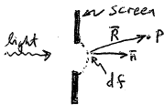
What is u at the observation point P?
Assume that at points of the aperture, the field is the same as it would have been in the absence of the screen.
At all points immediately behind the screen, the field is zero.

Slide 5
Introduce some surface that spans the aperture and is bounded by its edges.
Divide the surface in area elements df << size of the aperture, and df >>
Each df is a source of light waves spreading out on all sides. .
The field at P is the superposition of fields produced by all the df’s of the surface.
Huygens’ Principle.

Slide 6
The field at P due to df is proportional to the value of u at df.
The field at P due to df is proportional to the projection df_{n} of df on the plane perpendicular to the direction n of the ray coming from the source at df.
The same rays pass through df_{n} as passed through df, so the effect on the field at P is the same.
The field at P from df is proportional to u df_{n}.

Slide 7
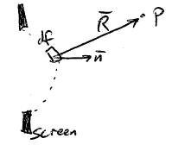
The amplitude and phase change by
during propagation from df to P.
k = 2π/λ = magnitude of the wavevector.
Thus the field at P due to the surface element df is
A complex constant, to be determined.

Slide 8
The superposition of the contributions from all the df’s gives the total field at P.
Integral is over any surface that spans the aperture.
Next we have to find the constant “a”.
For a plane wave propagating along X, the wave surfaces are parallel to the YZ plane.
u is constant on the YZ plane.
Choose P on the X axis, then u_{P} = u e^{ikx}

Slide 9
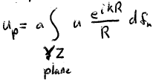
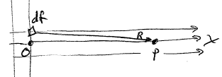
Alternatively
Yeah, all of it, even though the aperture is finite.
That is allowable because diffraction angles are small, so that deflected rays that arrive at P on the x axis cannot have come from points far off that axis.
Important region of integration is y,z << x. Then 1/R ~ 1/x, and in the phase

Slide 10
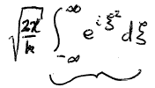
Then
Substitute in the first integral
And similarly in the second integral.
Each integral becomes

Slide 11
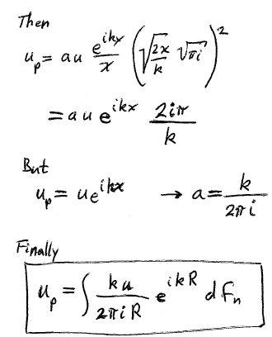

Slide 12
Diffraction theory determines the change in phase of a ray on passing through its point of tangency to the caustic.
Any wave surface
Choose XY & XZ planes to coincide with the principal planes of curvature at O.

Slide 13
Equation of surface near O: Parabolic in two directions with different curvatures.
Principle radii of curvature
X
R
P
x
Only a small part of the wave surface near O contributes field at P, y,z<<x.

Slide 14
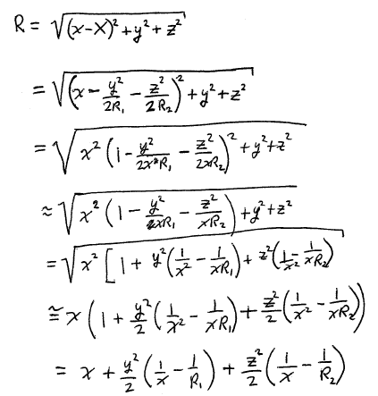

Slide 15
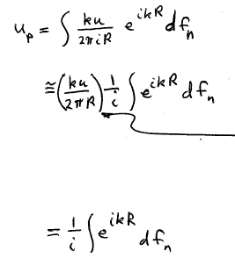
u is constant over the wave surface.
1/R is almost constant for all points on the wave surface that contribute significantly at P
Pull both u and 1/R out of the integral
An uninteresting constant if we care only about the phase. Drop it.
Keep this because i is a phase factor.

Slide 16
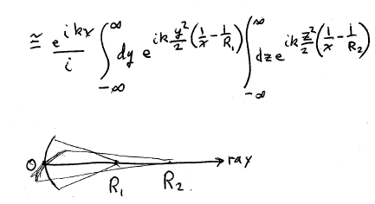
Now substitute the approximate expression for R into the complex exponential.

Slide 17
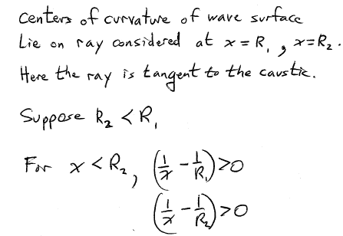

Slide 18
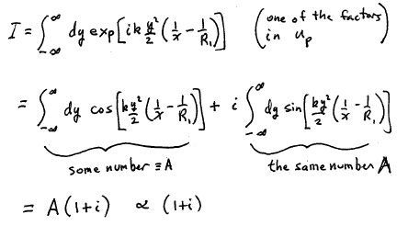
(See below)

Slide 19
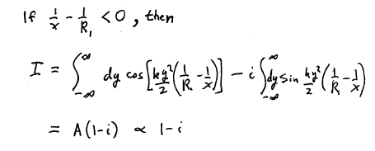

Slide 20
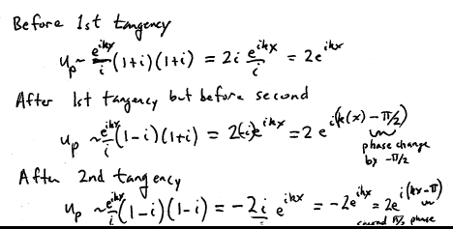

Slide 21
