Slide 1
Intensity
LL2 sec 54

Slide 3
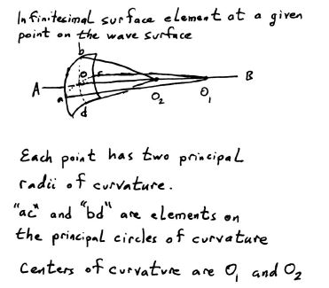

Slide 4
Questions:
Why just 2 principal radii?
Are ac and bd necessarily perpendicular?
Will it matter in the subsequent discussion?

Slide 5
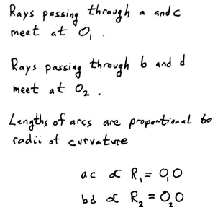

Slide 6
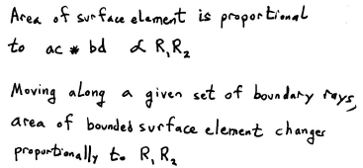
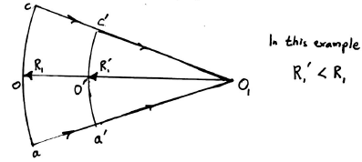

Slide 7
Intensity = energy flux density
~(surface area that given energy flows through)⁻¹
Gives change in intensity along a given ray as a function of distances from definite points on this ray
This formula cannot be used to compare intensity at different points on the same single surface.
The formula applies to points of intersection for a given ray passing through different wave surfaces

Slide 8
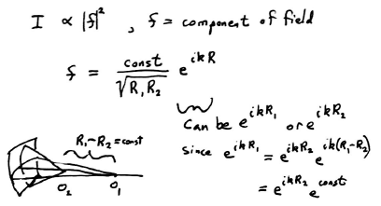

Slide 9
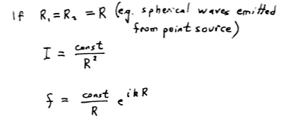

Slide 10
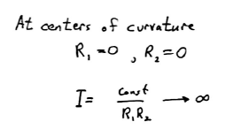

Slide 11
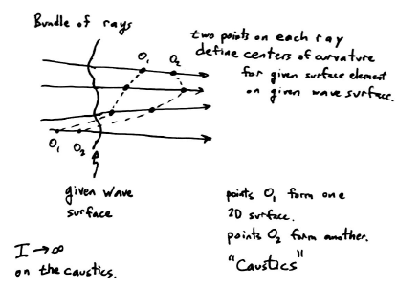

Slide 12
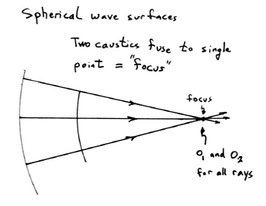

Slide 13
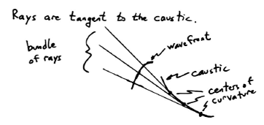

Slide 14
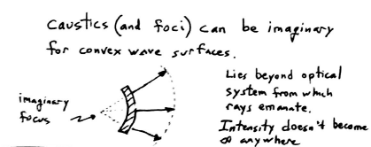

Slide 16
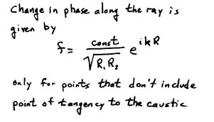

Slide 17
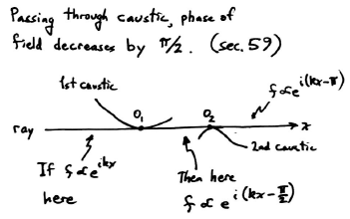

Slide 19
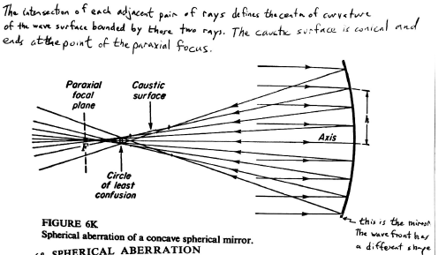
Question: Is wave surface spherical?

Slide 20
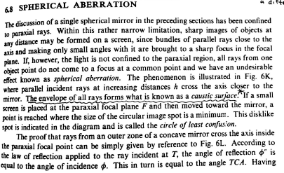
Assignment: Present this.

Slide 21
