Slide 1
Geometrical Optics
LL2 Section 53

Slide 2
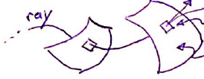
Arbitrary electromagnetic wave
Curve whose tangent at each point corresponds to propagation direction
Local propagation vector is perpendicular to wave surface
Looks like a plane wave if amplitude and direction are ~constant over distances of at least a wavelength
Wave surfaces: phase of the wave is the same on each such surface

Slide 3
Question
What defines a wavesurface?

Slide 4
Geometrical optics holds in limit λ 0, when propagation of rays is divorced from wave properties
Let f be any field component of the wave.
For plane monochromatic wave
constant

Slide 5
In general case, let f = a e^{iψ}
The phase ψ is called the “eikonal”
If the wave is not a plane wave, then a = a(r,t), i.e. not constant, and ψ ≠ -k_{i}x^{i} + α.
ψ changes by 2π when we move through one wavelength.
Since λ → 0 for geometrical optics, ψ must be large.

Slide 6
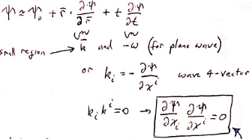
Choose an origin in 4-space. Near the origin, r and t are small.
Expand eikonal in powers of coordinates
As in any small region, wave looks like a plane wave, so
k=ωn/c (48.14)
Eikonal equation: Fundamental equation of geometrical optics
This equation determines the eikonal near the origin where the wave-surface is nearly a plane. Since you can put the origin wherever you want, this is the equation that defines the eikonal at any point.

Slide 7
Questions
What is the 4D wavevector k^{i}?
Why does its square equal zero?

Slide 8
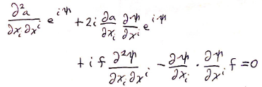
The 4D wave equation is
Substitute f = a e^{iψ}
The last term is 2nd order in the large quantity ψ.
All other terms are relatively small.
Again we get the eikonal equation.

Slide 9
Question
What does 4D wave equation become when written in 3D?

Slide 10
The Hamilton-Jacobi equation for a particle in given EM-fields involves first partial derivatives of the action S and is second order in S
(16.11)
For a free particle and
Compare these to and

Slide 11
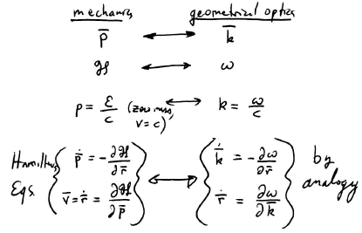
Propagation of particles Propagation of rays

Slide 12
Question
Why might k and r for a ray have time derivatives?

Slide 13
In vacuum
Rays are straight lines, and propagation speed is c
The wavevector is constant

Slide 14
A wavepacket is a superposition of monchromatic waves with a small range of frequencies that occupies a finite region of space
(48.15)
For each monochromatic component
Replace k^{i} by average values for the wavepacket
Compare
4-momentum for massless particle
Wavepacket average energy and momentum transform like frequency and wavevector

Slide 15
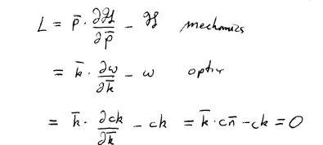
A Lagrangian for rays doesn’t exist

Slide 16
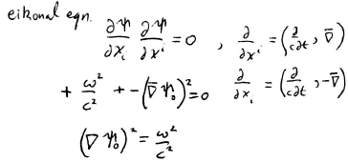
Time dependence for a wave with definite constant frequency is given by e^{-iωt}
If
Then eikonal must be
= constant

Slide 17
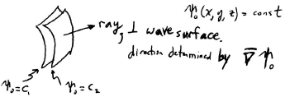
If ω is definite and constant, then wave surfaces are surfaces of constant ψ₀
Space part of f = a e^{iψ} must be constant
Then

Slide 18
When energy is constant,
Hamilton’s principle becomes Maupertius’s principle in mechanics
Integral is over the trajectory of a particle between two points, where

Slide 19
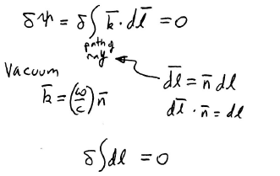
In optics, Maupertius’s principle becomes Fermat’s principle
Ray seeks the minimum path
Minimum path between two points is a straight line.
Fermat’s principle gives rectilinear propagation of rays in vacuum

