Slide 1
Characteristic vibrations of the field.
LL2 section 52

Slide 2
Suppose electromagnetic fields only, no charges, finite volume V = A x B x C
Fields can be expanded in triple Fourier series in x,y, and z
Vector potential
A(r,t) = A(t) Exp[i k . r)] (real)
Boundary conditions:
An integral number of waves fits between walls of box in each direction
, etc. With n_{i} = positive or negative integer
So that

Slide 3
The condition that A is real means that ± k pairs in sum must satisfy

Slide 4
We have freedom to choose gauge: Coulomb Gauge
Complex coefficients A_{k} are perpendicular to the wavevectors k.

Slide 5
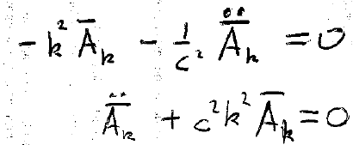
Substitute the expansion of A for waves in a box into the wave equation A = 0 (46.7)
Differential equation for coefficients A_{k}(t)
Simple harmonic oscillator equation:
A_{k}(t) are harmonic functions of time.

Slide 6
For large volumes,
is very close to its adjacent value
Since the n_{x} differ by unity, the number of possible values of k_{x} within Δk_{x} is the number of possible values taken by n_{x}, namely
The total number of values for k within the intervals Δk_{x}, Δk_{y}, and Δk_{z} is
Δn = Δn_{x} Δn_{y} Δn_{z}

Slide 7
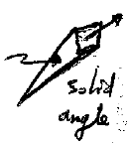
How many of those values of k in Δk are in a specific direction?
Δo
Spherical coordinates

Slide 8
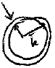
How many modes with wavevector magnitude k are within Δk (all directions)?

Slide 9
Total energy of fields

Slide 10
How to calculate squares of field magnitudes
All terms except those with k’ = - k vanish on integration due to the Exp[i(k + k’).r] oscillating factors. All r dependence disappears.

Slide 12
It’s also useful to simplify the cross products but not the time derivatives in ε

Slide 13
The expansion can represent standing or running waves, depending on the choice of the harmonic coefficients A_{k}.
For running waves:
with a_{k} ~ exp[-i ω_{k} t], ω_{k} = ck.
Then each term in the sum is a function of k.r – ω_{k}t,
and each is a wave propagating in the direction of k.

Slide 14
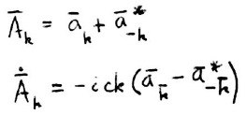
Since sum is over both signs of k, we can change the sign of k in the second term without changing the sum.
But we started with
Therefore
and
(terms a_{k}.a_{-k} and a_{k} *.a_{-k}* appear twice with opposite sign)

Slide 15
Since sum is over both signs of k, we can change the sign of k in the second term without changing the sum.
The total energy of the field is the sum of the energies of individual plane waves.

Slide 16
Total momentum of the field =
Momentum density, see section 32
Usual relation for momentum of plane wave
Homework
Unit vector in direction of k

Slide 17
Started with function expressed at every point in space in terms of continuous parameters x, y, and z.
Now we have same function expressed in terms of discrete variables k_{x}, k_{y}, and k_{z}.
(Simple periodic function known at every point of space)

Slide 18
Put field equations into canonical form by transforming the coefficients a_{k}
Define new coefficients
(discrete set of generalized coordinates and momenta)

Slide 19
Then the Hamiltonian (energy) of the field is expressed as
(HW)
Hamilton’s equations are the “equations of motion” for the field
This coincides with
which can therefor be considered a consequence of the equations of motion.

Slide 20
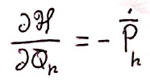
The other Hamilton’s equation
gives
This is the same differential equation satisfied by the A_{k}

Slide 21
Since A_{k} was perpendicular to k, a_{k} is too, and so are Q_{k} and P_{k} .
Therefore, Q_{k} and P_{k} each has 2 independent components giving the polarization of each traveling wave component k in the sum
Same for P_{k} ²
so
“Oscillator expansion”
Each independent term corresponds to one traveling wave of definite wavevector and polarization

Slide 22
Inverse relationships. (Look like raising and lowering operators!)

Slide 23
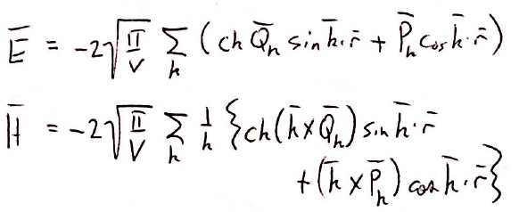
Homework

Slide 24
Assignments (10 minute white-board presentations)
Present the 3 derivations indicated in the slides.
Describe the quantization of EM field and how we get from waves to photons (see LL5 secs 2,3)

