Slide 1
Virial Theorem
LL2 Section 34

Slide 2
Trace of field part of energy momentum tensor vanishes

Slide 3
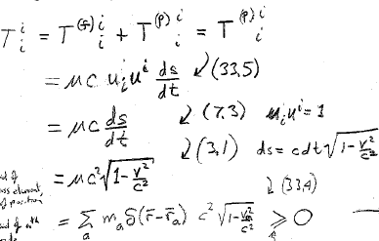
v = speed of given mass element, a function of position
Equality holds in vacuum
V_{a} = speed of a^{th} particle

Slide 4
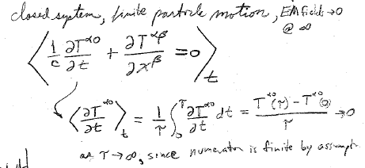
Closed system: finite particle motion, fields vanish at infinity.
Conservation law
Time average of space part
0
Since numerator is finite by assumption

Slide 5
So
For any α

Slide 6
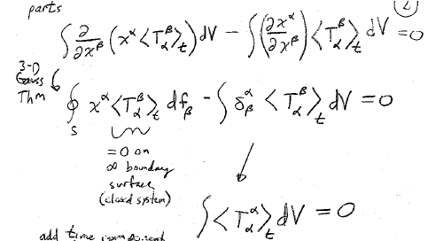
Integration by parts
3D Gauss theorem
=0 on boundary surface at infinity (closed system)

Slide 7
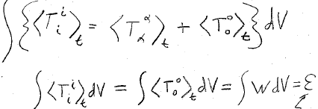
Add time component
Total energy of the system
including potential energy of Coulomb interaction

Slide 9
Relativistic virial theorem

Slide 10
Low velocity (using binomial theorem)
average kinetic energy = negative of (total energy – rest energy)
<T> = -(ε – ε₀)

Slide 11
Compare classical virial theorem for Coulomb interactions
<T> = -<U>/2 from LL1 Mechanics Section 10
ε = T + U = <T> + <U> = <T> - 2<T>
<T> = -ε

