Slide 1
Surface Impedance of Metals
Section 87

Slide 2
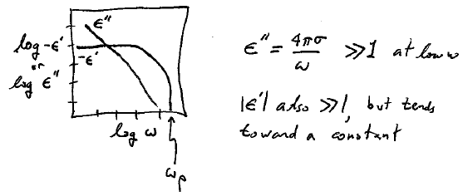

Slide 3
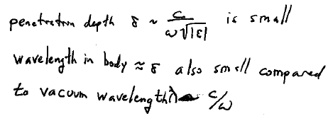

Slide 4
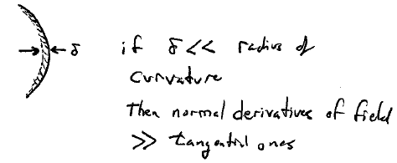

Slide 5
E = -(c/ωε) k x H
where
k = √(εμ)ω/c

Slide 6
Inside and near a metal surface

Slide 7
Since E_{t} and H_{t} are continuous at the surface, they are related by the same expression just outside

Slide 8
Surface impedance
At low ω

Slide 9
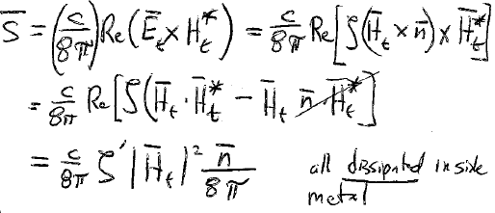
Time averaged energy flux through the metal surface

Slide 11
As frequency increases, penetration depth eventually becomes comparable to the electron mean free path.
The field is then too non-uniform to use the macroscopic description based on ε.
Fields don’t satisfy the macroscopic Maxwell equations in the metal

Slide 12
This is the only possible linear relation between the axial vector H and the polar vector E.

Slide 14
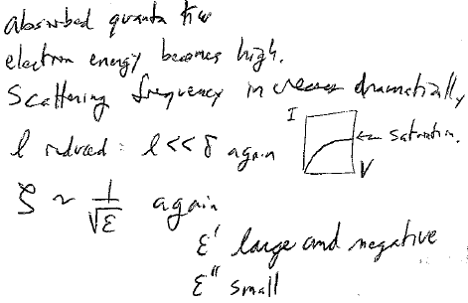
As frequency increases further…

Slide 15
Distance traveled by conduction electrons during one electromagnetic wave period
Then we can neglect the spatial inhomogeneity of the field relative to the electron motion

Slide 18
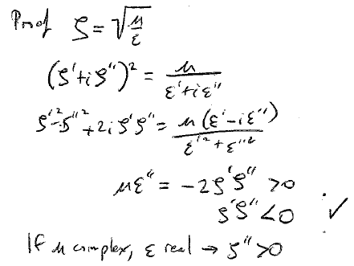

Slide 19
On the other hand…

Slide 20
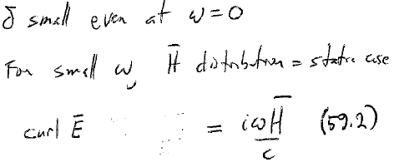
Superconductors

Slide 21
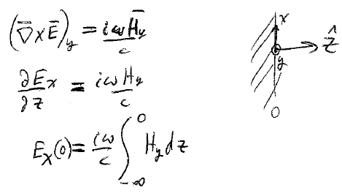

Slide 22
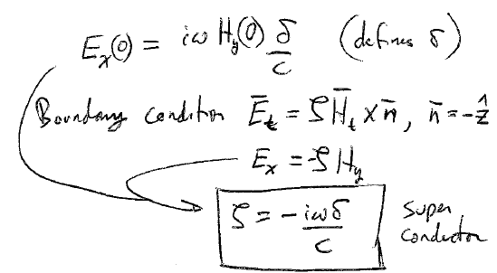

Slide 23
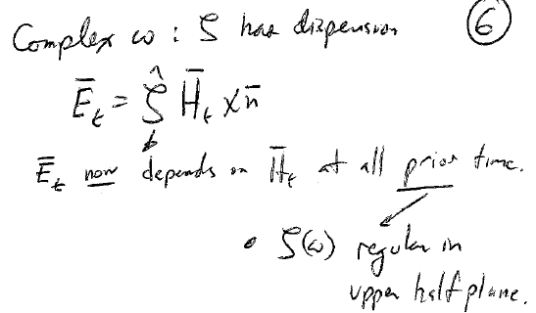

Slide 24
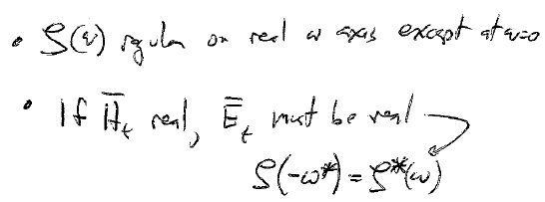

Slide 25
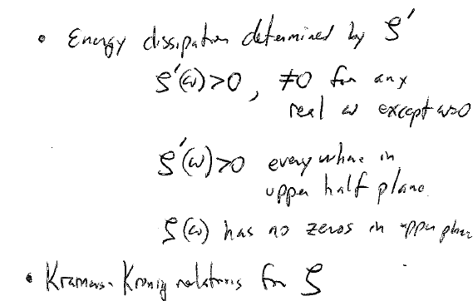

Slide 27
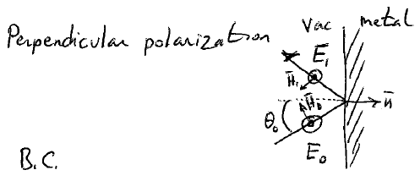

Slide 28
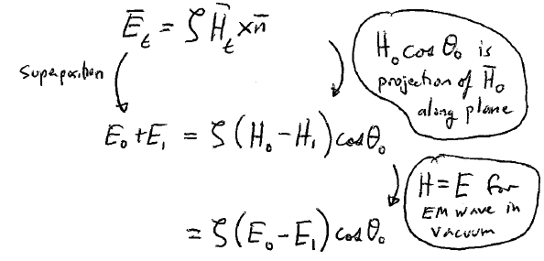

Slide 29
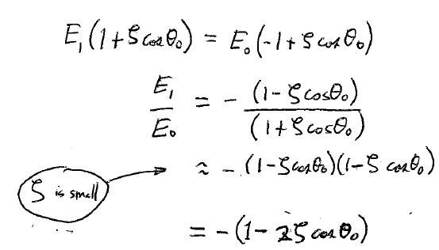

Slide 30
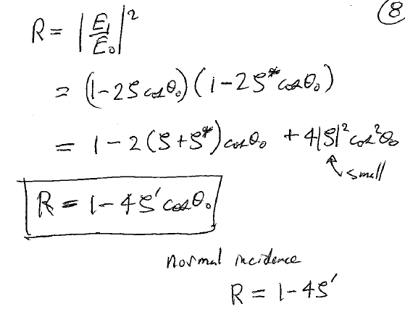

Slide 31
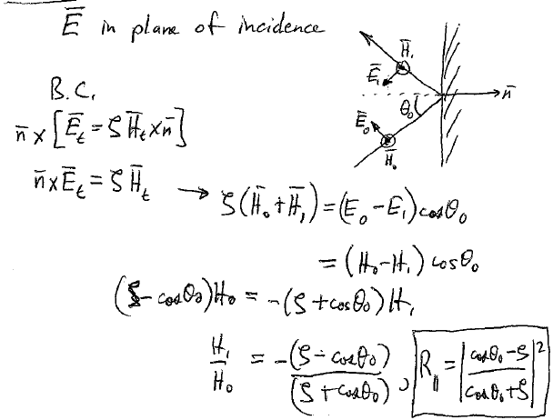

Slide 32
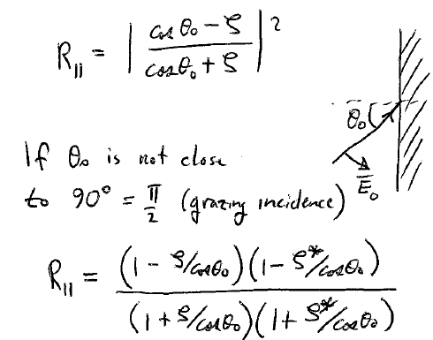

Slide 33
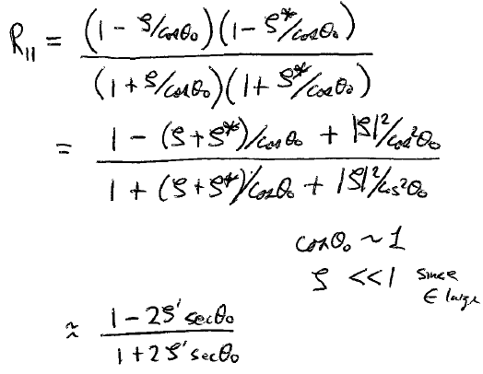

Slide 34
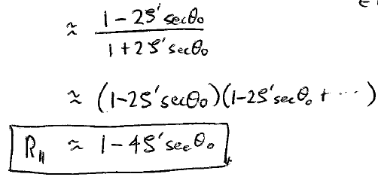

Slide 35
