Slide 1
The analytical properties of ε(ω)
Section 82

Slide 2
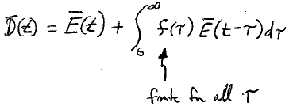
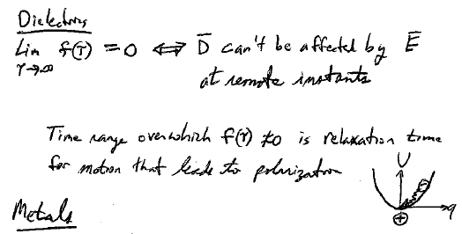


1. Function f(τ) is finite and tends to zero as τ goes to infinity in the past.
Finite for all times τ into the past
Dielectrics
D cannot be affected by what E was doing in the remote past.
The range of times over which f(τ) is significant is the relaxation time for the motion associated with the polarization

Slide 3
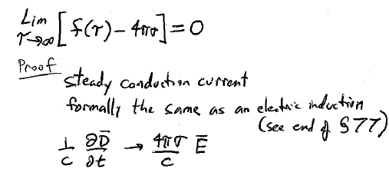
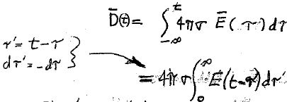






2. Conductors are different:
A steady conduction current is formally the same as a displacement current
(see end of section 77)
Integrate from infinite past to present.
Let
This apparent contribution to D appears if there is some conductivity, but steady current doesn’t lead to a polarization or give an actual contribution to D.
Then drop primes.
for dielectrics
The part of f due to steady current is 4πσ, which needs to be subtracted off, because it does not contribute to polarization
The part that gives rise to polarization doesn’t go infinitely far into the past, but the part that gives rise to conduction does. An oscillating field causes charge to flow back and forth at any time in the distant past, but this contributes nothing to the D(t) at the current time t.

Slide 4
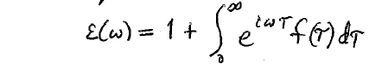
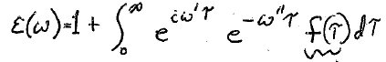
For periodic fields
Let’s consider ω to be complex to see what happens: ω = ω’ + i ω”
ε(ω) has no singularities in the upper half of the complex frequency plane, ω” > 0, since e^{-ω”τ} stays finite even as τ →∞, and since f(τ) is finite for 0 < τ < ∞.
Integral converges.
ω”
ω’

Slide 5
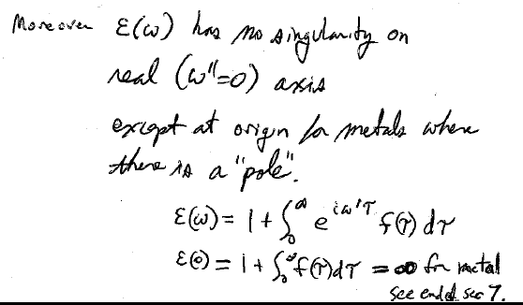

















ω”
For dielectrics, ε(ω) has no singularity on the real axis (where ω” = 0)
ω’
For conductors, there is a pole at the origin
= ∞
See end of sec. 7.
For DC E-field, mobile charge keeps going to the ends of the conductor, leading to large dipole moment, polarization, and induction.

Slide 6
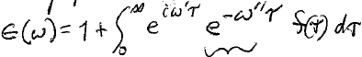






3. Formula is invalid on the lower half plane.
On lower half plane, ω”<0.
This blows up as τ goes to infinity, when ω” <0.
ω”
ω’

Slide 7

4. Regularity of ε(ω) in upper half plane is due to causality principle
Integral is taken from present to past, 0 < τ < ∞.
not from future to past, -∞ < τ < ∞.
Future times cause divergence in the upper half plane.

Slide 8
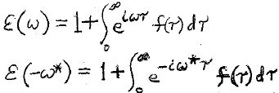



5. Generalization for complex ω of Eq. (77.7) ε(-ω) = ε*(ω) for real ω.
For purely imaginary ω, ω’ = 0 and ω = ω’ + i ω” = i ω”
On imaginary axis, the rule ε(-ω*) = ε*(ω) means
(remembering that ω” itself is a real number)
ε(i ω”) = ε*(i ω”)
In other words, permittivity is real on the imaginary frequency axis.
The positive part of this axis is the only part we have to worry about.
ω”
ω’

Slide 9
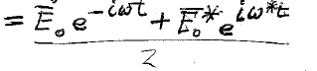
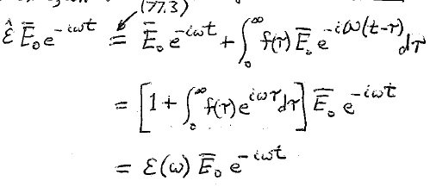
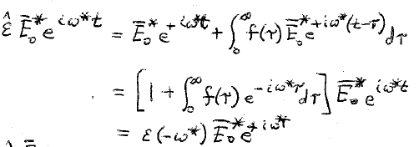
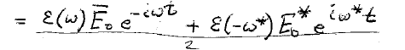






6. We can derive the rule ε(-ω*) = ε*(ω) a different way.
If E is real, D must be real.
Re[E(t)] = (E₀ e^{-iωt} + c.c.)/2
Get real D from Re[E] = (E + E*)/2
Combine both parts
For D to be real, we need
Thus, the rule ε(-ω*) = ε*(ω) is the condition for D to be real if E is real.
ε(ω) E₀ e^{-iωt} + ε*(ω) E₀* e^{iωt}
D =
2

Slide 10

7. Is there any finite frequency other than ω = 0 where ε” is exactly zero?
ε” is responsible for dissipation, so it has to be positive for all actual frequencies.
ε”(ω) > 0 for ω = ω’ > 0.
ω”
ω’
The rule ε(-ω*) = ε*(ω) means
ε’(-ω*) + i ε”(-ω*) = ε’(ω) - i ε”(ω)
Imaginary parts have to be equal
ε”(-ω*) = -ε”(ω)
ω”
On real axis ω = ω’
ε”(-ω’) = - ε”(ω’)
ω’
ε”(ω) < 0 for ω = ω’ < 0.

Slide 11








At ω = ω’ = 0, ε” changes sign.
It passes through zero for dielectrics
It passes from +∞ to -∞ for conductors.
Dielectric
Conductor
ω’=0 is the only point where ε”(ω’) can vanish on the real axis:
There is no dissipation for a DC field in a dielectric

Slide 12
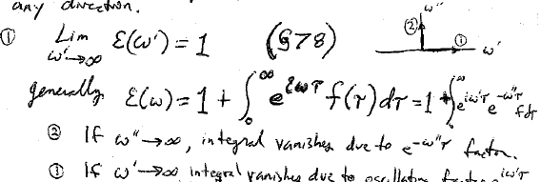

















8. ε(ω) tends to unity as frequency increases in any direction in the upper half of the complex ω plane.
Generally
integral vanishes due to e^{-ω”t} factor
integral vanishes due to oscillating e^{-iω’t} factor
ε” tends to zero at those infinite frequencies.

Slide 13


9. Theorem regarding permittivity on ω” axis.
We already showed that permittivity is real on the positive imaginary axis.
ω”
Theorem:
The only real ε(ω) values for any finite point in the upper half ω plane occur on the imaginary axis.
ε(ω”)
This real ε(ω”) value decreases monotonically from ε₀ > 1 for dielectrics, or from +∞ for metals, at ω = i ω” = i 0 to the value unity at ω = i ω” = i ∞.
Dielectric
Conductor
1
ω”
Corollary: ε(ω) has no zeros in the upper half plane of ω.

Slide 14
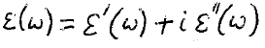
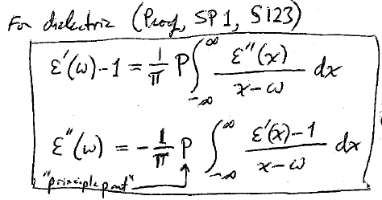










10. From the regularity of ε(ω) in the upper half ω plane, due to causality, we get the Kramers-Kronig relations
Kramers-Kronig relations: a consequence of causality.
Value: If we know one part at all frequencies, e.g. from experiment, we can find the other part at any one frequency.

Slide 15
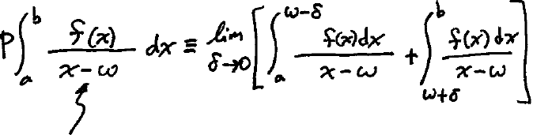
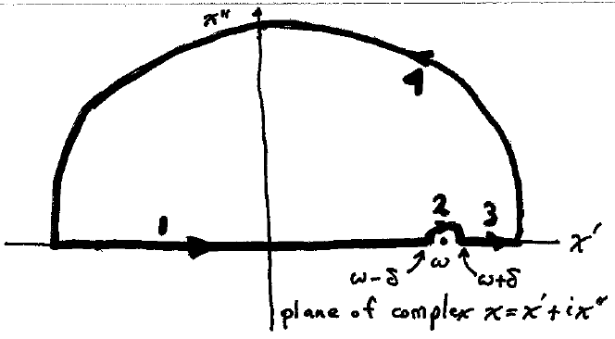




Mathematical interlude: Cauchy principal value
There is a pole at x = ω
Contour for Cauchy principal value integral

Slide 16
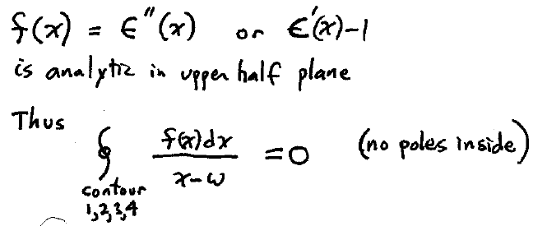








Second Cauchy Integral Theorem See Arfken section 6.4
or combination

Slide 17
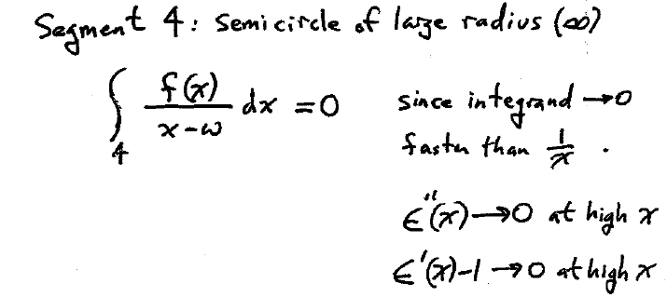


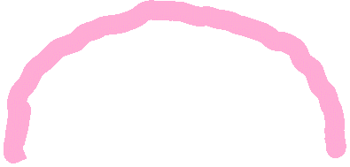


Look at each contribution to the contour integral

Slide 18
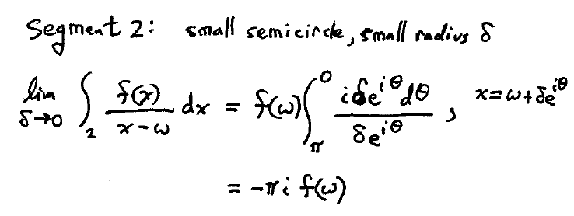









Slide 19
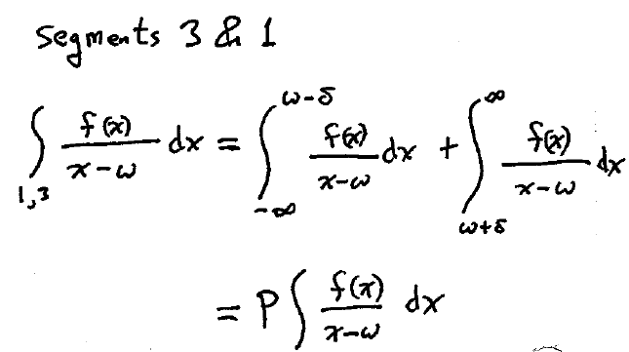




Slide 20
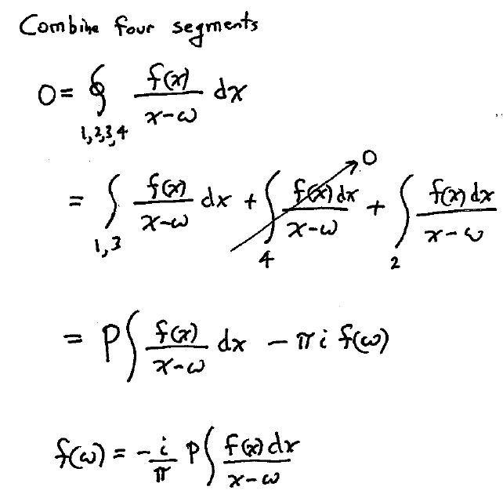



Slide 21
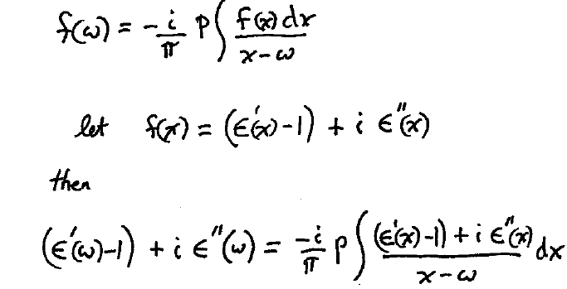


Slide 22
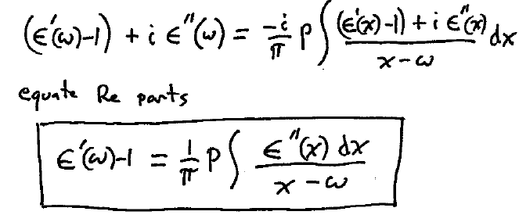
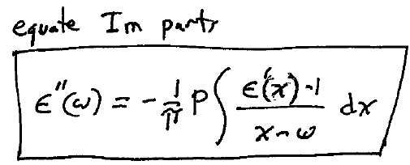




Kramers-Kronig

Slide 23
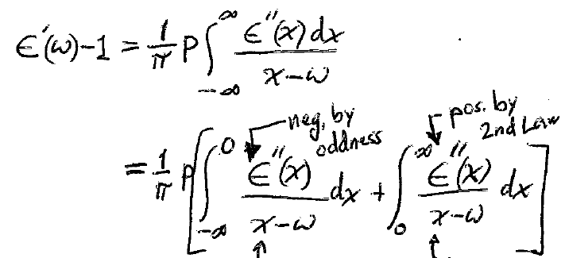
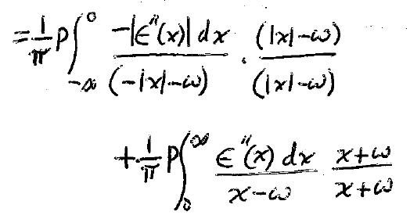
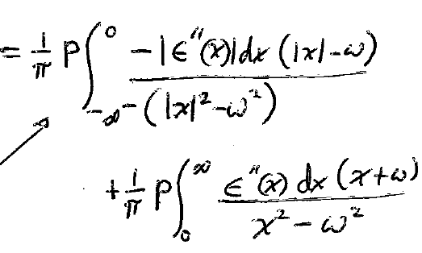


11. To use Kramers Kronig, we need them as integrals over only positive frequencies
(82.6)
Section 82, Problem 12. Derive (82.8) from (82.6)
Let x’ = -x, dx’ = -dx

Slide 24

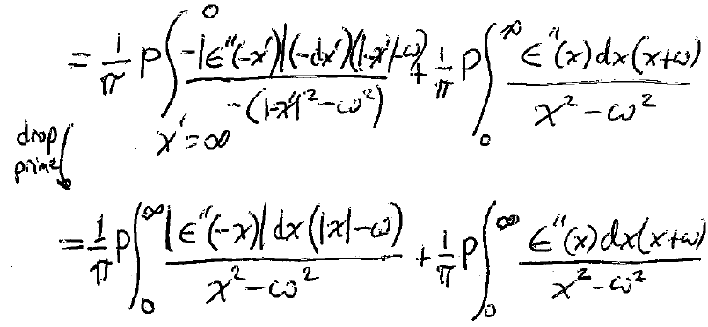
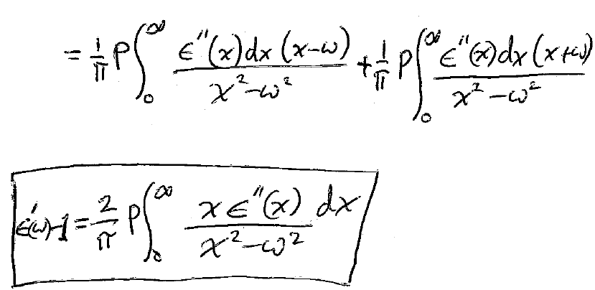

(82.8)

Slide 25
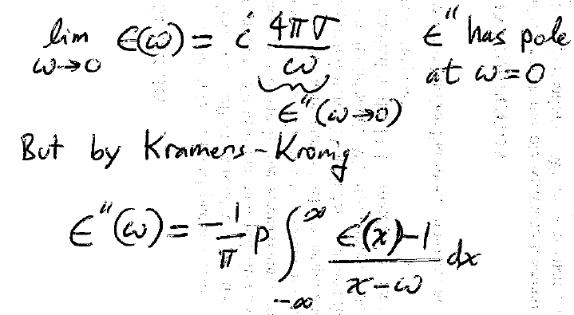
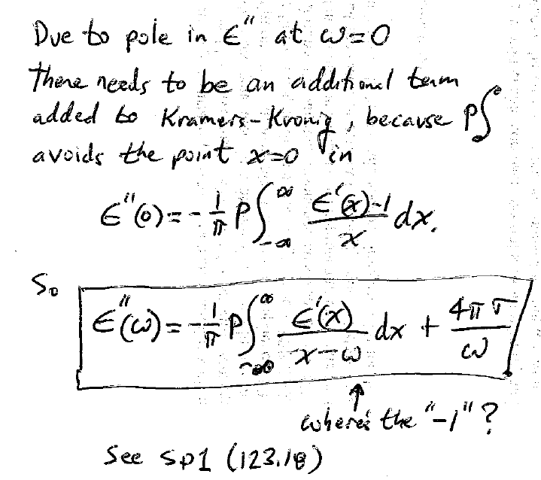
12. Metals

Slide 26
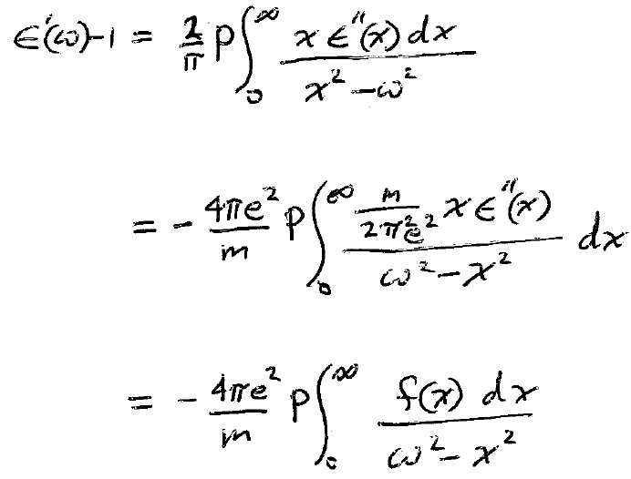
















13. Kramers-Kronig: ε’(ω) can be calculated if ε”(ω) is known at all frequencies, e.g. from experiment
Finding ε’’(ω) from experimental ε’(ω) is trickier, because experimental uncertainty may lead to unphysical negative values for ε”

Slide 27
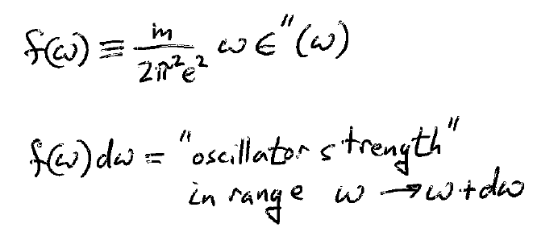
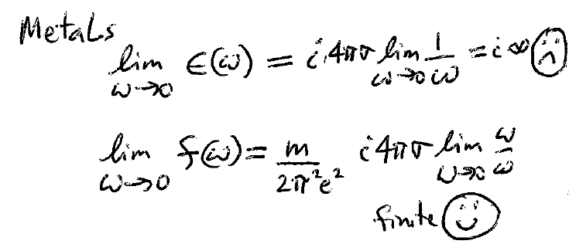








14. It’s customary to write the useful KK relation in terms of oscillator strength
There is an advantage for metals

Slide 28
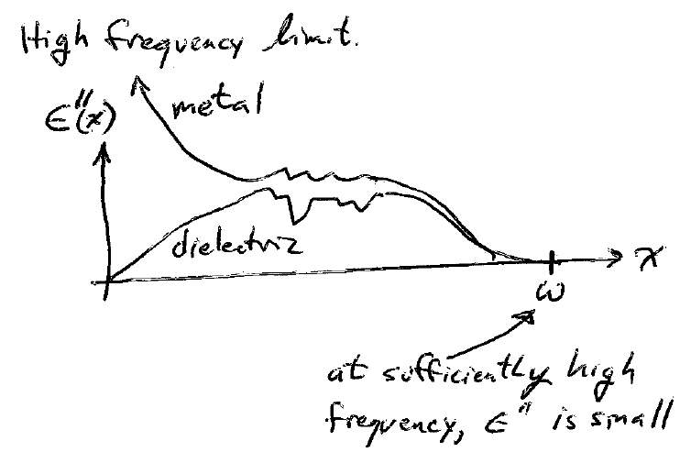
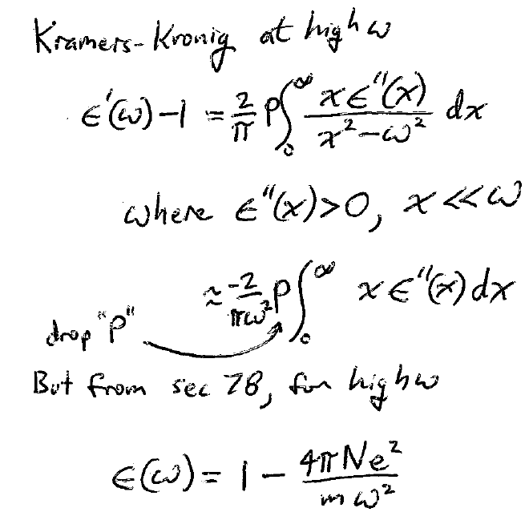


















15. Kramers-Kronig formula in limit of high frequencies gives sum rule
But the high frequency limit of permittivity is

Slide 29
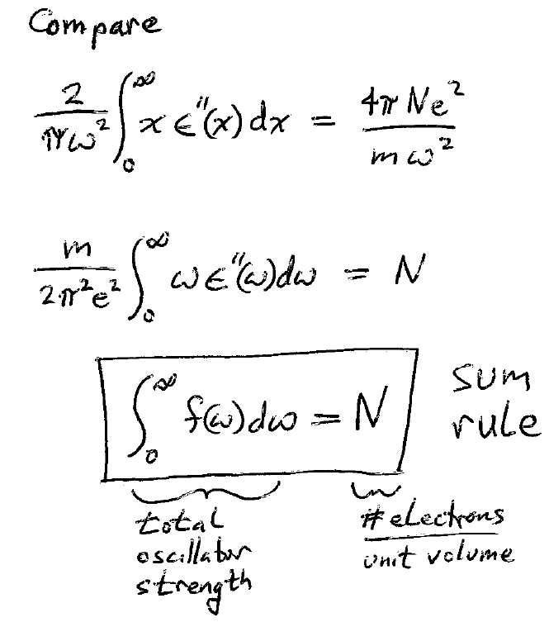



Slide 30
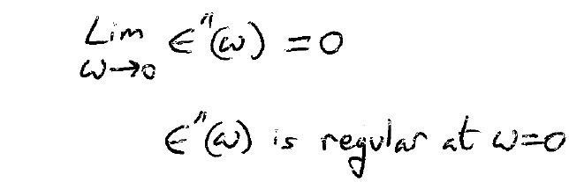
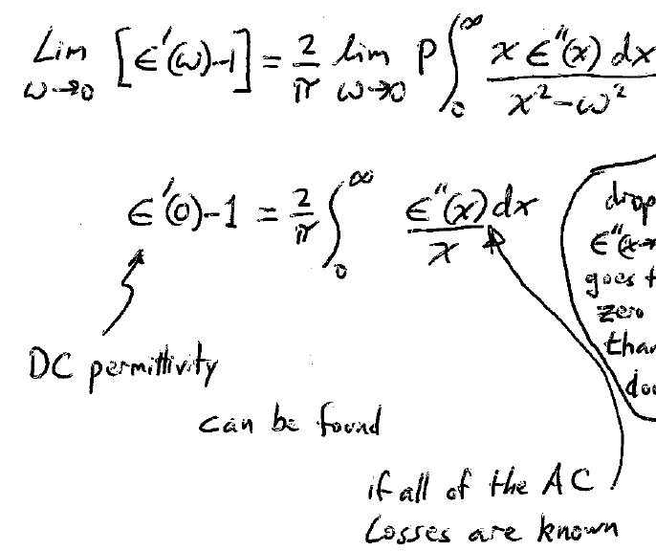



16. Dielectrics in low frequency limit
At low ω, ε” is proportional to ω, so integrand is finite. Drop P

Slide 31
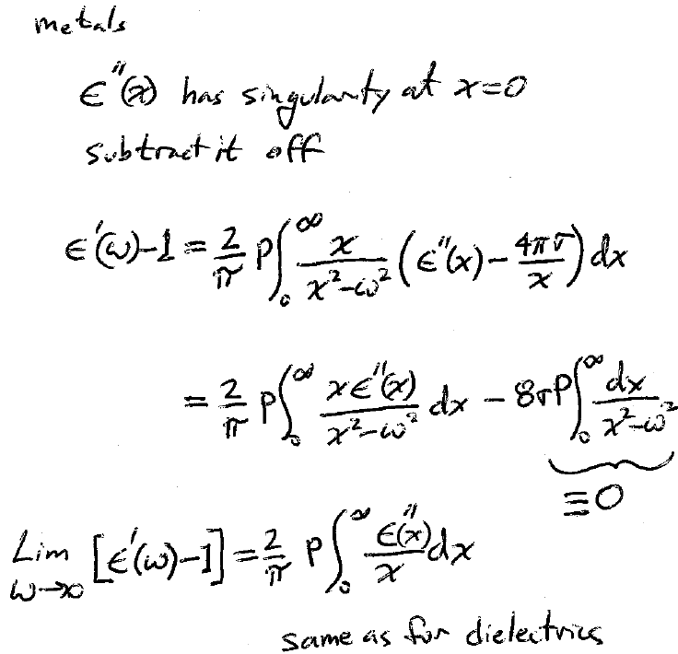


Slide 32
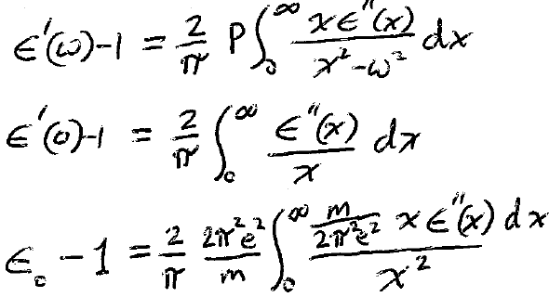
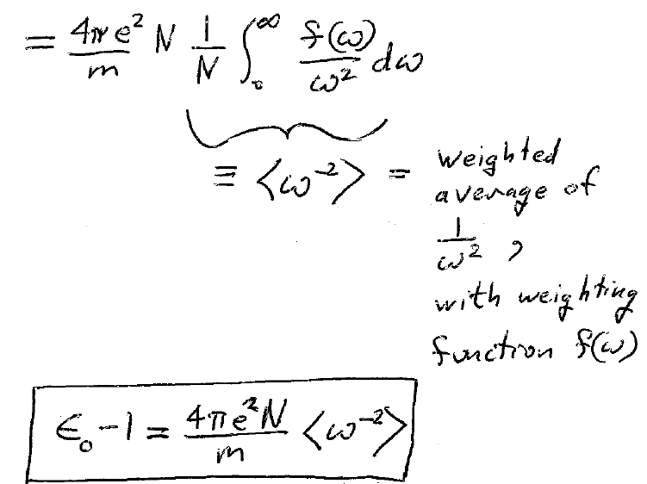
17. Another useful formula for the static dielectric constant

Slide 33
Last three paragraphs of section 82…

