Slide 1
Dielectric Ellipsoid
Section 8

Slide 2
Polarization of a conducting sphere in an external field was solved in Landau Problem 3.1. It is a classic undergrad problem that everyone must know.
Polarization of a dielectric sphere is another classic undergrad problem to know.
E=0

Slide 3
2. Dielectric sphere in a uniform external electric field
Field that would be without the sphere
Put the origin at the center of the sphere.
Potential of uniform external field
Change in potential caused by sphere
Potential outside the sphere
Same as the solution outside the conducting sphere (LL Problem 3.1), but constant A will be different due to different boundary conditions

Slide 4
Solution of Laplace’s Equation in spherical coordinates is of the form
There is no dependence on the azimuthal angle φ by symmetry
Blows up at infinity. Set a = 0.
The l = 0 term (const/r) doesn’t have the symmetry of the constant vector , the only parameter of the problem.
The l = 1 term is the first non-zero term.

Slide 5
3. Inside the sphere, the solution must be finite at the origin. Set b = 0.
The l = 0 term is just a constant. Ignore.
The l = 1 term is arCosθ
φ^{(i)} = -B E₀.r
Field inside = B E₀ , i.e. uniform

Slide 6
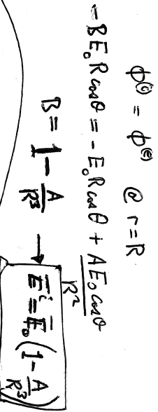
4. First boundary condition on potential is that it is continuous at boundary between two dielectrics.
There is still the undeterimined constant A to find. We need one more boundary condition.

Slide 7
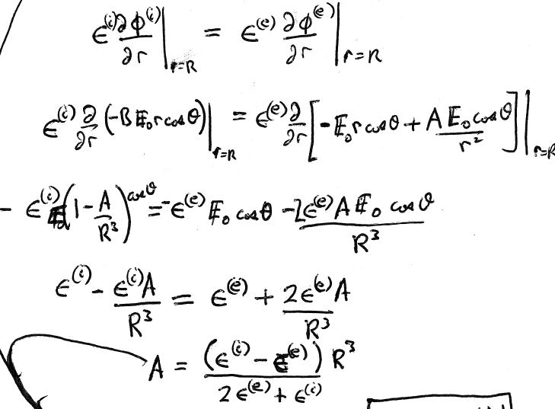
Second boundary condition is continuity of normal component of induction

Slide 8
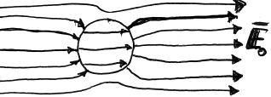
For a dielectric sphere in a uniform applied external field, the internal field is uniform
The sketch is for
E^{(e)} is similar to that of a conducting sphere in a uniform field.

Slide 9
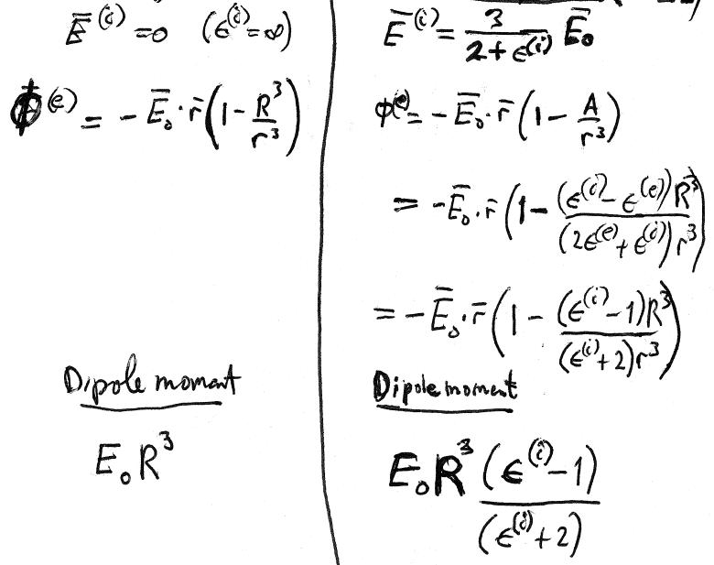
Conducting sphere
Dielectric sphere (ε^{(e)} = 1)

Slide 10
Other shapes to know

