Slide 1
Motion of a conductor in a magnetic field
Section 63

Slide 2
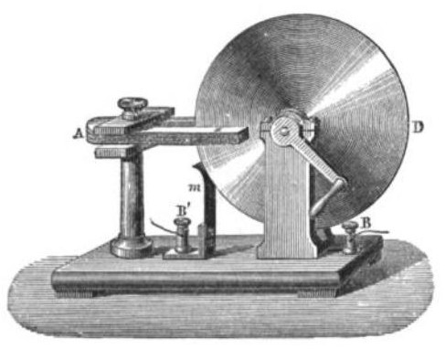
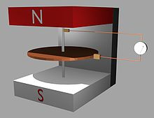
Faraday disk (1831)
Cu disk
Horseshoe magnet

Slide 3
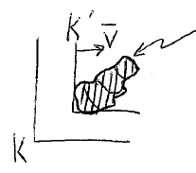






1. Ohm’s law j = σ E is valid at rest in the frame in which B and H are defined.
Charges moving in a B-field experience an additional force.
A conductor at rest in K’
E’ is the electric field in K’.
j = σE’ in K’.
Note that j is not transformed. Actually we mean j’ is almost the same as j.

Slide 4










3. Current is not transformed by motion of macroscopic conductors
= current 4-vector

Slide 5
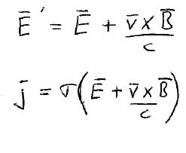




Lorentz transformation with v<<c (vol. 2 sec. 24)
Macroscopic conductors cannot travel nearly the speed of light
E, B are fields in K (lab frame)
= current in rest frame of conductor K’

Slide 6



Example of a motor
(v/c) x B is the correction to the electric field E that drives the current in the loop.
This is generally not small compared to E. The “correction” might be the only electric field in the loop.

Slide 7





4. Energy dissipation for given j cannot depend on conductor motion.
It is still given by j²/σ.
But
This is the effective electric field that produces the conduction current

Slide 8
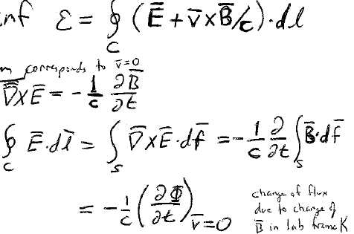



5. EMF due to “effective” electric field in a moving conductor
1st term corresponds to v = 0
Position of the contour unchanged
= Change of flux due to change in B-field in the lab frame K

Slide 9

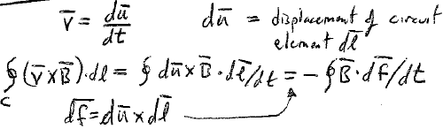






6. Second term in EMF is due to motion of circuit with given B (= const)
du = displacement of circuit element dl

Slide 10
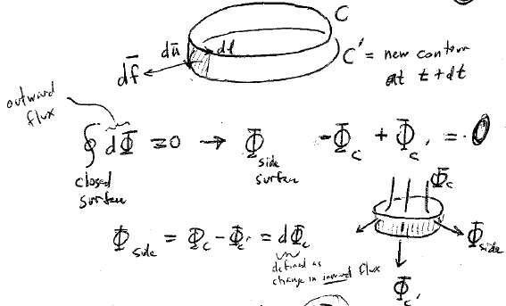

























= contour at t
new contour at t + dt
Outward flux
Change in flux through C due to motion of C

Slide 11
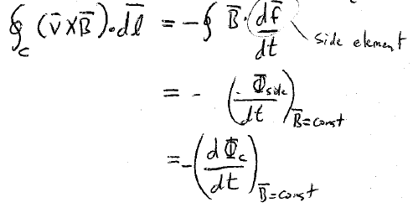








Slide 12
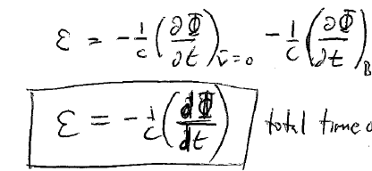










7. Add the two terms
= const
FARADAY’S LAW
Total time derivative

Slide 13


8. To induce an emf, the conductor must cross field lines.
Static magnetic field
In this case, any change in flux through the circuit could only be due to the motion of the circuit
If every point of the circuit moves along a field line, the flux through the side surface is zero, and the flux through the circuit is constant.

Slide 14
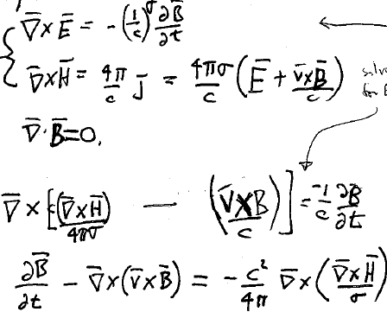






















9. Field equations for a moving conductor

Slide 15
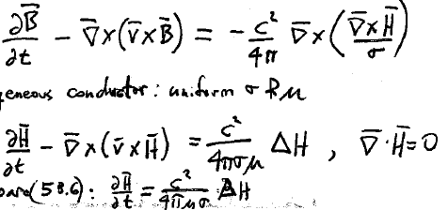





Assume a homogeneous conductor with uniform σ and μ
Compare with (58.6)
Motion of conductor gives new term to the quasistatic field equation

Slide 16
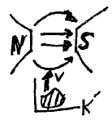



10. For a single conductor moving as a whole, without deformation, in an external H-field: problem “simplifies”
Choose coordinates fixed to the conductor.
External field then changes with time.
Becomes usual eddy current problem.
Electromagnetic induction is independent of the cause of the change in magnetic flux (Faraday’s law)

Slide 17
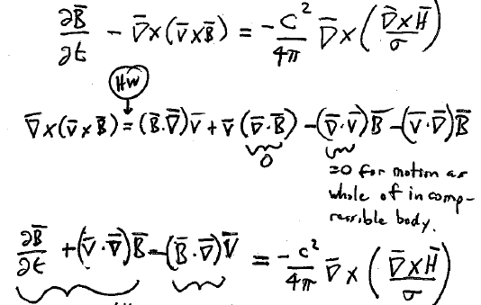














Equivalence proof
=0 for motion as a whole of an incompressible body
Time derivative of B w.r.t. axes fixed in a rotating body
“substantial” time derivative = rate of change of B at the point moving with v
Takes into account the change of direction of B relative to the body.
= 0 for uniform v (pure translation).
= -Ω x B for v = Ω x r (pure rotation)

Slide 18
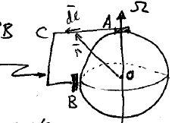






11. Unipolar induction
Sliding contacts A & B
Rotating magnetized conductor
Current flows in the wire
To find emf
Choose rotating coordinates fixed to the magnet
Then wire rotates with –Ω while magnet is at rest.
Then the conductor is moving at v in a given static field B due to the fixed magnet

Slide 19

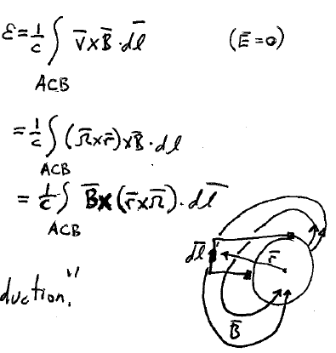









EMF =
Effective electric field of moving wire in static B-field
Unipolar induction

Slide 20
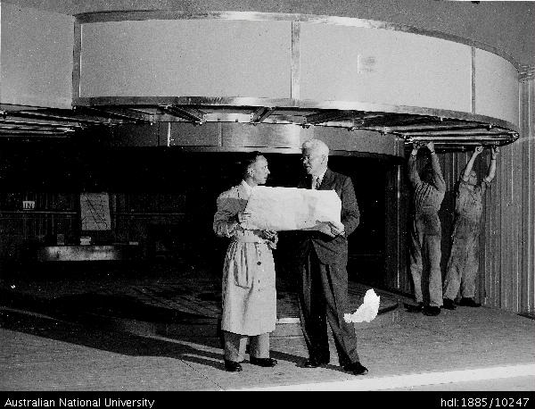
Professor Mark Oliphant discusses the specifications of the homopolar generator with his senior technical officer, Mr Jimmy Edwards

Slide 21
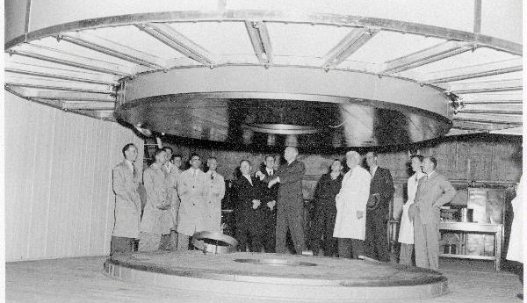
Homopolar generators underwent a renaissance in the 1950s as a source of pulsed power storage. These devices used heavy disks as a form of flywheel to store mechanical energy that could be quickly dumped into an experimental apparatus. An early example of this sort of device was built by Sir Mark Oliphant at the Research School of Physical Sciences and Engineering, Australian National University. It stored up to 500 megajoules of energy^{[3]} and was used as an extremely high-current source for synchrotron experimentation from 1962 until it was disassembled in 1986. Oliphant's construction was capable of supplying currents of up to 2 megaamperes (MA).

Slide 22
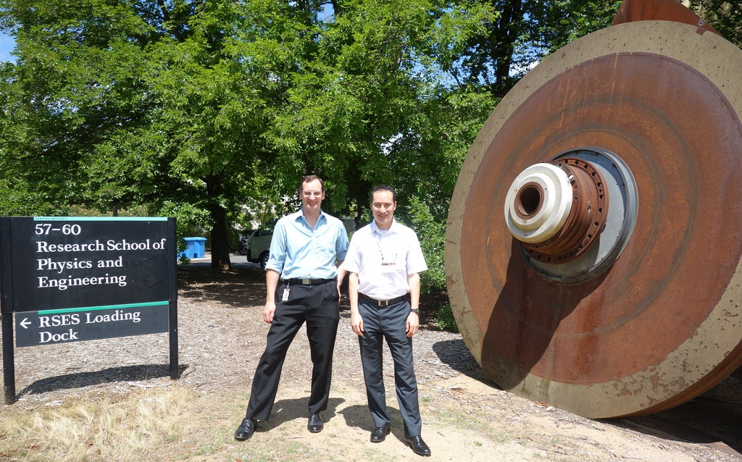
After the funding ends…

