Slide 1
Penetration depth of quasi-static H-field into a conductor
Section 59

Slide 2























1. A conductor in an external periodic magnetic field
Field as perturbed by conductor
Unperturbed field
The conductor is penetrated by the H-field, which induces a variable E-field, which causes “eddy” currents.
Penetration of field is determined by the thermal conduction equation
T propagates a distance ~
in time t
Thermometric conductivity

Slide 3
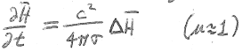












Since H satisfies the same heat conduction equation,
then H penetrates a conductor to a characteristic depth
In a time equal to a half period while H has a given polarity
Induced E and eddy currents penetrate to the same penetration depth, because

Slide 4
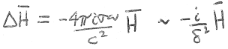
2. Periodic fields
A periodic field varies as Exp[-iωt]

Slide 5
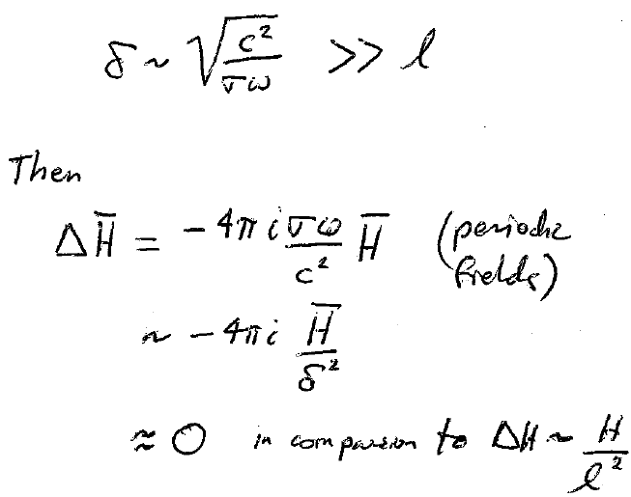
3. Two limits
  “low” frequencies
  “high” frequencies (still below THz)
Low frequency limit:
(Periodic fields)
This is the same equation as holds in the static case, when ω = 0.

Slide 6
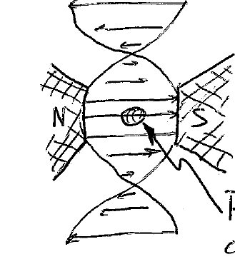



The solution to the static problem is H_{ST}(r), which is independent of ω.
The solution of the slow periodic problem is H_{ST}(r)Exp[-iωt], i.e. the field varies periodically in time at every point in the conductor with the same frequency and phase.
Low frequency recipe
Solve for the static H field
Multiply by Exp[-iωt]
Find E-field by Faraday’s law
Find j by Ohm’s law
H completely penetrates the conductor

Slide 7
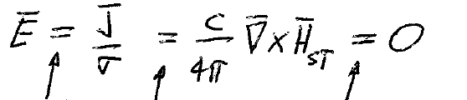





In zeroth approximation, E = 0 inside conductor
Ohm’s law
Maxwell’s equation
(29.7) for static H-field

Slide 8
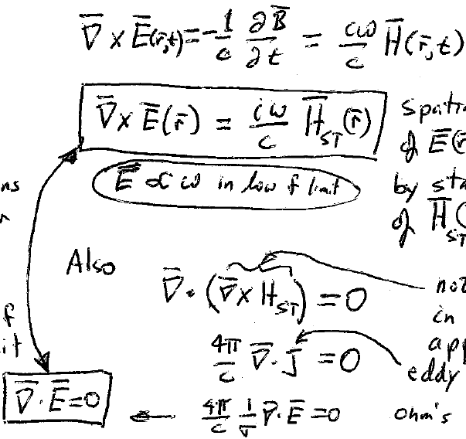




E-field and eddy currents appear inside the conductor in the next approximation
The spatial distribution of E(r) is determined by the distribution of the static solution H_{ST}(r)
Equations for E in the low frequency limit
E ~ ω in the low frequency limit
Not zero in the next approximation
Eddy currents
By Ohm’s law

Slide 9
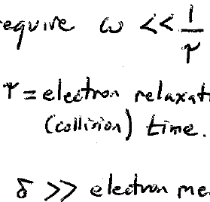





4. High frequency limit
We are still in the quasi-static approximation, which requires
= electron relaxation (collision) time
AND
>> electron mean free path
This means frequencies << THz.
This is far-infrared, or sub-mm waves

Slide 10
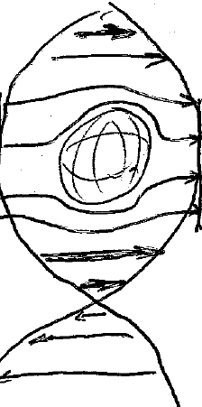
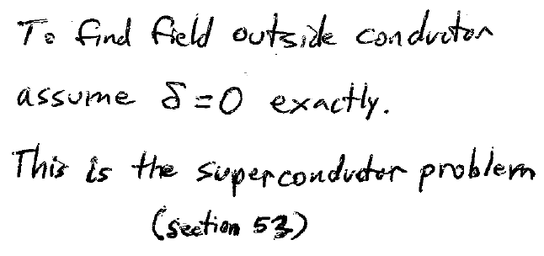









5. External high frequency field is the same as for a superconductor
In the high frequency limit
H penetrates only a thin outer layer of the conductor
To find the H field outside the conductor, assume exactly
This is the superconductor problem (section 53), where field outside a superconductor is determined by the condition B = 0 inside.

Slide 11
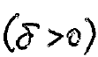
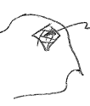
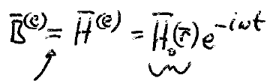






6. Method of finding high-frequency field in the surface layer
Then, to find the field inside the conductor
Consider small regions of the surface to be planes
To find the field that penetrates, we need to know it just outside, then use boundary conditions
H₀(r) is the solution to the superconductor problem
In vacuum, μ = 1
What is H₀(r) near the surface?

Slide 12
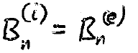


To find B^{(e)}(r), we assumed B^{(i)} = 0.
Since div(B) = 0 always,
The following boundary condition always applies
Just outside the conductor surface in the high frequency quasi-static case, B_{n}^{(e)} = 0.
Thus, H_{0,n} = 0, and
H₀(r) must be parallel to the surface.
Same boundary condition as for superconductor

Slide 13
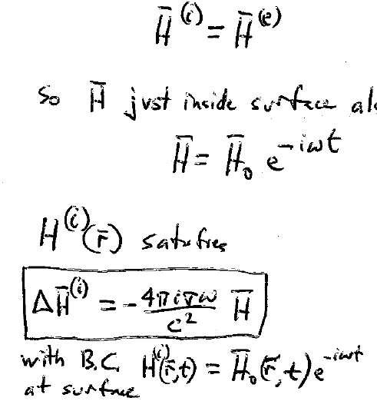




At high frequencies, μ ~ 1.
The boundary condition is then
So H on both sides of the surface is
(Parallel to the surface)

Slide 14
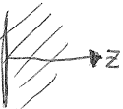


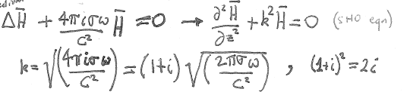




7. Formulas for internal high-frequency field and its penetration depth
A small section of the surface is considered plane, with translational invariance in x,y directions.
Then H = H(z,t)
= 0 (for homogeneous linear medium)
= 0
H_{z} does not change with z inside.
Since H_{z} = 0 at z = 0, H_{z} = 0 everywhere inside.
The equation satisfied by quasi-static H is

Slide 15


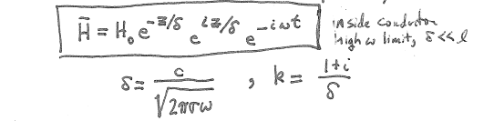











Possible solutions of SHO equation are oscillating functions.
This one decreases exponentially with z
This one diverges with z. Discard.
Inside conductor, high ω limit

Slide 16
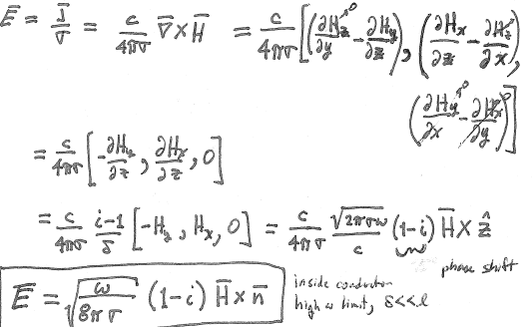

8. From H inside, we now find E-field inside (high frequency limit)
Phase shift

Slide 17
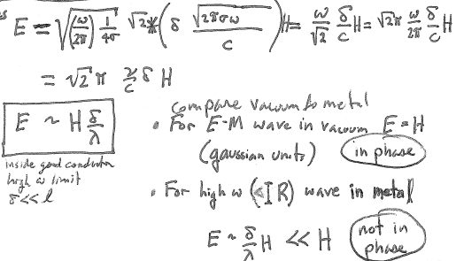




Magnitudes
Compare vacuum to metal
For electromagnetic wave in vacuum
  E = H (Gaussian units)
  E and H are in phase
For high frequency quasi-static limit in metal
Not in phase

Slide 18
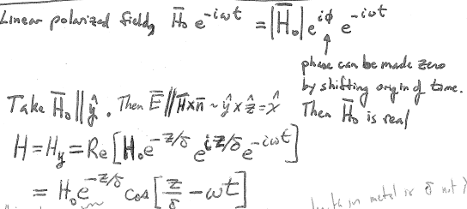




9. Linearly polarized H-field
Linearly polarized field:
Phase can be made zero by shifting the origin of time.
Then H₀ is real.
Take
Then
Wavelength in metal is δ, not λ.
But δ is also the characteristic damping length.
Not much of a wave!

Slide 19
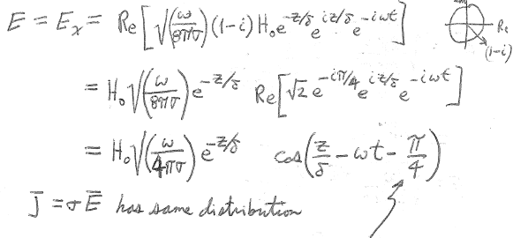




E and j have the same distribution
E and j lead H by 45 degrees

Slide 20





10. Surface impedance
Quasi-static approximation, microwave frequencies and below
Complex “surface impedance” of a conductor
General case, frequencies up to visible, see section 87

Slide 21
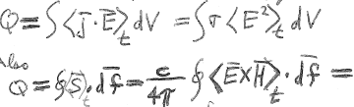




11. Eddy currents dissipate field energy into Joule heat
Heat loss per unit time
Also
Mean field energy entering conductor per unit time
Conductor surface
We are going to use both of these equations to find ω dependence of Q in the two limits.

Slide 22








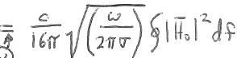









12. Dissipation in the low frequency limit increases as ω². But in the high frequency limit only as
Low frequency limit:
~
High frequency limit:
Homework

Slide 23
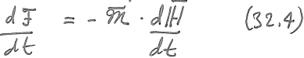




13. Dissipation can be expressed in terms of the induced magnetic moment of the conductor.
Magnetic moment induced by a periodic external H-field has the same period.
Rate of change of free energy
The change in free energy is due to
  Dissipation
  Periodic flow of energy between the body and the external field
Time averaging the change leaves just dissipation

Slide 24
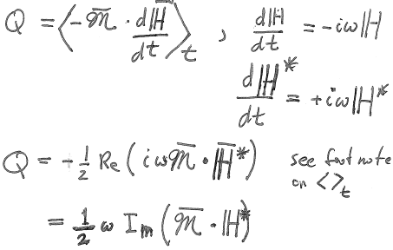





The mean dissipation of energy per unit time is

Slide 25
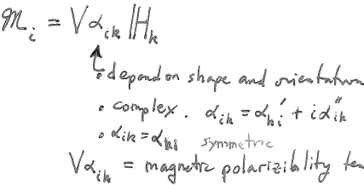








14. Dissipation in terms of the driving field and the magnetic polarizability tensor.
Depends on shape and orientation of the body
Complex
Symmetric
Magnetic polarizability tensor for the body as a whole

Slide 26
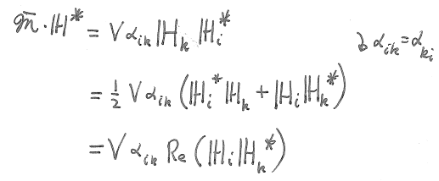
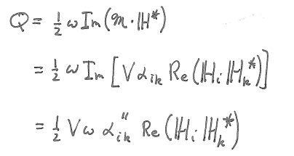





Slide 27
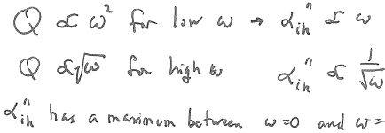
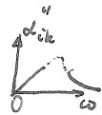




15. Dissipation is determined by the imaginary part of the magnetic polarizability
infrared

Slide 28
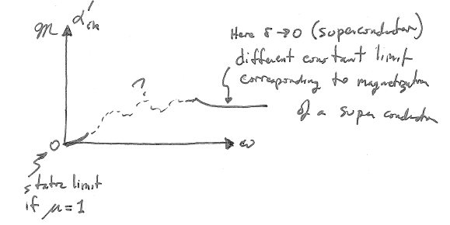




16. Magnetic moment of a conductor is due to conduction currents induced by the variable external H-field.

Slide 29
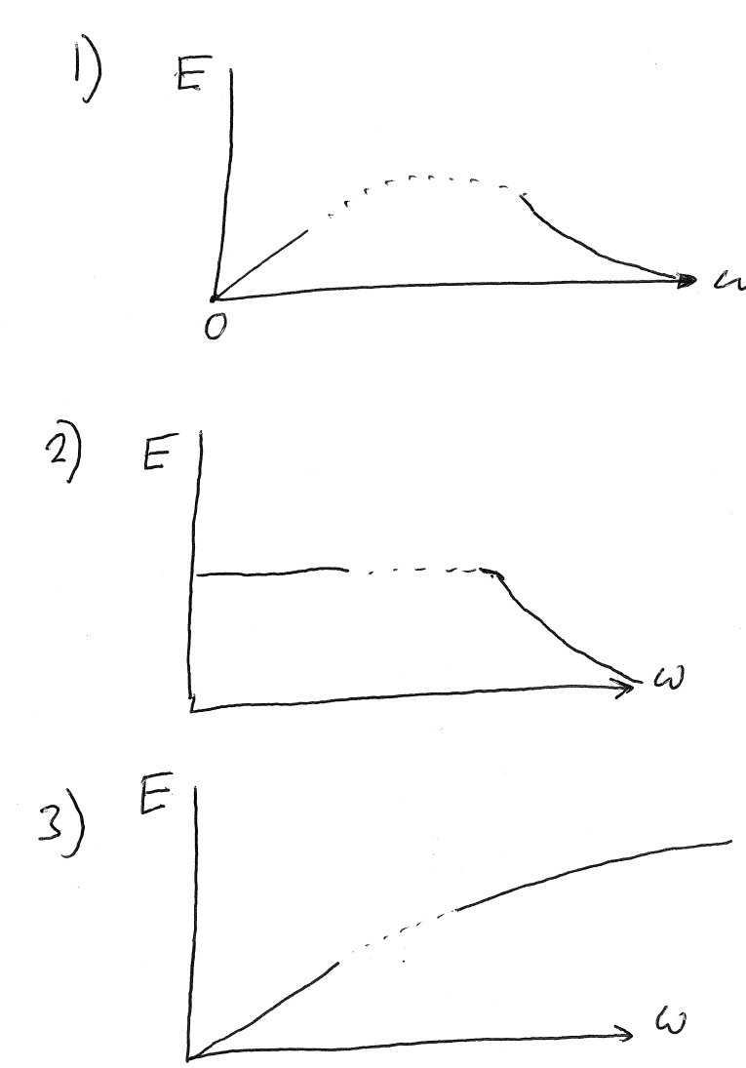
Quiz: What is a possible frequency dependence for the electric field at a given point inside a metal?
.P

