Slide 1
Self-inductance of linear conductors
Section 34

Slide 2
1. When finding the mutual inductance, we neglected the thickness of the linear conductors.
To determine self inductance, we cannot neglect the finite size of the conductor
Otherwise
diverges as R 0,
since both integrals follow the same path

Slide 3
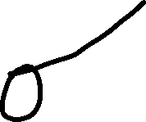
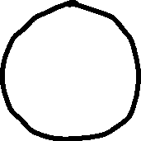
For a bulk conductor, self-inductance depends on the current distribution.
But at low frequencies, current doesn’t vary much over the cross section of a linear conductor.

Slide 4
3. Divide the self inductance into two parts
L = L_{e} + L_{i}
Internal part.
External part.
This is the main contribution, since most of the field energy is in the infinite space outside the linear conductor

Slide 5
External part of self inductance L_{e}
Infinite straight wire
External free energy per unit length
Permeability of external medium
Self inductance per unit length
Compare
Diverges as r infinity

Slide 6
But linear currents never extend to infinity.
Linear circuits are closed.
For r > l, the fields from the two branches tend to cancel,
so that H falls off faster than 1/r.
and L do not diverge.
Use the straight wire result for r<l. Then just ignore all the energy for r>l.
gives relative error.
For long skinny circuits, l >> a, so >>1, and error is small

Slide 7
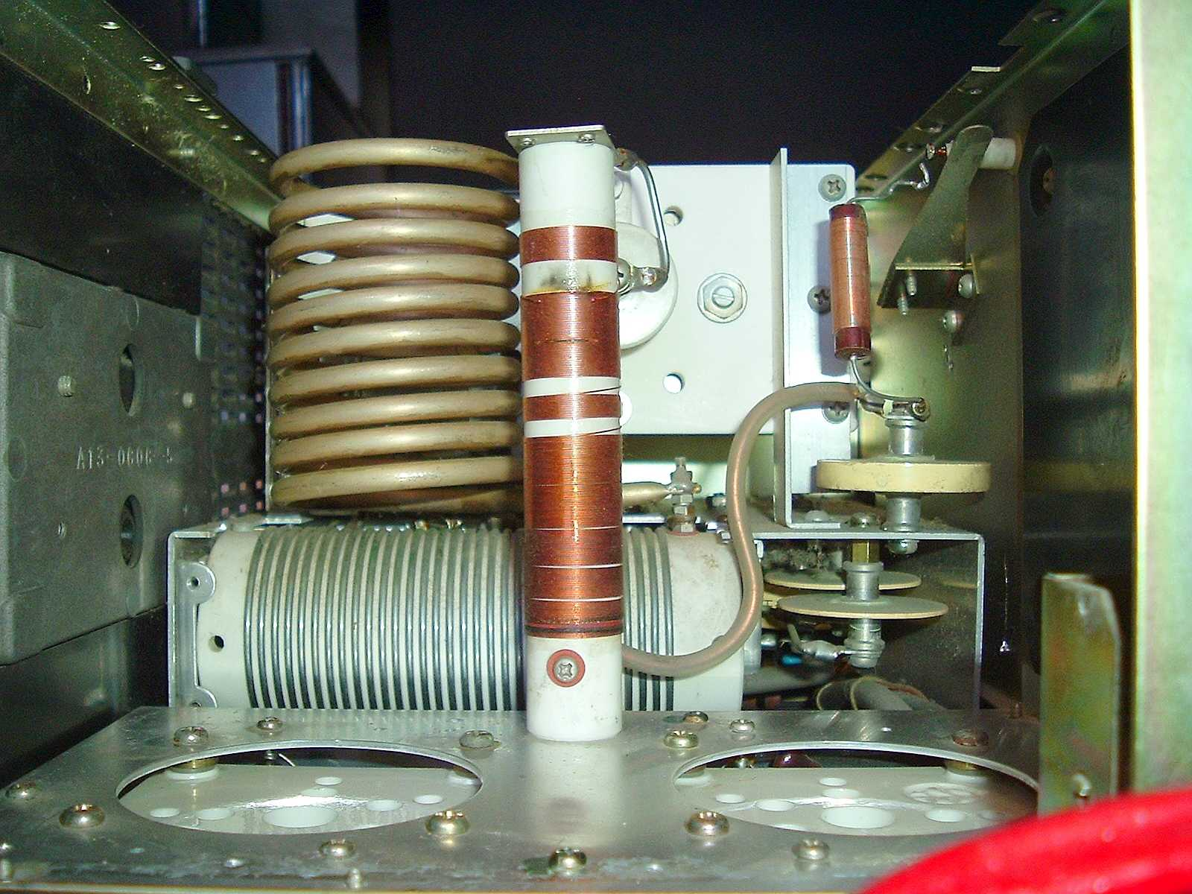
Coils of wire are very often found in rf circuits for use as “rf chokes”.
To design such circuits, we must know how to calculate the inductance of coils, which are usually made by hand.

Slide 8
4. Solenoid: wire wound in a helix
HW: Same derivation as for (29.16), except with conduction surface current density instead of magnetization surface current density

Slide 9
For long solenoid, g = nJ, J = current in the wire, n = turns/unit length
H₂ = 0
H₁ = (uniform)
Satisfies
and boundary condition, so that’s the solution

Slide 10
Field energy per unit length of a long solenoid,
h>>b
neglect end effects.
Permeability of magnetic core
_{e} J²

Slide 11
If total length of the wire is l
Sub one power

Slide 12
For solenoid
For single loop of same length
=
=
=
Ratio
N = total number of rows of wire, usually <1000
While l/a might be >100m/0.0001m = 10⁶.

