Slide 1
Methods of solving problems in electrostatics
Section 3

Slide 2
Method of Images
Plane interface between a semi-infinite (hence grounded) conductor and vacuum
What happens?
a
e

Slide 3
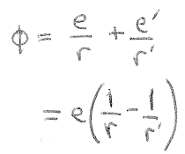
Find fictitious point charges, which together with given charges, make the conductor surface an equipotential (φ = 0)
Vanishes on boundary, when r’ = r
Δφ = 0 satisfied.
Boundary conditions satisfied.
Uniqueness theorem.
Done.

Slide 4
The real charge e is attracted to the plane by the image force.
Image force =
Energy of interaction =
Induced surface charge density =
Total surface charge =

Slide 5
Instead of semi-infinite, assume an isolated, uncharged conductor that is large but finite
Positive charged is induced on the back surface, but that surface is so large that σ ~ 0.

Slide 6
Spherical conductor
Field point P(x,y,z)
e
Actual charge
Fictitious image charge
In the space outside the sphere
What are e’ and l’?
φ vanishes on the surface if l/l’ = (e/e’)² and R² = l l’ (HW)

Slide 7
If spherical conductor is grounded, φ = 0 on the surface.
Potential outside the sphere = is
since
= e R/l
This approaches –e when e approaches surface, which looks more and more planar.
Induced charge on the surface = is

Slide 8
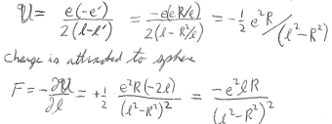
Energy of interaction between charge and sphere = that between charge and its image
The charge is attracted to the sphere

Slide 9
If the conducting sphere is insulated and uncharged, instead of grounded, it has nonzero constant potential on surface. Then we need a 2nd image charge at the center = +e’

Slide 10
Interaction energy of a charge with an insulated uncharged conducting sphere

Slide 11
Spherical cavity inside a conductor with charge e at position A’
The potential inside the conductor can be any constant (or zero if the conductor is grounded).
Image charge

Slide 12
Boundary condition: The potential on the inner surface of the cavity must be the same constant.
Potential at the cavity field point P
Vanishes on the boundary
-e’=eR/l’
The total potential is
Field inside cavity is determined by this part, independent of the constant.

Slide 13
Method of Inversion
Laplace’s equation in spherical coordinates
This equation is unaltered by the inversion transform r -> r’ where r = R²/r’, while φ -> φ’ with φ = r’ φ’/R.
R is the “radius of the inversion”

Slide 14
Consider a system of conductors, all at φ₀, and point charges.
Field point P
Usually φ 0 as r infinity
Shift zero of potential so that conductors are at zero potential and φ - φ₀ as r infinity
What problem is solved by φ’?

Slide 15
Inversion changes the shapes and positions of all conductors.
Boundary conditions on surfaces unchanged, since if φ = 0, then φ’ = 0, too.
Positions and magnitudes of point charges will change.
What is e’?
inversion
φ=0

Slide 16
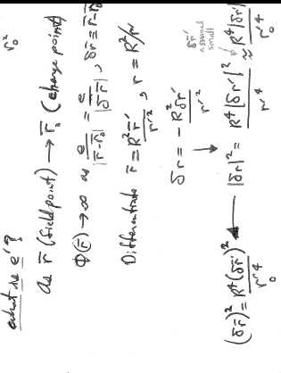
As r (the field point) approaches r₀ (the charge point)
r - r₀
|²

Slide 17
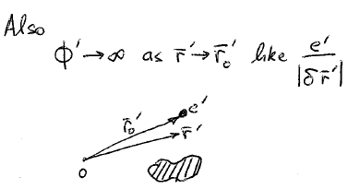

Slide 18
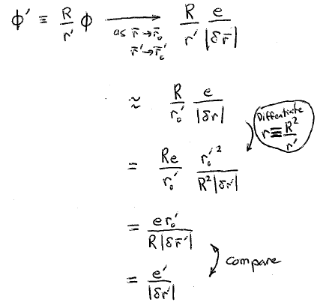
But φ’

Slide 19
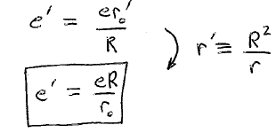
This is how the charge is transformed by inversion…

Slide 20
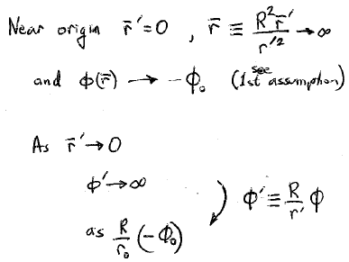

Slide 21
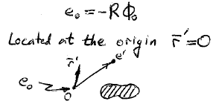
In the inverted universe, there is a charge
Inversion transforms point charges, moves and changes shapes of conductors, and puts a new charge at the origin. Why do it?

Slide 22
Spherical conductors are transformed by inversion into new spherical conductors
Equation of the sphere
After inversion, the equation of the sphere becomes
Another sphere

Slide 23
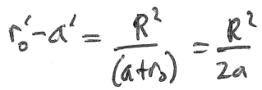
If the original sphere passes through the origin
This sphere is transformed into a plane
And distant
from the origin

Slide 24
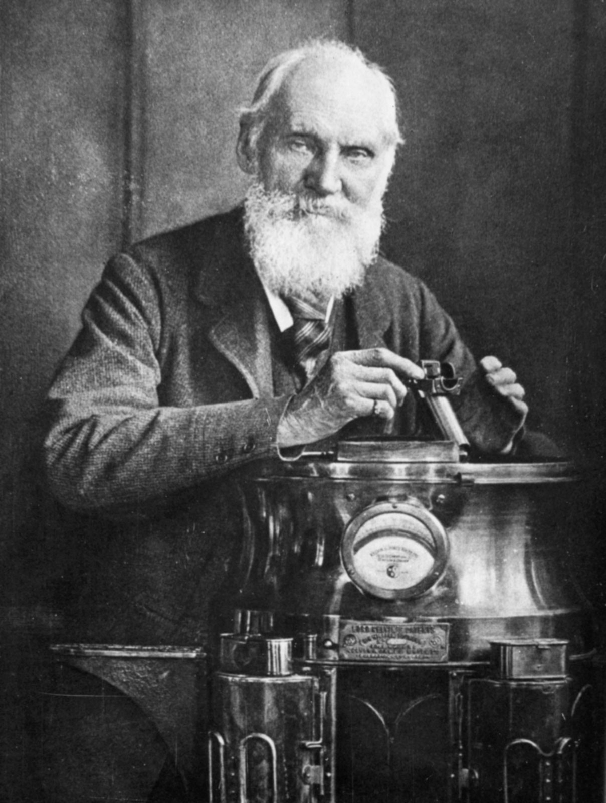
Inversion was used by Lord Kelvin in 1847 to obtain the charge distribution on the inside and outside surfaces of a thin, charged conducting spherical bowl.
Landau Problem 10

Slide 25
Method of Conformal Mapping
2D problem of fields that depend on only two coordinates (x,y) and lie in (x,y) plane
Electrostatic field:
Vacuum:
A vector potential for the E-field (not the usual one)

Slide 26
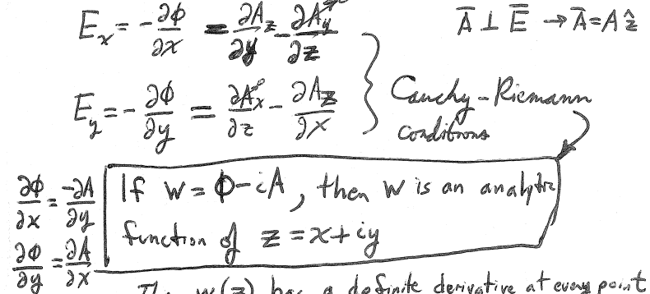
Then w(z) has a definite derivative at every point independent of the direction of the derivative

Slide 27
Derivatives of w(z) = φ(z) – i A(z) in complex plane, z = x + iy
Take derivative in the x-direction
w is the “complex potential”

Slide 28
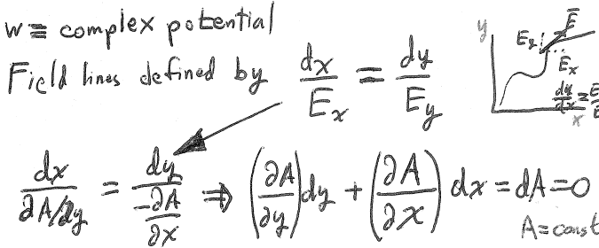
E is tangent to field line
E_{x}
E_{y}
Lines where Im(w) = constant are the field lines

Slide 29
Lines where Re(w) = φ = constant are equipotentials

Slide 30
The 2D vector
defines the direction of the field lines according to
field lines since dA = 0 along the field lines)
The 2D vector
defines the direction of the equipotentials according to
equipotentials )

Slide 31
Since
Equipotentials and field lines are orthogonal.

Slide 32
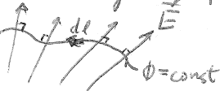
Electric flux through an equipotential line
n = direction normal to dl

Slide 33
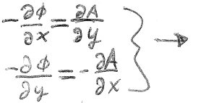
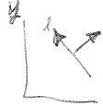
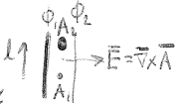
We have
n
X
Direction of dl is to the left when looking along n
φ decreasing in the x direction
A increasing in the y direction
φ decreasing in the y direction
A decreasing in the x direction

Slide 34
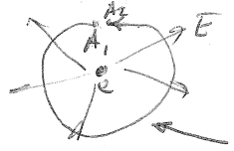
Values of A at the end points
Flux through closed contour for the 2D field
λ
Total charge enclosed by contour per unit length normal to the plane
λ
Line integral taken CCW on equipotential line

Slide 35
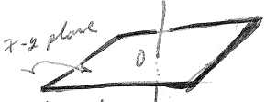
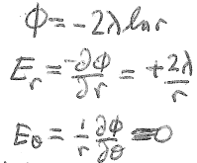
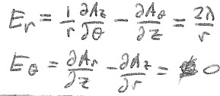
Trivial example: What is the field of a charged straight wire?
Solution using Gauss’s law
cylinder
λ = charge per unit length
Solution using complex potential
then
Integral around circle

Slide 36
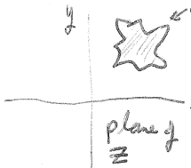
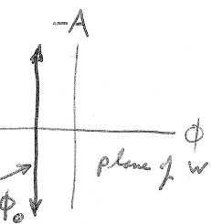
w = w(z) is the conformal map of the complex plane of z onto the complex plane of w
Cross section C of a conductor that is translationally invariant out of plane.
Potential φ = φ₀ is constant on C
x
= x + iy
The method maps C onto line w = φ₀
Then Re[w] = φ at points away from C.

