Slide 1
Four-dimensional velocity
LL2 Section 7

Slide 2
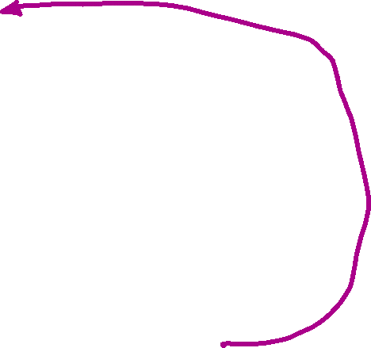
1. We can construct a 4 vector from the components of the 3D velocity.
4-velocity
A particle at rest in K’ moves at speed v in K
Two events at rest in K’ and separated by a small time interval dt’ have interval
ds’ = c dt’ = c* (proper time interval for the particle)
In the K system the same interval is
These two infinitesimal intervals have to be the same: ds = ds’

Slide 3
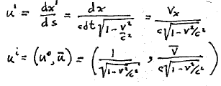
The 4-velocity is unitless.

Slide 4
2. The components of u^{i} are not independent.
u⁰ can be expressed in terms of u¹, u², and u³.
u^{i} is a unit 4-vector that is tangent to the world line.
is an infinitesimal change in the position 4-vector of a particle

Slide 5
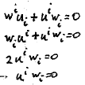
3. The second derivative of the 4-radius gives the 4-acceleration
4-velocity and 4 acceleration are mutually perpendicular

Slide 6
Advantage of 4-velocity
The transformation of the ordinary 3-velocity was ugly (Section 5).
The transformation of the 4-velocity is the usual Lorentz transform Eq. (6.1), the same as for any 4-vector.

