Slide 1
E&M1
Griffiths Chapter 5

Slide 2
Lorentz force
This term defines E.
There are electromagnetic forces that depend on the velocity of a charge in given fields, and these forces are perpendicular to v. This term defines a field “B”, which is the macroscopic magnetic field, or “Magnetic Induction”.

Slide 3
Cyclotron motion: charge moving in a magnetic field.
Lorentz force provides centripetal force
Momentum

Slide 4
Cycloid motion. Charge accelerated by an E-field in a perpendicular magnetic field.

Slide 5
y
Equation of motion,
Newton’s second law:
=Q
Define the “cyclotron frequency”:
Take time derivative of the first equation and substitute into the second equation

Slide 7
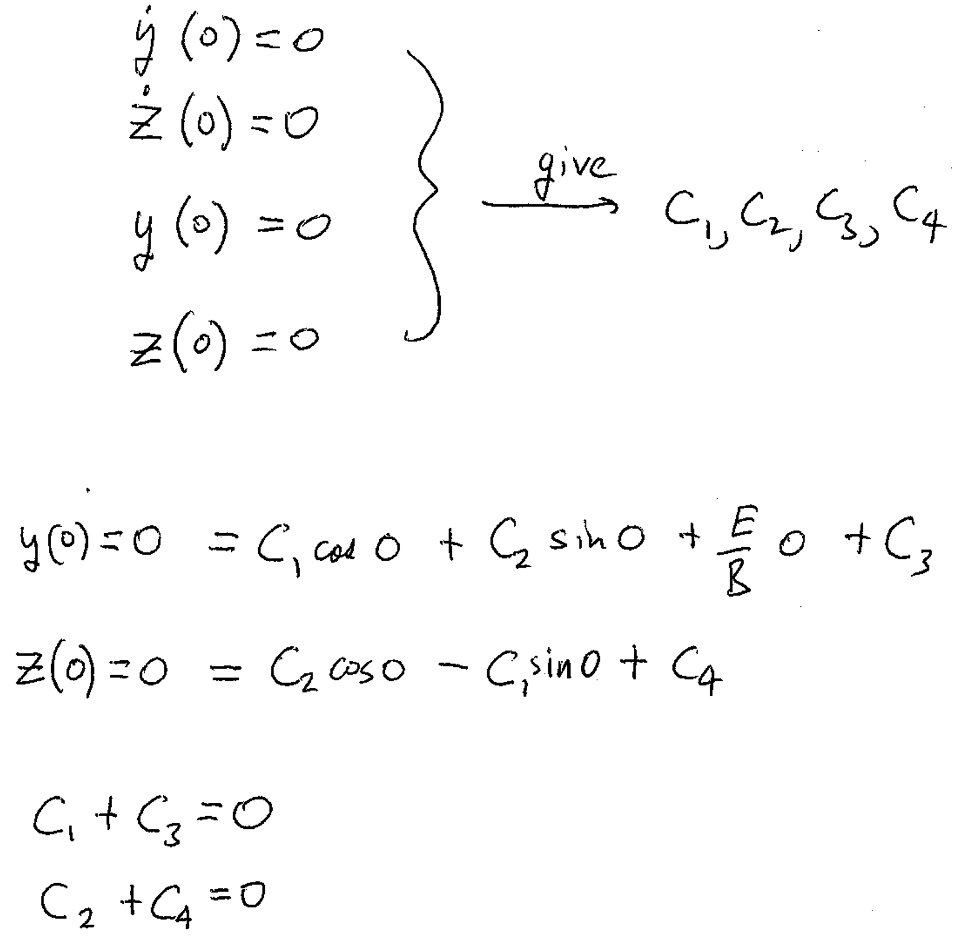
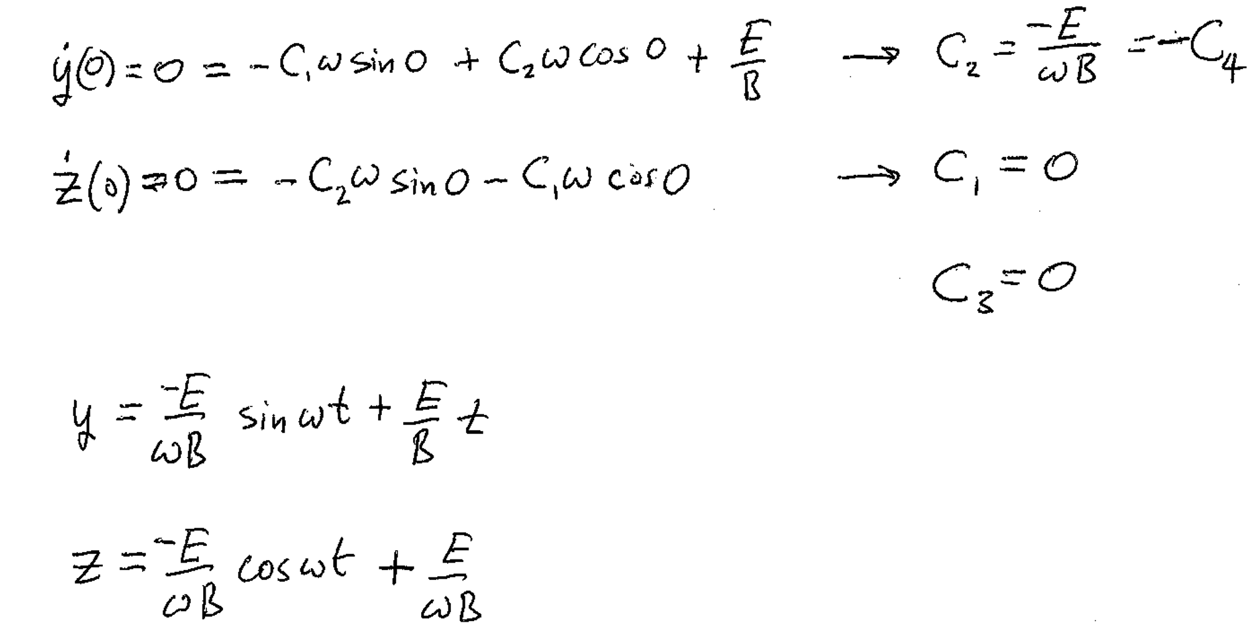
Initial conditions

Slide 8
This is the equation of a circle with a moving center

Slide 9
No work is done by magnetic forces
Q
v
dl = v dt
= 0

Slide 10
A current is a line of charge moving in a wire
Charge per unit length
= charge per second
The magnetic force on the wire is the sum of the magnetic forces on all the elements of moving charge
And I has the same magnitude at every point in the wire
In the wire

Slide 11
Surface current density
Surface charge density
A ribbon of current flowing on a surface is like a wire of current
The magnetic force on a surface current is found by summing the force on each ribbon of current

Slide 12
Volume current density
The magnetic force on a volume current is found by adding the forces on the currents in all volume elements

Slide 13
The total current leaving a volume is
By the divergence theorem
By charge conservation
= the rate at which charge is lost from v due to outflowing current
=
This is the continuity equation, a mathematical statement of charge conservation

Slide 14
Currents are the source of magnetic fields. If the currents are steady, we have magnetostatics.
Thin wires are approximately line currents. Current is the same at every point in the wire
Biot-Savart

Slide 15
Griffiths presents Biot-Savart as a fact, without derivation.
Biot-Savart comes from time averaging the magnetic field in Maxwell’s equations for charges that perform a finite motion (as in a circuit).
We don’t have Maxwell’s equations yet, so the logic of Griffith’s presentation is messed up.

Slide 16
Permeability of free space
In the case of a steady surface current, Biot-Savart becomes
In the case of a steady volume current, Biot-Savart becomes

Slide 17
Example: The long straight wire with constant current, B(r)
is out of the page

Slide 18
If the wire is very long, and the field point is close:
, and B = μ₀I/(2 π s)

Slide 19
What is the force between two parallel wires?
The field at wire 2 from the current in wire 1.
Into the page by RHR
The force on wire 2 due to the field from wire 1 is
The force per unit length is
This line integral becomes very large for long wires
Attractive for parallel currents
Anti parallel currents repel

Slide 20
Magnetic field on the axis of a current loop
The horizontal components cancel

Slide 22
The Biot-Savart law gives Ampere’s Law
Currents are flowing in this region of space
Take derivatives of B with respect to field point coordinates

Slide 23
Take divergence of B
This is true for any possible distribution of currents

Slide 24
Take curl of B
Product rule #8
These two terms are zero because J depends only on r’, not r.

Slide 26
Steady currents don’t build up charge density anywhere
The integration volume contains all currents
There are no currents on the boundary
There
Ampere’s law, differential form

Slide 27
Integrate Ampere’s law over any open surface
Curl, or “Stokes”, Theorem
Ampere’s law, integral form
Integral around perimeter of surface:
The “Amperian Loop”

Slide 28
Apply Ampere’s law to a straight line current
We already derived this using Biot-Savart. Ampere’s law is easier.

Slide 29
Apply Ampere’s law to a sheet of current
Divide the sheet into narrow wire-like strips. Vertical field compoents from neighboring strips cancel.

Slide 30
Apply Ampere’s law to the wires in a solenoid
The horizontal B-field components from neighboring wires cancel.
Net field inside is up.
Net field outside is down.
Field goes to zero at large distances.

Slide 31
Apply Ampere’s law to an infinite solenoid
For the Amperian loop that encloses the wires
The magnetic field outside an infinite solenoid is zero.

Slide 32
Apply Ampere’s law to a toroid.
A toroid is a solenoid bent into a donut.
The B-field outside is zero.

Slide 33
Basic equations of electro and magneto statics.
These are special cases of Maxwell’s equations when nothing changes over time.
Lorentz Force Law
Fields go to zero at infinity

Slide 34
“Vector potential”
Because we always have
= 0, we can write
Since
= 0
For any vector A

Slide 35
In terms of the vector potential, Ampere’s law becomes
Definition of A
Second derivative rule #5

Slide 36
We can add the gradient of any scalar function λ to A without changing B,
because
new
old
We can choose
So that
Then
Remembering the solution to Poisson’s equation

Slide 37
With this choice of “gauge”, Ampere’s law simplifies to
This is a Poisson’s equation for each component of the vector potential A
We already know the solution from Chapter 2.

Slide 38
If the current is confined to a thin wire
If the current is confined to a surface
The vector potential tends to be in the same direction as the current, or at least in the direction of the part of the current closest to the field point.

Slide 39
The triangle of magneto statics

Slide 40
To solve the differential equations for B, we are going to need boundary conditions
There are no magnetic charges
Integrate both sides
Divergence theorem
The normal component of B is condintuous

Slide 41
Surface current creates a discontinuity in the tangential component of B

Slide 42
The boundary conditions on B can be combined into a single vector equation.

